Slide 1
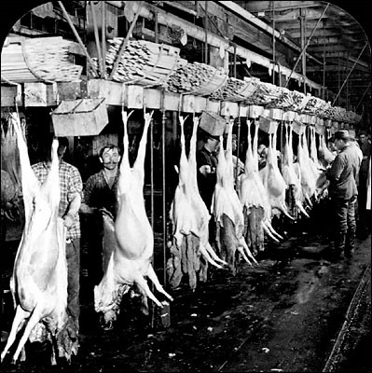
SWBAT identify the negative effects of the global meat production. Do Now: List what you know and what you want to know about global meat production.
ES Unit 7 2/24/16
Lesson 10

Slide 2
Fertilizer Research
Turn and talk to share out your research about organic and inorganic fertilizer

Slide 3
Announcements
Unit Exam on Tuesday, March 1st
ALL late work due then
Come up at lunch to make up lab If you were absent yesterday
You must have a note with your essay for it to not be considered late

Slide 4
Agenda
Lecture
Check Seeds!
Hw./Wrap up

Slide 5
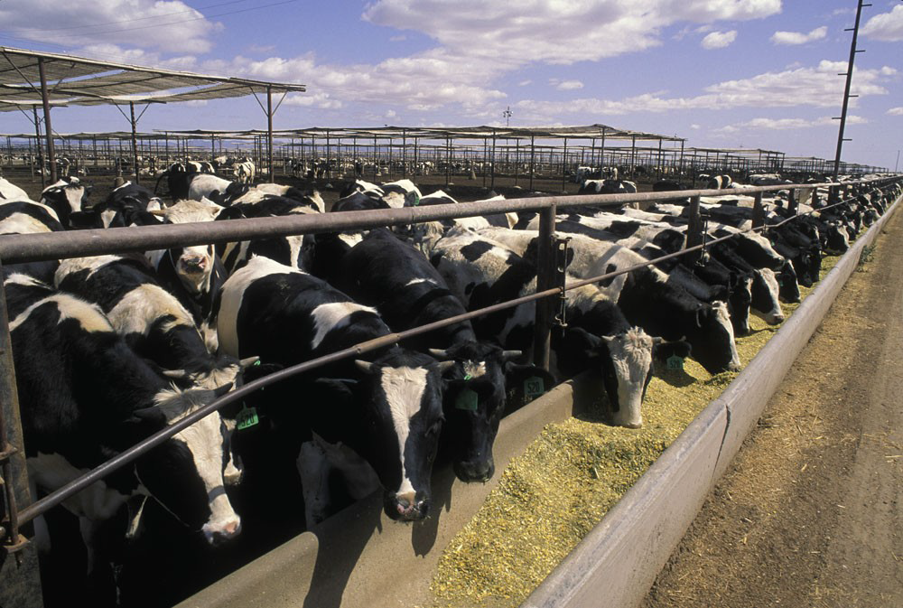
Industrialized Meat Production
CAFOs (Confined Animal Feeding Operations)
Keeping large number of animals in a small space.

Slide 6
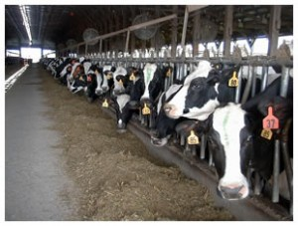
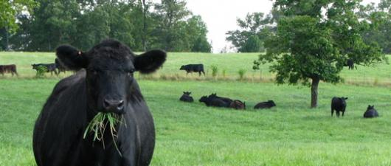
Industrialized Meat Production
Corn-based diet
Cows can gain more weight in less time
Requires less space

Slide 7
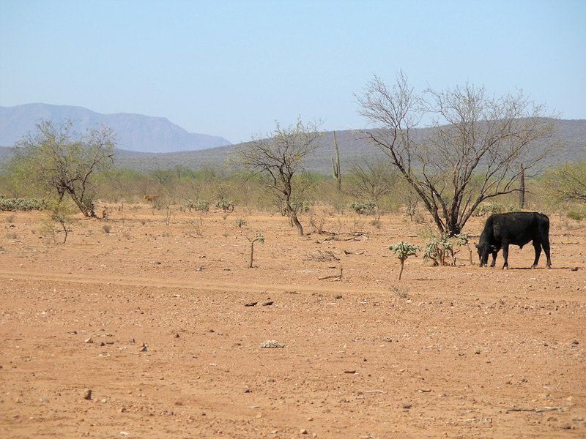
Advantages of CAFOs
Increased Meat production→ More profit
Less land use→ protection of biodiversity
Reduced overgrazing
Reduced soil erosion

Slide 8
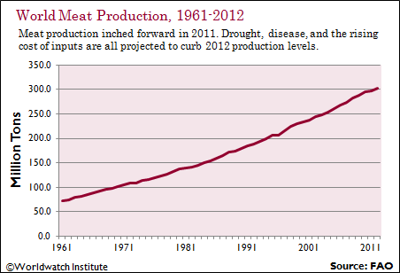
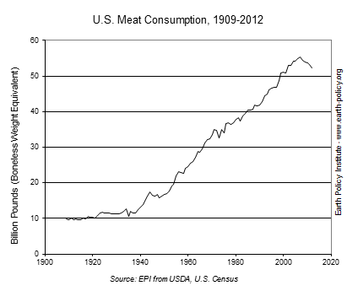
Advantages of CAFOs
Increased meat production→ increased meat consumption

Slide 9
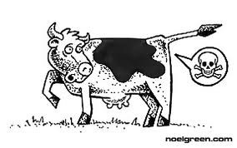
Disadvantages of CAFOs
Contribute to climate change
CAFO cattle produce twice as much methane as grass-fed cattle

Slide 10
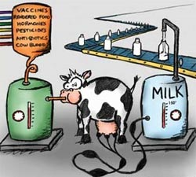
Disadvantages of CAFOs
Hormones given to animals
Hormones stimulate growth and milk production
Used for beef cows and dairy cows
Raises human health concerns
How much is in our food products?
How much do we absorb?

Slide 11
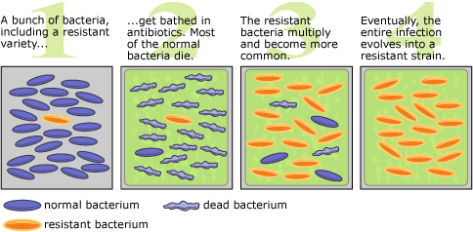
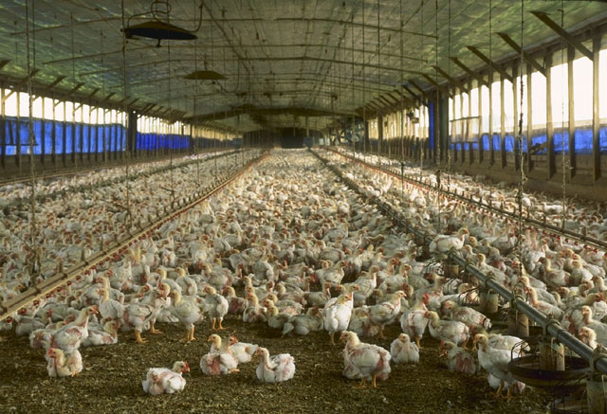
Disadvantages of CAFOs
Antibiotics given as preventatives
Increase in antibiotic resistant bacteria

Slide 12
Disadvantages of CAFOs
Zoonotic Pathogens crossing over to humans
Mad cow disease
H1N1 Flu (swine flu)
Avian Flu

Slide 13
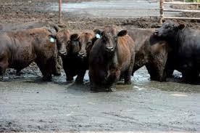
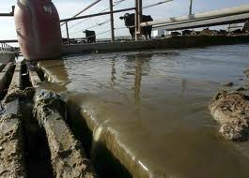
CAFOs Disadvantages
CAFOs contribute to water pollution.
Runoff carries nitrates and bacteria from manure into nearby lakes and streams.
This can trickle down into ground water.

Slide 14
Check on your seeds!
Volunteers to pass out lab notebooks
Send one person from your table to collect your seed bags
Count how many seeds have germinated and record it in your data table!
Add water/fertilizer if the napkin is dry
Place the seed bags back on the countertop

Slide 15
Meat Recall Video
http://losangeles.cbslocal.com/2013/11/11/salads-sandwiches-sold-at-trader-joes-whole-foods-recalled-over-e-coli-fears/

Slide 16
Discussion
Do you think the advantages of CAFOs outweigh the disadvantages? Why or why not?
What are some strategies that you think we could implement to change food production in the meat industry?

Slide 17
Homework
Research a recent case in which there was a food recall due to E. Coli contamination
List the type of food recalled and how many people were affected
Cite your source!

