Slide 1
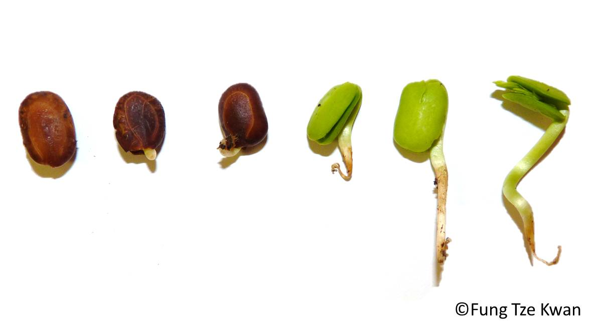
SWBAT perform a lab to analyze the effect of fertilizer on seed germination. Do Now: Why is urban gardening beneficial for the environment?
ES Unit 7 2/23/16
Lesson 10

Slide 2
Homework Share out
Turn and talk to share out your homework research about aquaponics/urban gardening

Slide 3
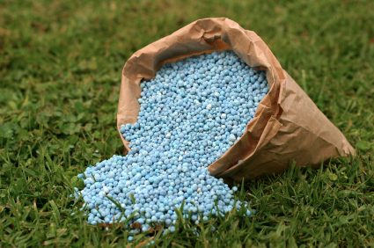
Fertilizer
Fertilizers foster plant growth by providing plants with essential nutrients:
Phosphorous
Nitrogen
Potassium

Slide 4
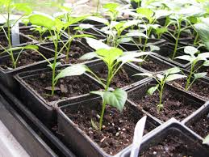
Fertilizer lab
Testable question: How does the amount of fertilizer affect seed germination?
Independent variable:
Dependent variable:
Hypothesis:
Control:
Constants:

Slide 5
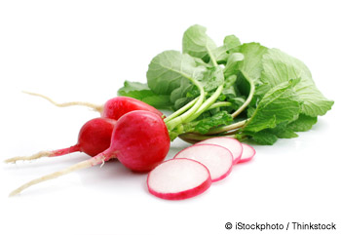
Materials
Radish Seeds
Plastic Bags
Miracle-Gro Fertilizer
Water
Napkins

Slide 6
Data Table: Number of seeds that have germinated
 | Day 1 | Day 2 | Day 3 | Day 4
Control
.5 tsp. fertilizer
1 tsp. fertilizer

Slide 7
Lab Tips
If you’re confused, re-read the procedure or ask a group member
Try not to spill the seeds
Don’t throw the procedure away!

Slide 8
Gathering materials
Person closest to the countertop grab one cup of seeds
Volunteers to pass out plastic bags (3 to each group)
Volunteers to pass out napkins (3 to each group)

Slide 9
Adding liquid
Person closest to the aisle add water with 1 tsp fertilizer
Person closest to the countertop add water with .5 tsp fertilizer
Person in the middle add water (control)

Slide 10
Sources of Error
What are some sources of error that might have occurred while setting up the experiment?
How might these affect your results?

Slide 11
Review!
Why is fertilizer important for plants?
What important nutrients does it provide to them?

Slide 12
Homework
Research the difference between regular fertilizer and organic fertilizer.
Which one do you think is better? Why?

