Slide 1
SWBAT understand the theory of tragedy of the commons through a real world situation. Do Now: How is the fishing industry an example of tragedy of the commons?
ES Unit 6 1/21/16
Lesson 7

Slide 2
Reminder!
Socratic Seminar make-up at lunch

Slide 3
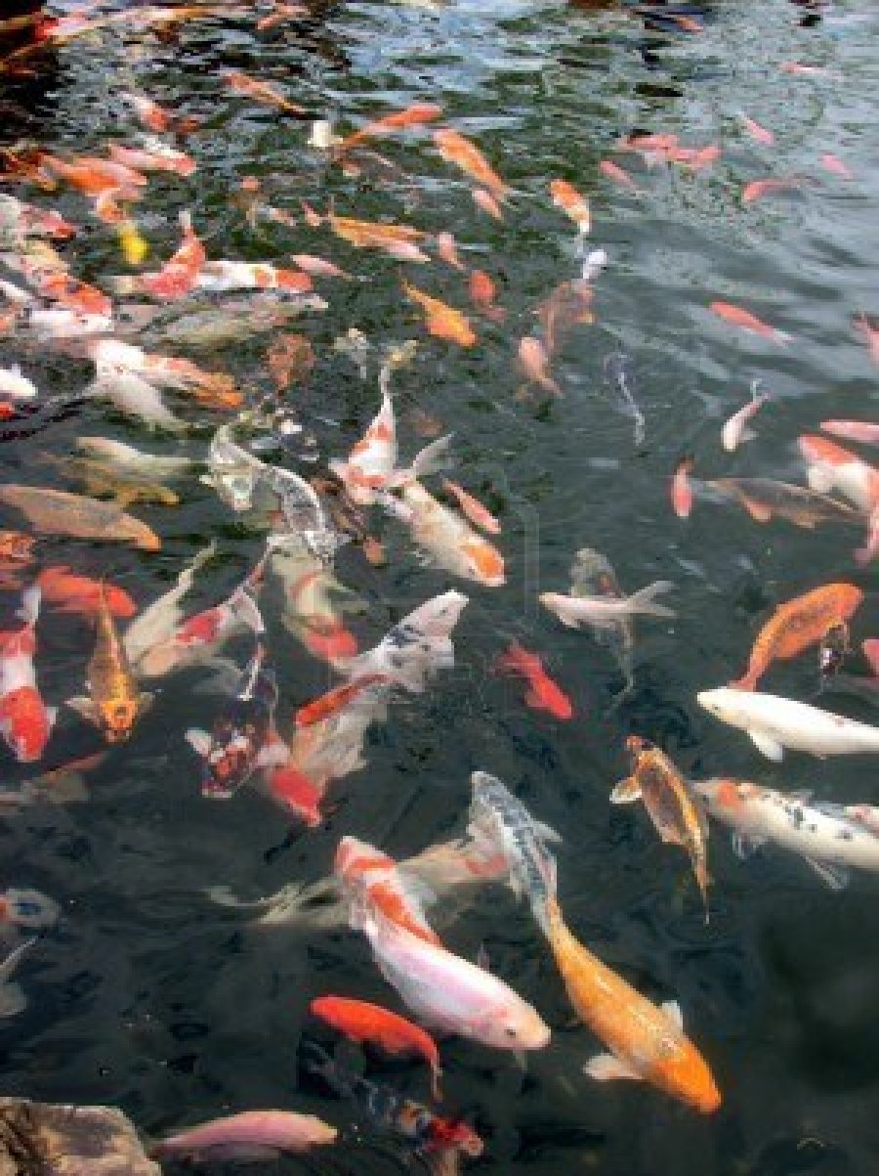
Tragedy of the Commons Lab

Slide 4
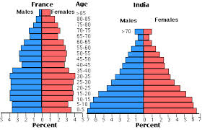
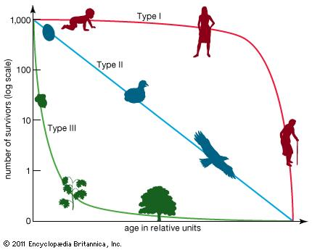
Review

Slide 5
Lab Rules
Do NOT eat the fish!
Behave like adults

Slide 6
Round 1
Decide who will fish first for each year (everyone should get a chance to fish first).
No talking! You may not persuade your group members to take more or less fish.
Continue for 3 years OR until you run out of fish.
After each year call me over to replenish the fish
Fill in the group totals
STOP after round 1.

Slide 7
Round 2
You may communicate with your group members!
Follow the same procedure as round 1.
When you are finished, answer the analysis questions.

Slide 8
Homework
Finish the analysis questions if you did not do so in class.
Study for your exam!

