Slide 1
SWBAT understand the theory of tragedy of the commons by applying it to environmental situations. Do Now: Picture what the UASCJ bathroom looks like at the end of the day. Does it look the same or different than the bathroom in your apartment? Why or why not?
ES Unit 6 1/20/16
Lesson 6

Slide 2
Announcements
Unit 6 exam this Friday (will count for next marking period)
If you were absent for the Socratic seminar, come make it up tomorrow at lunch!
ALL late/absent work for this unit is due by Monday

Slide 3
Agenda
Lecture
Video
Return Midterms
Worksheet

Slide 4
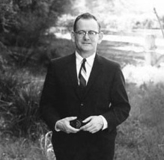
Tragedy of the Commons
Theory by Garret Hardin
If a resource is considered common use for all, it will ultimately be destroyed.
Common use for all: not owned by anyone.

Slide 5
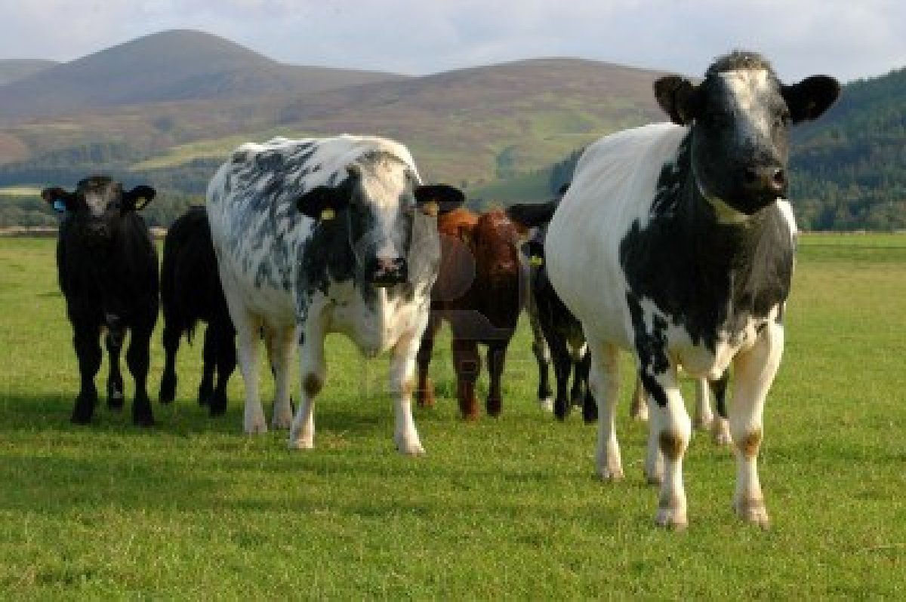
Tragedy of the Commons
Everyone uses common resources for their own gain.
Each person acts individually (self-interest)
Goes against the groups’ interest
Eventually deplete the “commons” (tragedy)

Slide 6
Video

Slide 7
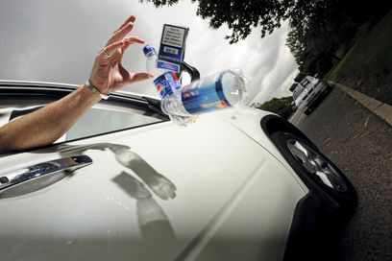
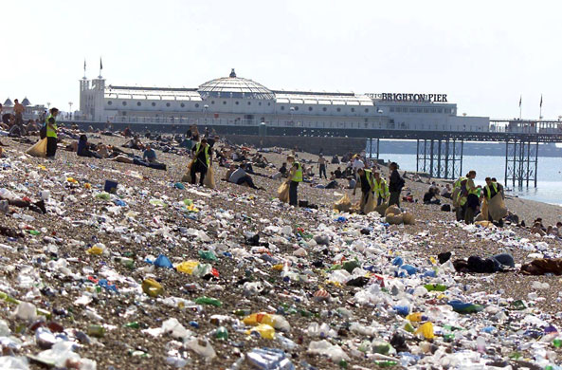
Tragedy of the Commons: Littering

Slide 8
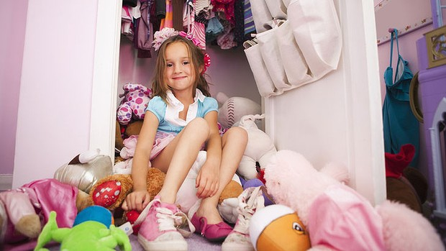
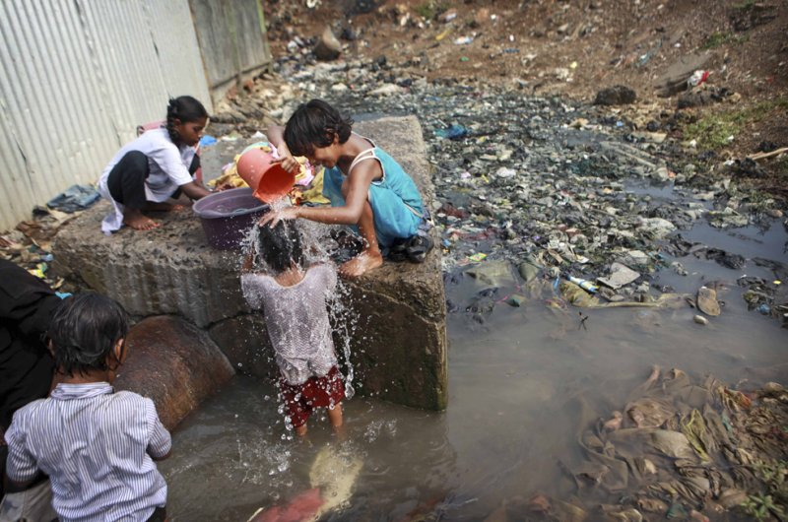
The problem: Over population
Hardin blamed the welfare state…

Slide 9
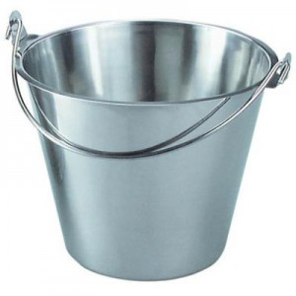
Discussion:
How does the tragedy of the commons relate to carrying capacity?

Slide 10
Midterm Tracking Data
Average: 75%
Write your first AND last name
Add up the number of points you got right
Number 30 is out of six points
Number 19 is the extended response

Slide 11
Discussion
Do you believe the tragedy of the commons is inevitable? Why or why not?
How could you stop people from destroying the commons?

