Slide 1
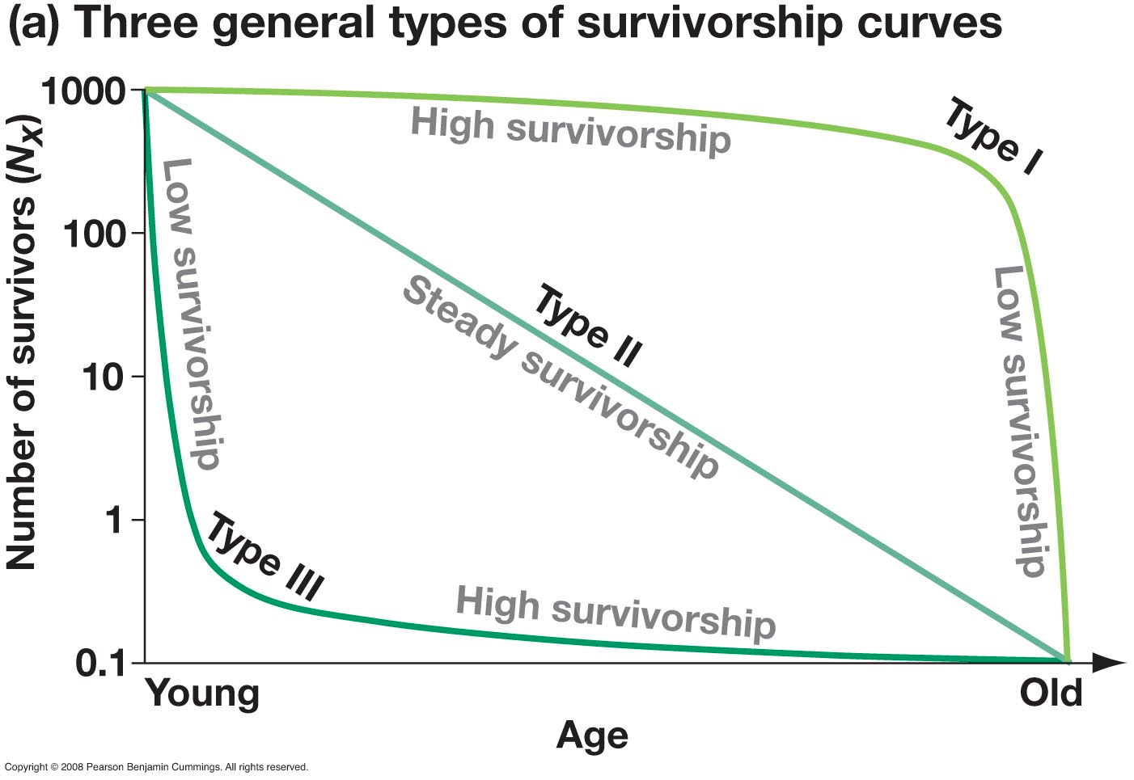
ES Unit 6 1/15/16 Lesson 4
SWBAT evaluate the best methods for population control.
Do Now:
How is a type I survivorship curve different than a type II survivorship curve?

Slide 2
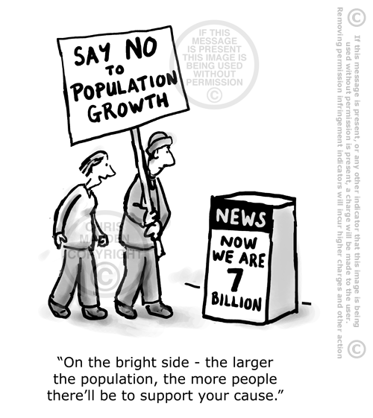
Population Control Strategies

Slide 3
Agenda
Mini-Lecture
Finish Population Pyramids Lab Questions
Hw

Slide 4
Measuring Growth
Total Fertility Rate
Developed Countries: | Developing Countries:
United States (N.A.)- 2.1 France (Europe) – 2.1 China (Asia) - 1.6 Israel (Asia) – 2.7 Germany (Europe) – 1.4 India (Asia) – 2.6 | Chad (Africa) – 4.8 Democratic Republic of the Congo (Africa) – 5.0 Afghanistan (Asia) – 5.5 Niger (Africa) – 7.0 Guatemala (S.A.) – 3.1

Slide 5
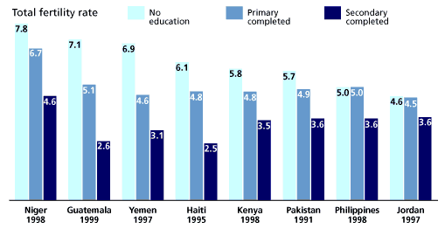
Population control: the process of artificially changing the growth rate of a human population

Slide 6
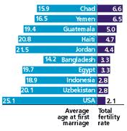
Stop and Think
How might population control be done? What strategies and methods might curb population growth?

Slide 7
Methods
Contraception
Abstinence
Reducing infant mortality
Abortion
Improving status of women
Emigration
Immigration reduction
Sterilization
Legislation

Slide 8
The Girl Effect
The Girl Effect: https://vimeo.com/24855575

Slide 9
Effects on the Environment
Humans require:
Space to live
Space to grow food
Fuel Resources
Leads To:
Overcrowding, Habitat Destruction
Deforestation, Overfishing, Chemical Use, etc.

Slide 10
Advantages and disadvantages
What are some advantages and disadvantages of human population control?

Slide 11
Population Control
Advantages:
Too many people can hinder the economic growth
People may run out of basic resources
Disadvantages:
Restriction of Personal Freedoms – Constitutional Rights
Against many Religious Beliefs
Lessens young workforce to support economy and society
Goes against Nature

Slide 12
China
One-Child Policy: unauthorized births are punished by fines.
Recently Changed to China’s two-child policy

Slide 13
China one child policy
Accusations of illegal forced abortions, forced sterilization and infanticides.
Credited with preventing hundreds of millions of births and lifting countless families out of poverty.

Slide 14
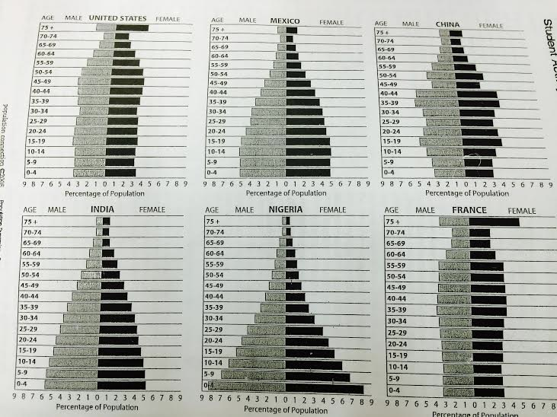
Group Analysis

Slide 15
Homework
Read the human population growth article and answer questions
Write three questions that can be used to generate discussion for the Socratic Seminar.

