Slide 1
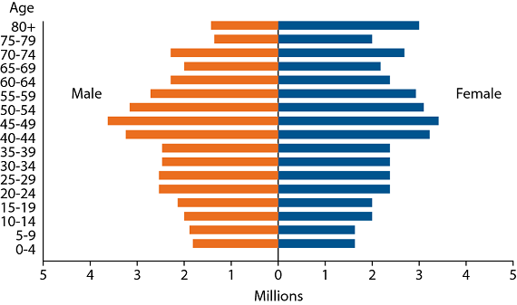
SWBAT examine how human lifespan has changed over year by constructing survivorship curves. Do Now: What kind of growth would the following population pyramid have? Why?
ES Unit 6 1/14/16
Lesson 3

Slide 2
Turn and Talk
Share the most surprising/interesting information from the population webquest

Slide 3
Agenda
Mini-lecture
Construct survivorship curves

Slide 4
Vocabulary
Demography: the composition of a particular human population
Mortality: Rate of death

Slide 5
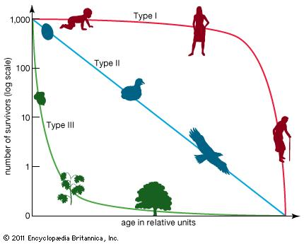
Survivorship Curves
Type 1 (Late Loss survivorship curve): Mortality rate is low in infants and increases rapidly in old age
Ex: Humans

Slide 6
Survivorship Curves
Type 2 (Constant loss survivorship curve): Mortality is relatively constant through all life stages.
Ex: Squirrels

Slide 7
Survivorship Curves
Type III Early Loss Survivorship Curve: Mortality is very high during early life stages, followed by low death rate for few individuals who reach adulthood.
Ex: trees

Slide 8
Take a guess!
What is the survivorship curve of humans prior to 1950?
What is the survivorship curve of humans after 1950?

Slide 9
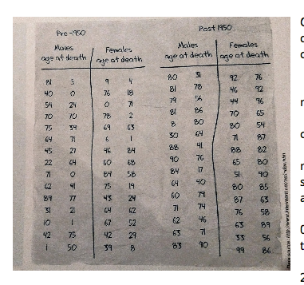

Slide 10
Group Work
Person #1: Calculate # of deaths and survivorship for females pre-1950
Person #2: Calculate # of deaths and survivorship for males post-1950
Person #3: Calculate # of deaths and survivorship for females post-1950
Share your data with your group members!

Slide 11
Exit Ticket
Leatherback turtles lay anywhere from 50 to 200 eggs. Only about 2 of these will survive to adulthood. Out of the ones that survive, they can live until 100 years old. Which type of survivorship curve do leatherback turtles exhibit? Why?

Slide 12
Homework
Finish the survivorship curves and the analysis questions

