Slide 1
Aim: What can population pyramids tell us about the rate of growth in a country? Do Now: Why is total fertility rate usually higher in developing countries rather than developed countries?
APES Unit 7 1/13/16
Lesson 2

Slide 2
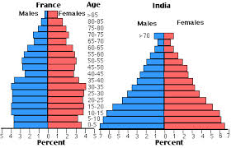
Population Pyramids
Used to study the number and ages of people in a population
Three sections:
Pre-reproductive (age 0-14)
Reproductive (15-44)
Post-reproductive (45 and older)

Slide 3
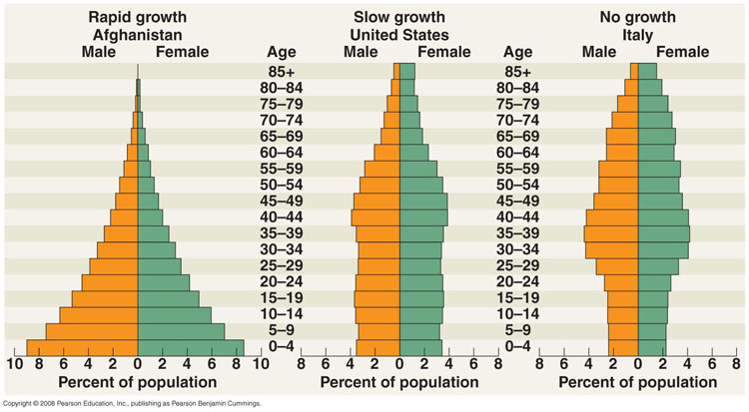

Slide 4
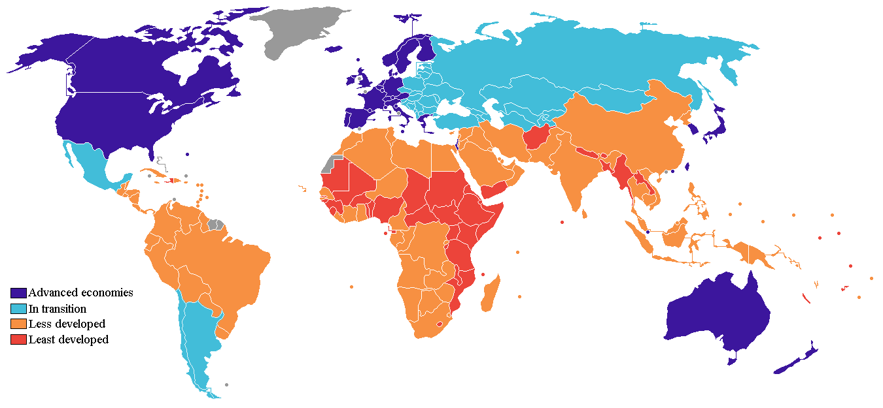

Slide 5
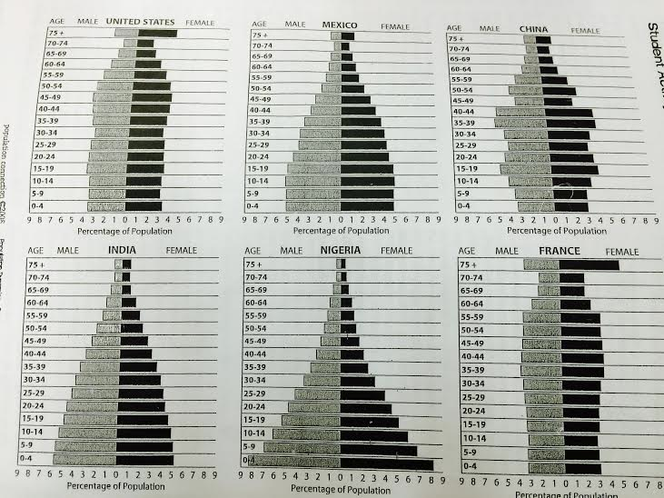
Group Analysis

Slide 6
Homework
Take home binders!
Finish Webquest

