Slide 1
Unit 6 1/12/16 Lesson 1
SWBAT identify explanations for exponential human population growth.
Do Now:
How do you think a growing human population will impact the environment?

Slide 2
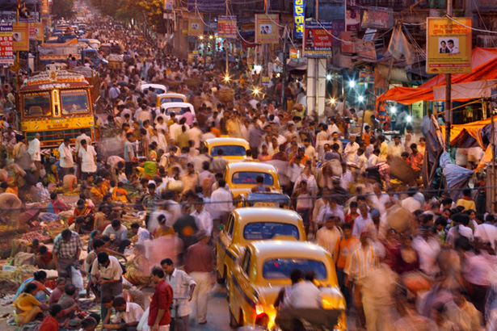
Unit 6: More Humans, More Problems
~ 2 weeks
Can human population grow indefinitely?
Will the economy be the death of the environment?
How do we limit ourselves in a world of limitless consumption?

Slide 3
Announcements
Make up midterm exam today at lunch!
You will need to take home your binders tomorrow

Slide 4
Quick Poll
Which country has the highest population?
Second highest?
Third?

Slide 5
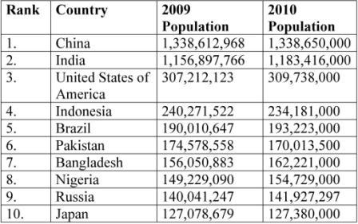

Slide 6
Cities by highest population
1. Shanghai, China 17.8 million
2. Lagos, Nigeria 14.9 million
3. Istanbul, Turkey 13.6 million
4. Karachi, Pakistan 13.1 million
5. Mumbai, India 12.5 million
6. Moscow, Russia 11.9 million
……
22. New York, USA 8.3 million

Slide 7
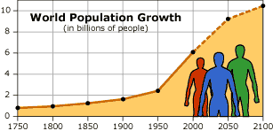
What factors do you think are causing exponential population growth rate?

Slide 8
Video
http://www.npr.org/2011/10/31/141816460/visualizing-how-a-population-grows-to-7-billion

Slide 9
Causes of exponential population growth
Improved medicine
Life expectancy has increased
Less infant-mortality
Better technologies to produce food
Better trade

Slide 10
Total Fertility Rate
The average number of children expected to be born to a woman throughout her child-bearing years.

Slide 11
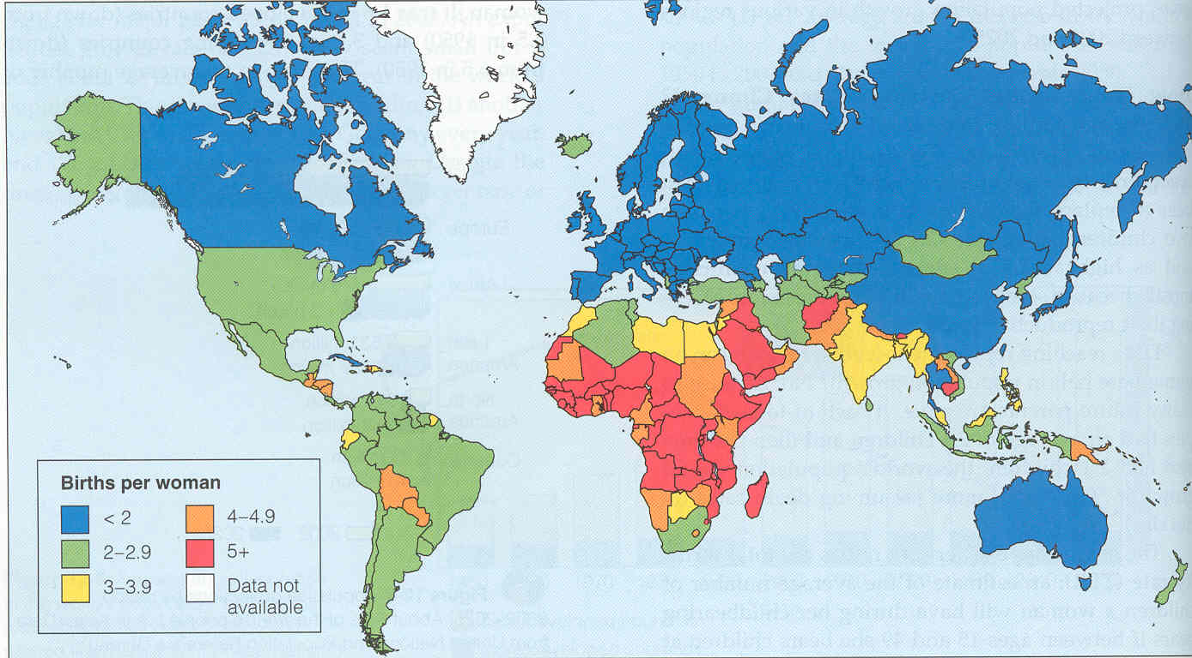
Total Fertility Rate

Slide 12
Factors that affect fertility
Availability of contraceptives
Demand for children in the labor force
Education level for women
The population’s religious beliefs, culture and traditions
Existence of public and or private retirement systems

Slide 13
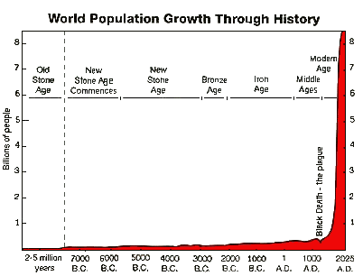
Population Growth Reading

Slide 14
Discussion
Who, if anyone, is at fault for exponential human population growth?
What do you think are some methods we could use to slow human population growth?

Slide 15
Homework
Human Population Webquest (Due Thurs.)

