Slide 1
SWBAT identify methods used to measure climate change. Do Now: Why do you think it’s important to measure climate change?
ES Unit 5 12/21/15
Lesson 9

Slide 2
Sea Level Rise
Do you think the government should be encouraging people to move away from coastal cities? Why or why not?

Slide 3
Agenda:
Lecture/ Videos
Independent practice

Slide 4
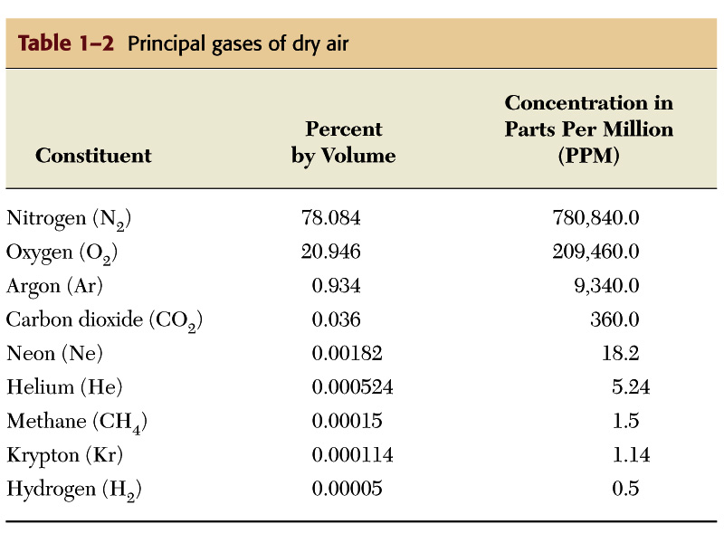
Composition of Atmosphere

Slide 5
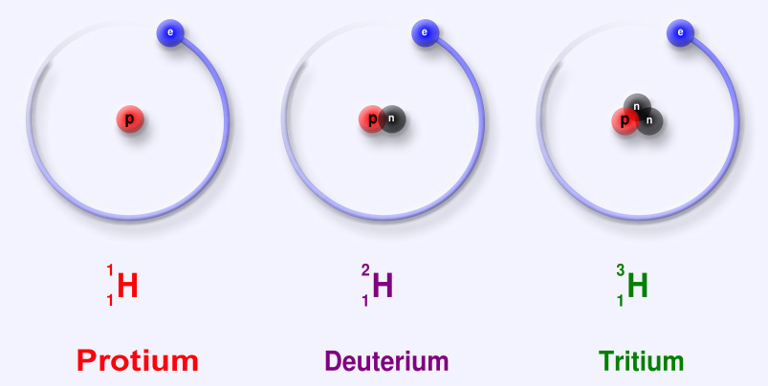
Vocab
Climate Proxies: preserved physical characteristics of the past that enable scientists to reconstruct climate conditions.
Isotopes: Atoms that have the same number of protons but different numbers of neutrons

Slide 6
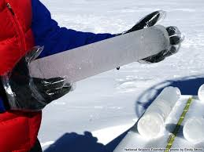
Ice Cores
Used to measure atmospheric gases
CO₂
CH₄
Contain bubbles of air from the time of snow.
Found in polar ice caps and mountain glaciers.

Slide 7
Ice Core Video

Slide 8
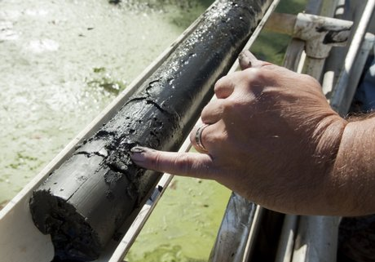
Sediment Cores
Stored at the bottom of lakes, ponds, and oceans
Contain biological material
Small fossils
Pollen from plants
Types of plants
Abundance of plant species
Based on the type of plants, can determine the climate history

Slide 9
Sediment Core Video
http://www.sciencelearn.org.nz/Contexts/Dating-the-Past/Sci-Media/Video/Sediment-core-tour

Slide 10
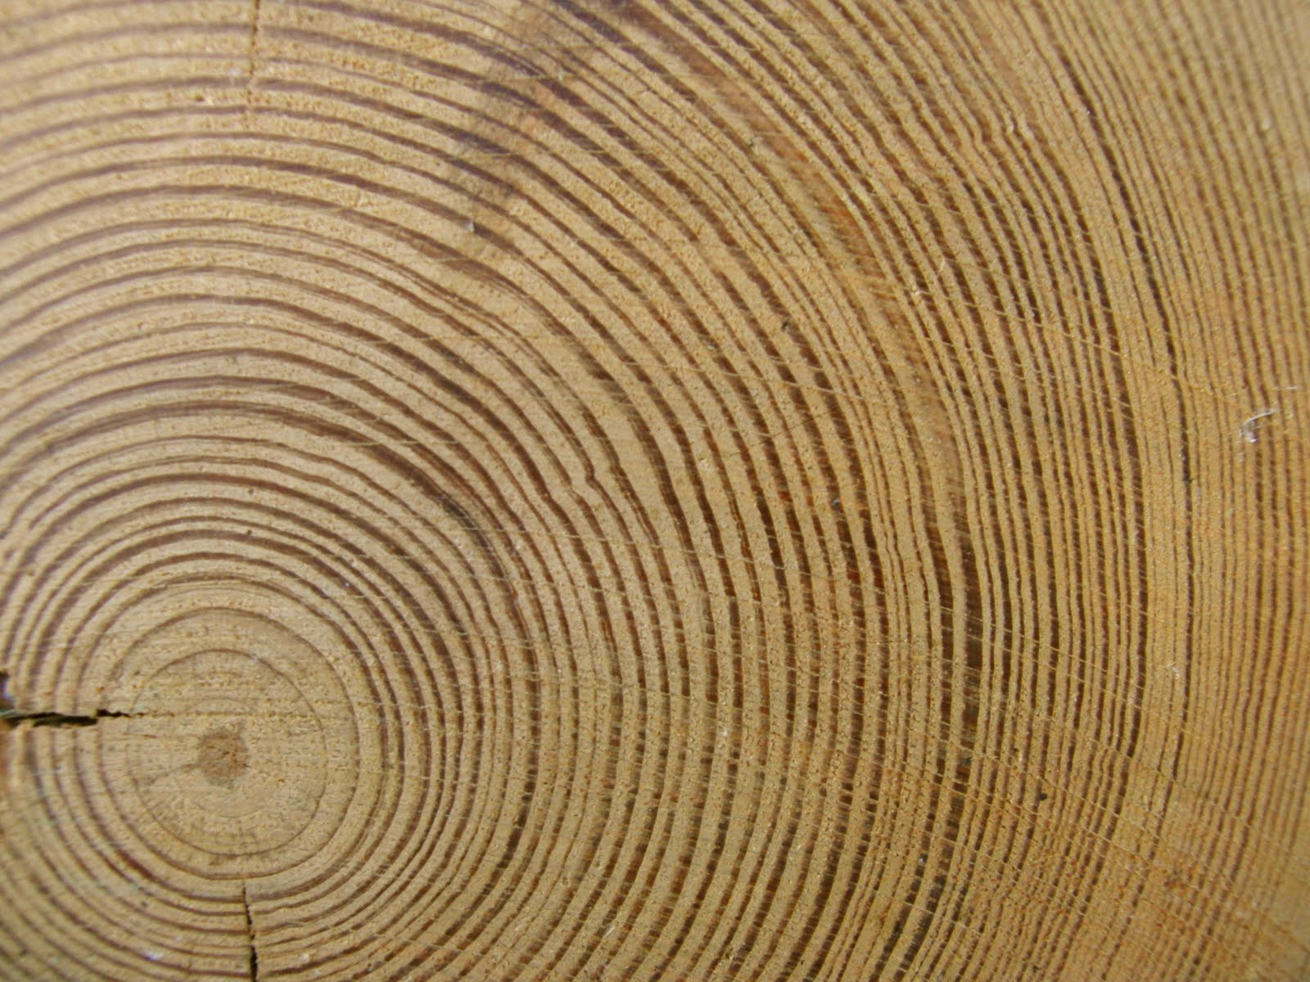
Tree Rings
Growth of trees is influenced by the climate
Temperature and Precipitation
Growth rings show change in climate
Wide ring: good conditions for growth
Narrow ring: poor conditions for growth

Slide 11
Tree Ring Video
https://vimeo.com/6872454

Slide 12
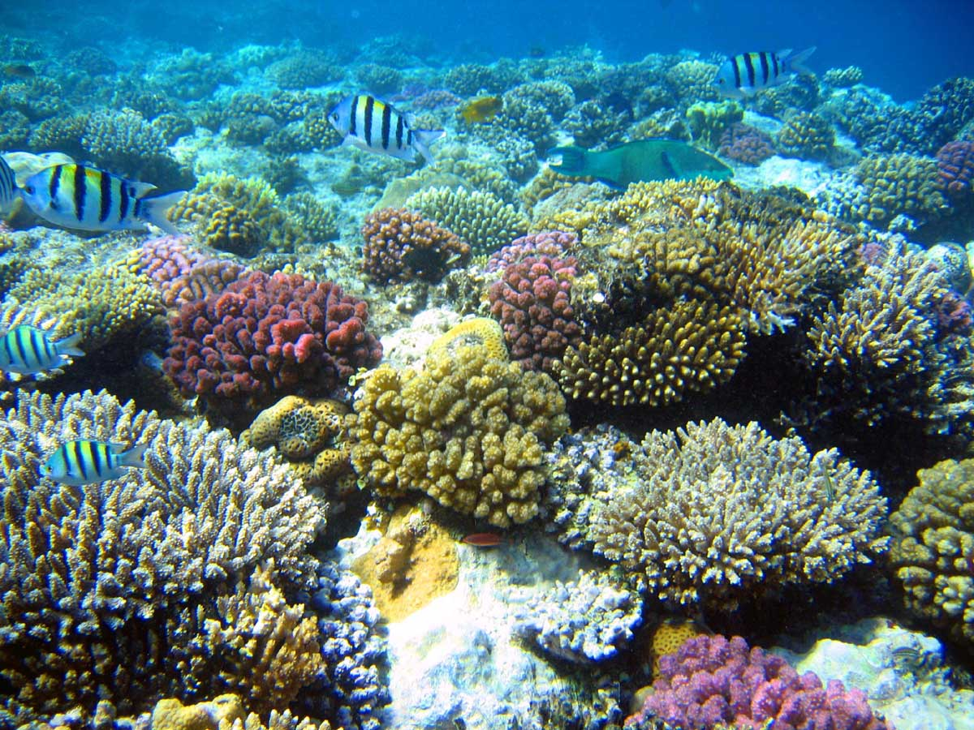
Coral Cores
Skeletons composed of calcium carbonate CaCO₃
Carbonate contains isotopes of oxygen
Determine temperature of the water

Slide 13
Let’s Review
What information can ice cores tell us that is different from tree rings?
How are sediment cores different from coral cores?

Slide 14
Homework
Write down one remaining question regarding climate proxies and find the answer through research.

