Slide 1
SWBAT determine the causes and effects of rising sea level. Do Now: What are three different effects of climate change?
ES Unit 5 12/17/15
Lesson 8

Slide 2
Turn and Talk
Homework Share Out

Slide 3
Agenda
Mini-lecture
Reading
Video
Wrap-up/Hw

Slide 4
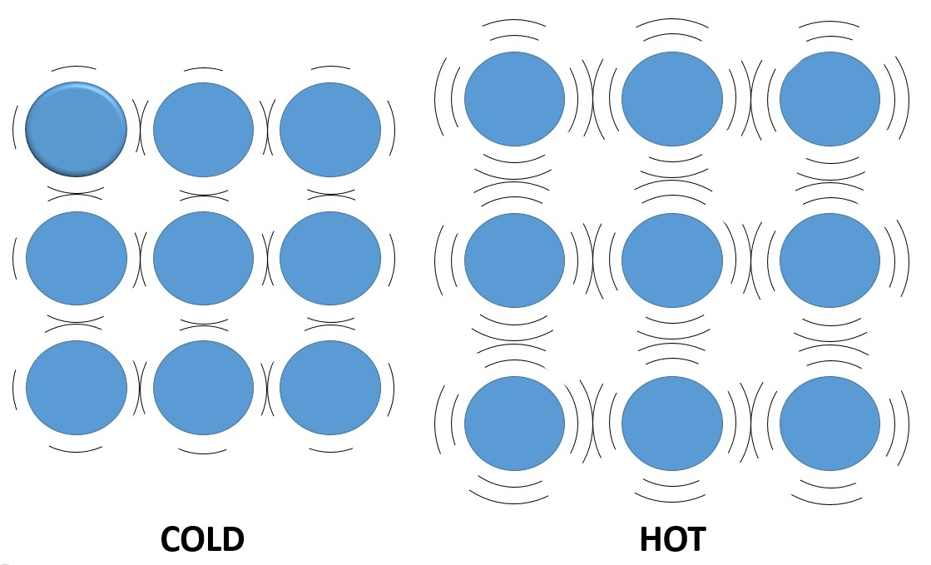
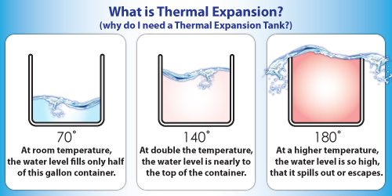
Sea Levels Rising
Causes:
Melting glaciers→ More water
Thermal expansion of water
Warmer water → water molecules move farther apart→ volume of water in ocean increases

Slide 5
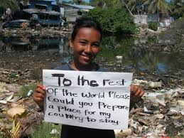
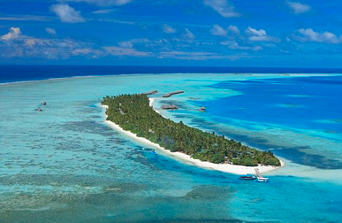
Environmental Effects
Increased soil erosion
Change in salinity
Loss of species that have a low salinity tolerance

Slide 6
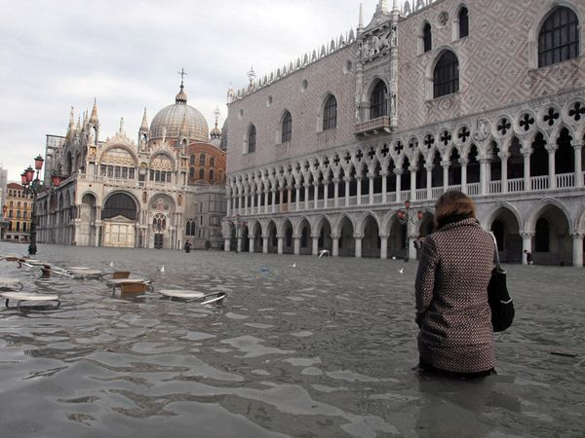
Economic Effects
Damage to private property
Loss of tourism
Loss of commercial fishing

Slide 7
Turn and Talk
Which cities in the U.S. do you think will be most affected by rising sea level? Why?

Slide 8
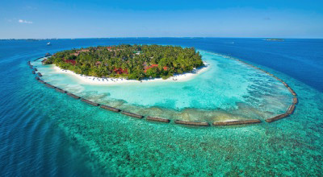
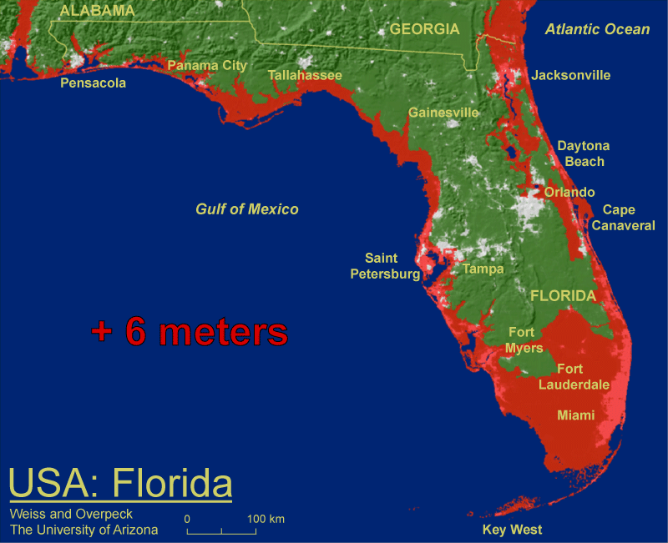
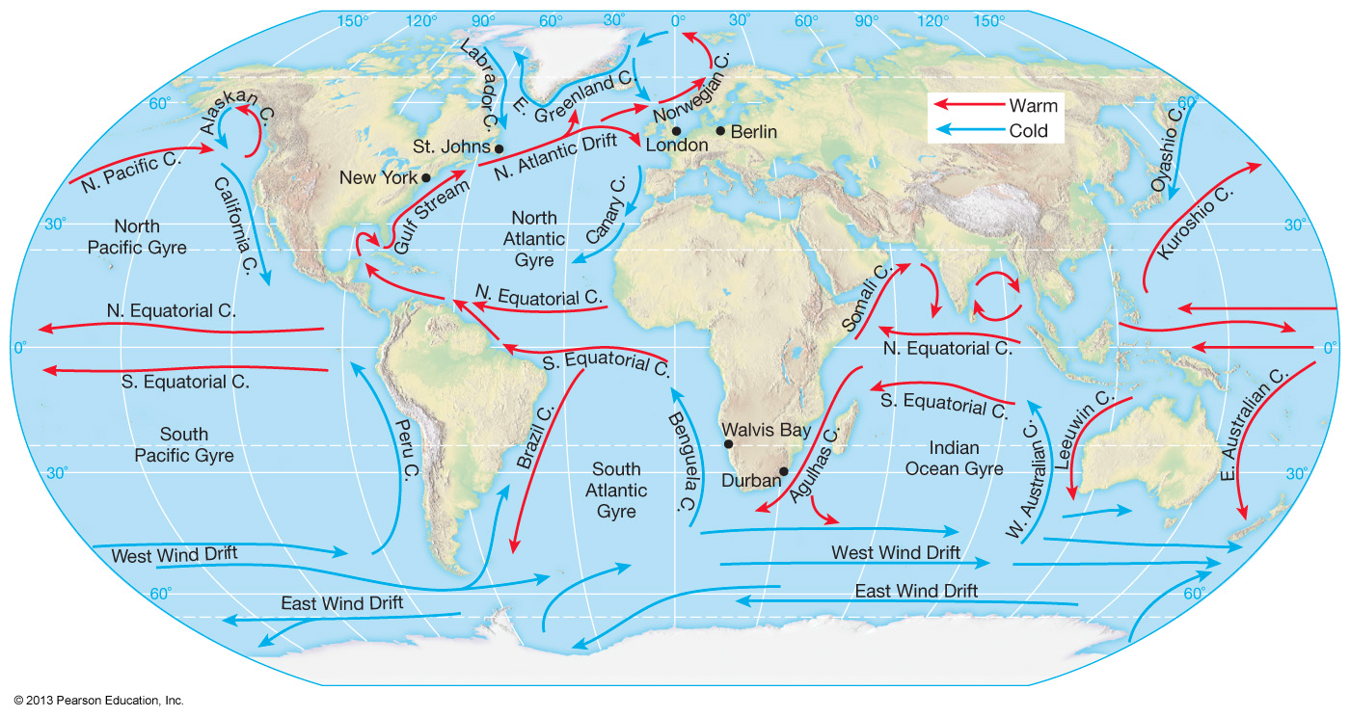
Sea Level Rise

Slide 9
Homework
Have a great weekend! ☺

