Slide 1
SWBAT identify ways in which warming temperatures are affecting the environment. Do Now: Why do you think there are many people who don’t believe in climate change?
ES Unit 5 12/17/15
Lesson 7

Slide 2
Video
National Geographic Climate Change Video
http://video.nationalgeographic.com/video/environment/global-warming-environment/global-warming-101/

Slide 3
Glacier TED Talk
http://www.ted.com/playlists/78/climate_change_oh_it_s_real.html

Slide 4
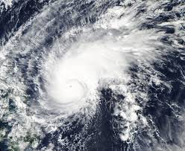
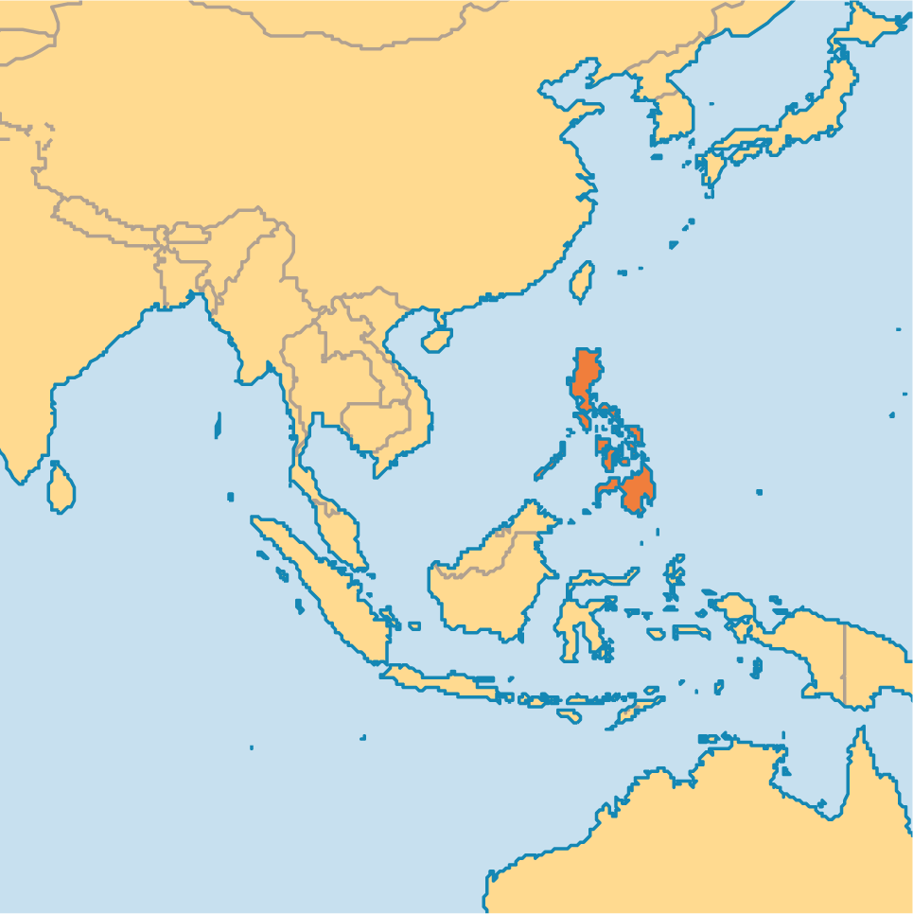
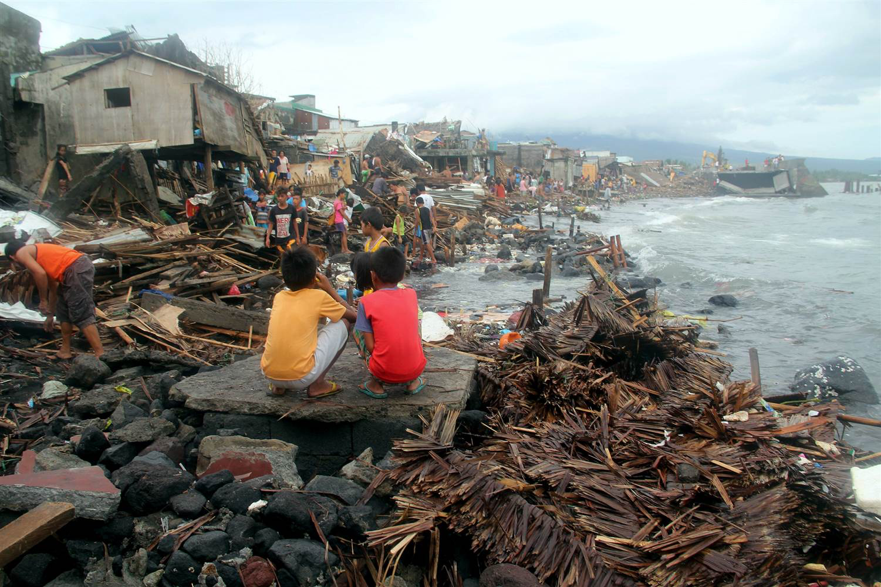
Typhoon in the Philipines

Slide 5
Homework
Research a natural disaster (hurricane, tornado, tsunami) that has occurred in the past 10 years. Include:
Where it happened
How many people died
How it affected the environment
How it affected the economy

