Slide 1
SWBAT design a lab to simulate the effect of ocean acidification on shells. Do Now: What are the effects of the ocean increasing in acidity?
ES Unit 5 12/15/15
Lesson 5

Slide 2
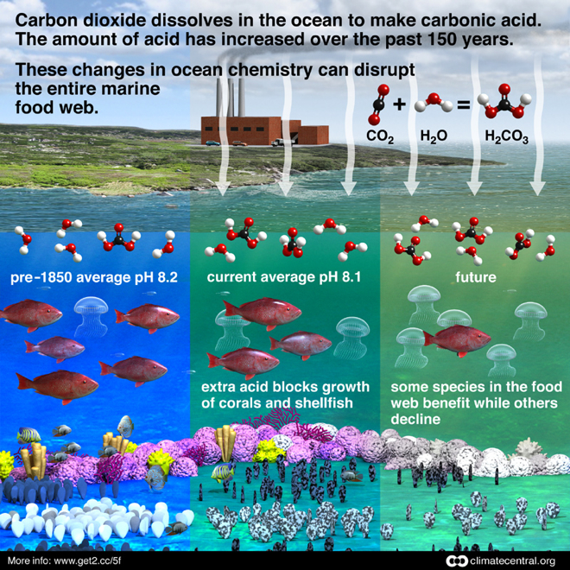
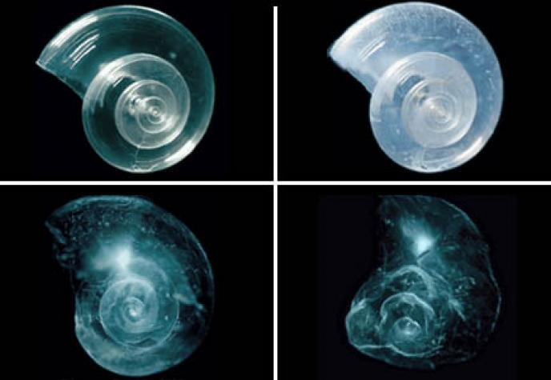
Ocean Acidification

Slide 3
Homework Share
Share out your homework about ocean acidification.

Slide 4
Agenda
Design lab

Slide 5
Ocean Acidification Lab
Introduction: Leave blank space
Experimental Design:
Testable question: How does pH affect the mass of shells?
Independent variable:
Dependent variable:
STOP and call Ms. McDaniel over to check
Hypothesis: (If…. Then….. Because)

Slide 6
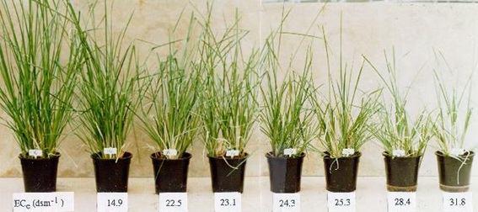
Constants
Constant: something that scientist makes sure is the same throughout the experiment
Ex. Watering the plants the same amount of water
Constants:____________
STOP and call Ms. McDaniel over

Slide 7
Control
Control: The part of the experiment that isn’t affected by the independent variable.
Ex: plant without any fertilizer

Slide 8
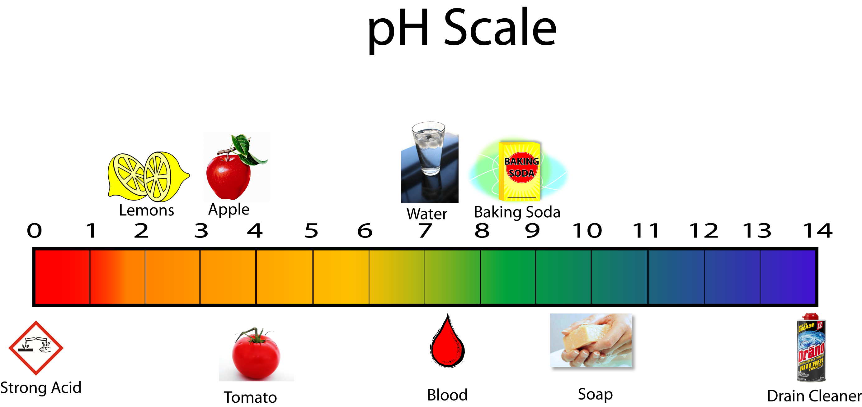
Control
Control:
Water

Slide 9
Materials
Materials:
Vinegar
Water
2 Beakers
Scale
Pipet
Goggles
Gloves
Tape

Slide 10
Introduction:
How are humans causing an increase in ocean acidification?
How is marine life being affected? (think shells…)
What is the purpose of this experiment? (hint… re-read the objective)

Slide 11
Procedure and Results:
Procedure: Leave blank space!
Results:
 | pH | Initial Mass of shell | Final Mass of shell | Difference in weight | Percent change
Water
Vinegar

Slide 12
Homework
Write a paragraph in your own words that answers the following question: How will climate change affect New York City?
List your source!!

