Slide 1
SWBAT identify the negative effects of ocean acidification. Do Now: How might an increase in the amount of dead organisms affect the carbon cycle? How might exponential human population growth affect the carbon cycle?
ES Unit 5 12/14/15
Lesson 4

Slide 2
Agenda
Read Article
Videos
Pass Back Exams

Slide 3
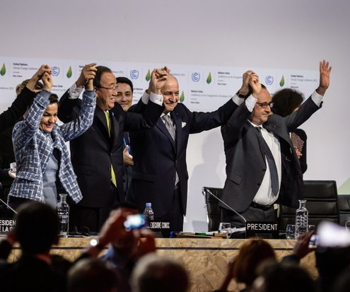
Good News!
Paris Climate Accord
195 nations reached an agreement
Will take effect in 2020

Slide 4
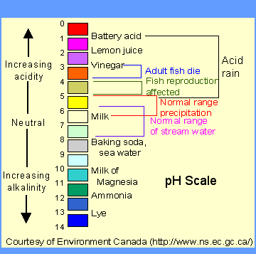
pH Scale

Slide 5
Article Annotation
Write a C next to the cause of ocean acidification
Write an E next to the effect of ocean acidification

Slide 6
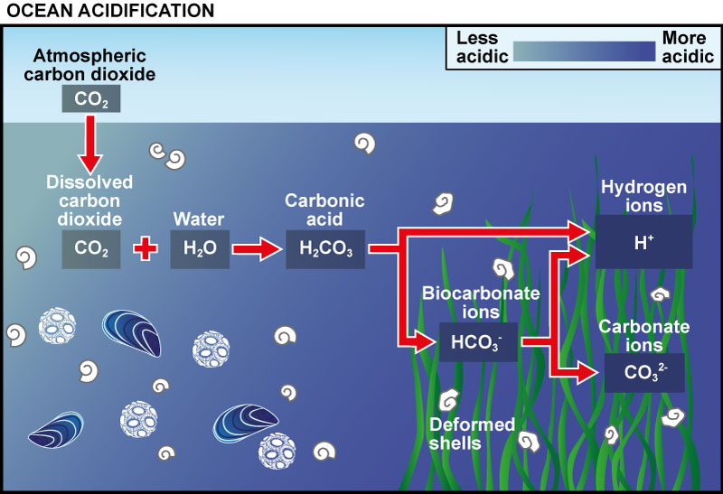
Ocean Acidification:
Atmospheric CO₂ is dissolving in the ocean
Creates carbonic acid
Ocean acidity increases

Slide 7
Ocean Acidification:
http://www.livescience.com/40913-ocean-acidification-the-other-carbon-dioxide-threat-video.html

Slide 8
Ocean Acidification in the Arctic:
https://vimeo.com/65512340

Slide 9
Turn and Talk
How do you think ocean acidification could affect the economy?

Slide 10
Internship Opportunity
DonorsChoose internship opportunity
Practical work experience
Training in workplace communication and research techniques
Regular meetings with a staff mentor
Professional development sessions with organization leadership
Deadline: Jan. 6th
Time commitment: twice per week for a minimum of 2 hours

Slide 11
Homework
Find an article about ocean acidification, summarize it in a paragraph in your own words
List the source!

