Slide 1
SWBAT perform an experiment to model the greenhouse effect. Do Now: What are all the ways in which carbon can enter the lithosphere?
ES Unit 5 12/10/15
Lesson 3

Slide 2
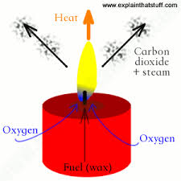
Greenhouse Gas lab

Slide 3
Greenhouse Gas Lab
Independent variable: Presence of CO₂ gases
Dependent variable: Temperature
Hypothesis: If independent variable __________ then dependent variable_______ because __________.

Slide 4
Data Table
Time | Temp.
0
5
10
15
20

Slide 5
Roles:
Glass beaker temperature reader
Plastic beaker temperature reader
Timer
Person who holds the heat lamp

Slide 6
Safety
Don’t burn yourself!
Don’t touch the bulb of the heat lamp!

Slide 7
Clean up:
4th and 5th period: place everything back in the tray and place on the lab bench
Place the beakers back where you found them
Place the heat lamps back where you found them
8th period:
throw soil from the beaker in the trash
Place candle back in the box
Rinse out beakers

Slide 8
Graph
Make a line graph of your data
Trends:
As ___________ increases/decrease, __________ increases/decreases.

Slide 9
Homework
Finish analysis questions

