Slide 1
Unit 5 12/8/15 Lesson 1
SWBAT describe how greenhouse gases are causing the greenhouse effect.
Do Now: list what you know and what you want to know about climate change.

Slide 2
Do Now
Know Want to know

Slide 3
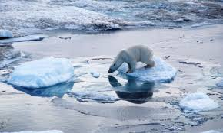
Unit 5: Climate Change
~ 4 weeks
More labs!
Essential Questions:
Is the greenhouse effect a blessing or a curse?
Do human civilizations impact earth systems to the same degree that earth systems affect human civilization?
How is climate change disproportionately affecting people in developing countries?

Slide 4
Agenda
Lecture
Independent Practice
Pass back essays!
Exit Ticket

Slide 5
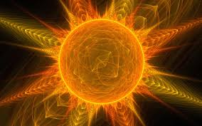
Vocab
Radiate: emit energy or heat especially in the form of rays or light

Slide 6
The Greenhouse Effect
Energy from the sun can be
absorbed in the atmosphere
reflected by earth and atmosphere
absorbed by the earth’s surface

Slide 7
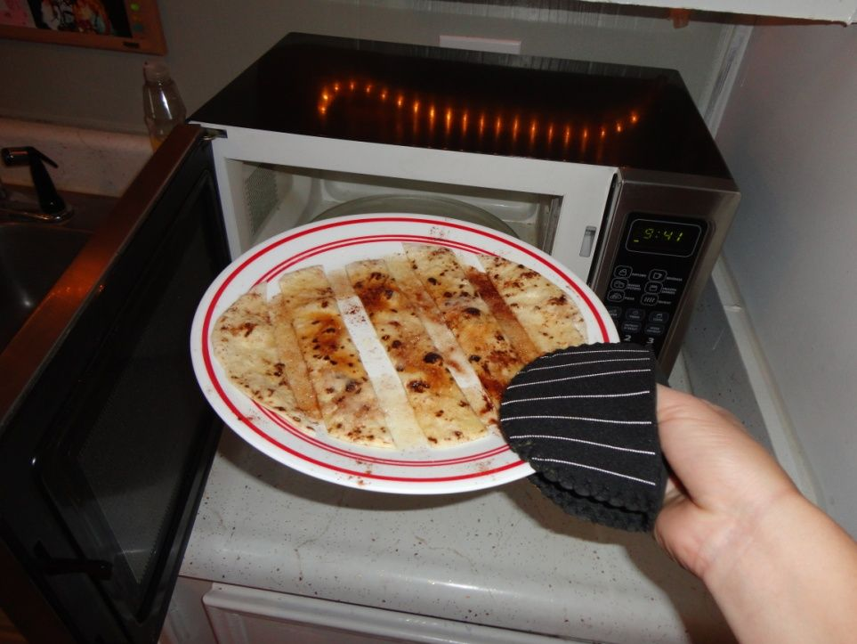
The Greenhouse Effect
Some energy from the sun is absorbed by the earth.
The earth radiates some of this energy back into the atmosphere.

Slide 8
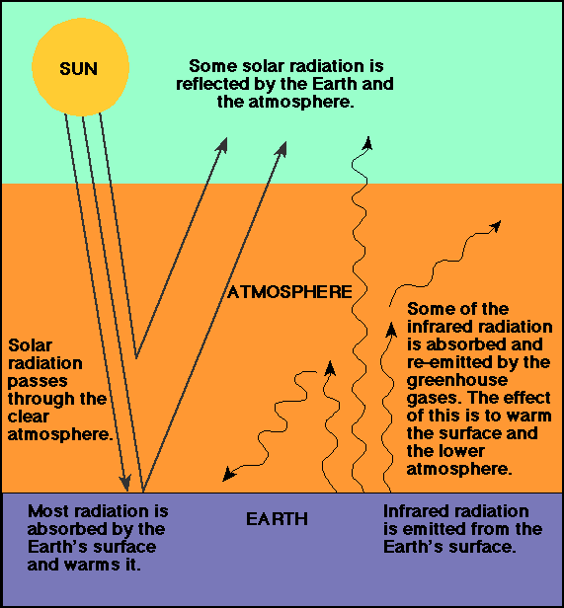

Slide 9
The Greenhouse Effect
Greenhouse gases trap some of the energy radiated by the earth.
This causes an increase in temperature→ global warming

Slide 10
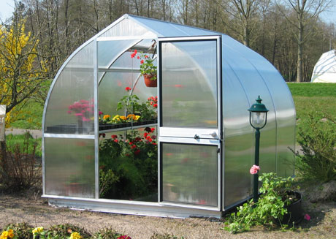
The Greenhouse Effect
Video
http://science.howstuffworks.com/environmental/203-what-is-the-greenhouse-effect-video.htm

Slide 11
Check for Understanding
Do greenhouse gases come from greenhouses?
Nope!

Slide 12
Greenhouse Gases
H₂O
CO₂
Methane (CH₄)
CFCs

Slide 13
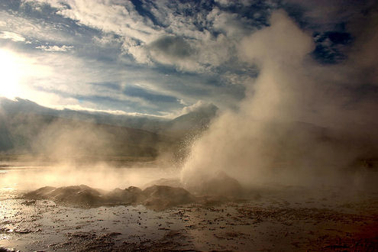
H₂O (Water vapor)
Most abundant greenhouse gas
Not due directly to humans
Remains in the atmosphere for a few days

Slide 14
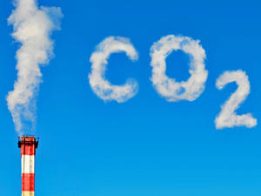
Carbon Dioxide (CO₂)
Comes from:
Burning fossil fuels (coal, oil, natural gas)
Deforestation
Stays in the atmosphere the longest

Slide 15
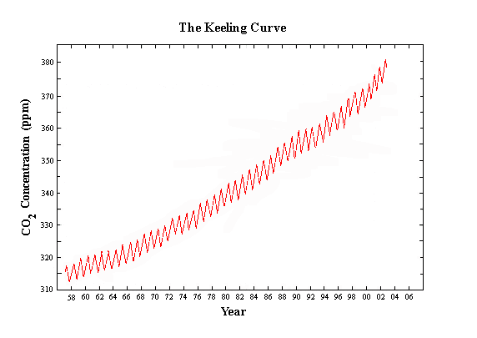

Slide 16
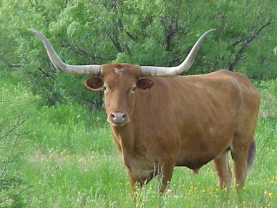
Methane (CH₄)
Produced by cattle and rice
Most effective greenhouse gas

Slide 17
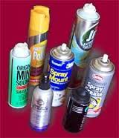
CFCs (Chloroflourocarbons)
Produced by aerosols
Refrigerator parts
Outlawed but have long half life

Slide 18
Essay feedback
+ (glow)
Triangle (grow)
Great job pulling evidence from the article to support your position
Be careful of scientific info:
Lionfish venom vs. ciguatoxins
More analysis!
Write a goal!

Slide 19
Exit Ticket
How does an increase in the amount of CO₂ cause an increase in the temperature?

