Slide 1
SWBAT identify the agreements in the Paris Climate Accord. Do Now: List three processes in the water cycle. How is decomposition similar to respiration in the carbon cycle?
ES Unit 5 1/6/16

Slide 2
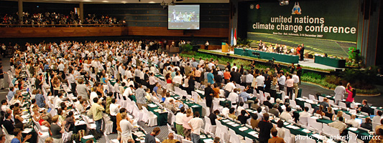
Turn and Talk
What was the Kyoto Protocol and why was it a failure?

Slide 3
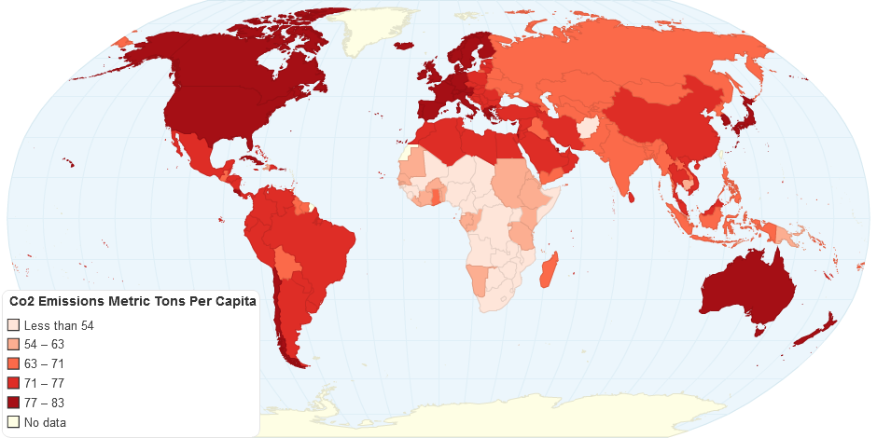
CO₂ emissions per person by Country

Slide 4
Agenda
Reading
Discussion
Hw
Core Cash Opportunity:
Come up at lunch to help me organize red folders

Slide 5
Video
http://www.reuters.com/article/us-climatechange-summit-idUSKBN0TV04L20151213

Slide 6
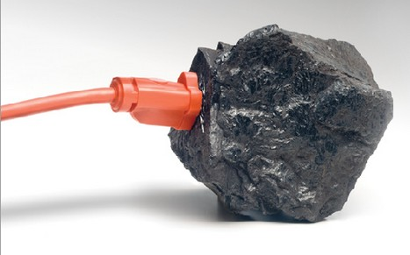
Paris Climate Accord

Slide 7
Paris Climate Accord Summary
to aim to limit the increase to 1.5°C, since this would significantly reduce risks and the impacts of climate change
come together every 5 years to set more ambitious targets as required by science;
report to each other and the public on how well they are doing to implement their targets;
track progress towards the long-term goal through a robust transparency and accountability system.

Slide 8
Discussion
Do you believe it should the government’s responsibility or an individual’s responsibility to reduce climate change? Explain your answer.
Do you believe the Paris Climate Accord will be successful? Why or why not?
Do you believe countries should be punished if they aren’t able to reduce their emissions? Why or why not?
How do you think the Paris climate accord could be improved?

Slide 9
Homework
Review sheet!

