Slide 1
ES Unit 5 1/5/16 Lesson 13
SWBAT distinguish between positive and negative feedback loops.
Do Now: What is the difference between a positive and a negative feedback loop?

Slide 2
Agenda
Practice identifying feedback loops!

Slide 3
Homework Share Out
Share out your research about positive and negative feedback cycles

Slide 4
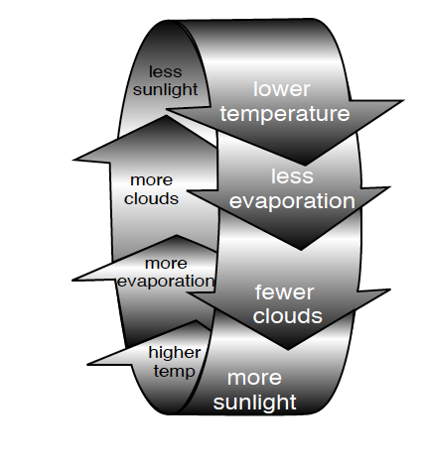
Practice:

Slide 5
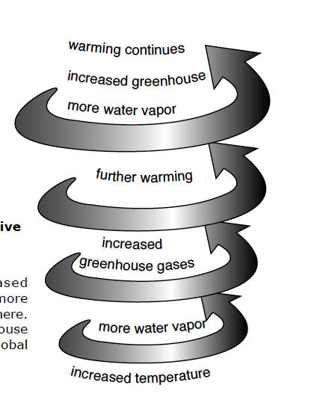
Positive vs. Negative Feedback Loops

Slide 6
Directions:
Identify the key parts and draw a model
Label the feedback loop as positive or negative
Identify what would need to be taken away in order to stabilize it OR what would need to be added to make it unstable
Ask 3 before me!!

Slide 7
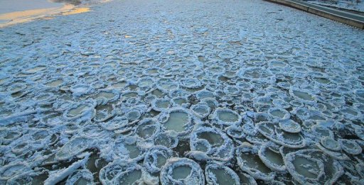
Feedback loops

Slide 8
Red Folders
Write you first and last name in pen

Slide 9
Homework
Research the Kyoto Protocol and explain why it was a failure in your own words

