Slide 1
SWBAT identify the elements of a feedback system and fill out a flow chart to model the feedback system. Do Now: Which greenhouse gas is the most abundant? Which is released due to a combustion of fossil fuels? Which is released due to livestock?
ES unit 5 1/4/16
Lesson 12

Slide 2
Agenda
Mini-lecture
Worksheet
Announcement:
Midterm on Monday Jan. 11th

Slide 3
Systems
Systems: A network of relationships among parts that interact with one another.
Exchange energy, matter or information.
Systems receive inputs and produce outputs.

Slide 4
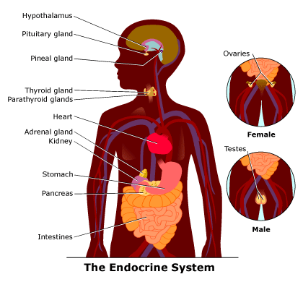
System

Slide 5
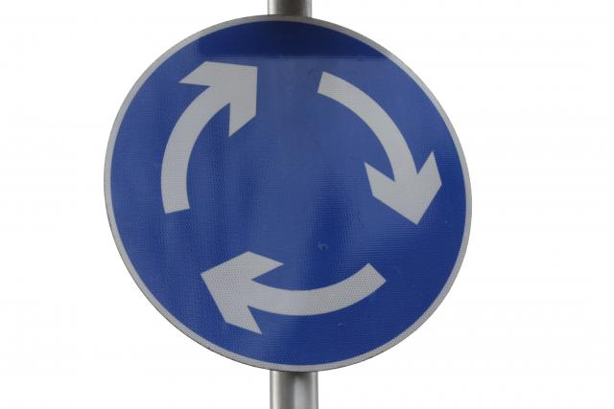
Feedback Loops
When an event is both an input (cause) and output (effect).
Results in a cycle
Can be either negative or positive.

Slide 6
Negative Feedback Loops
A change (increase or decrease) in some variable results in the opposite change in the second variable
Common in nature
Notes:
Ex: thermostat

Slide 7
Negative Feedback Loops
Promotes stability

Slide 8
Positive Feedback Loops
A change (increase or decrease) in one variable promotes the same kind of change in another variable
Generally rare but common in environments changed by humans.
Notes:
Ex: poison ivy

Slide 9
Positive Feedback Loops
Unstable

Slide 10
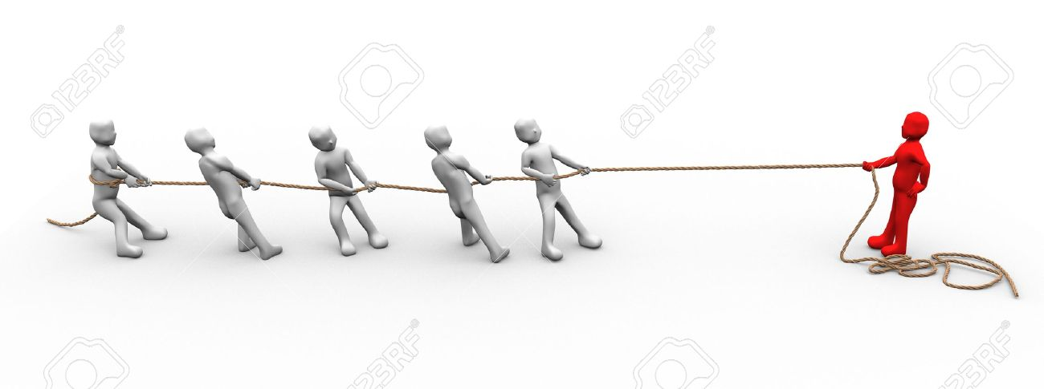
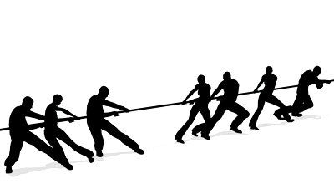
Positive vs. Negative feedback loops

Slide 11
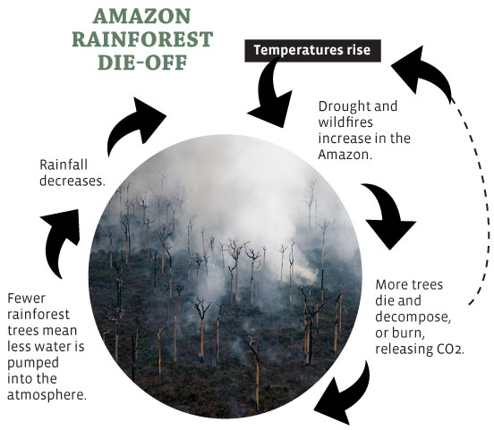
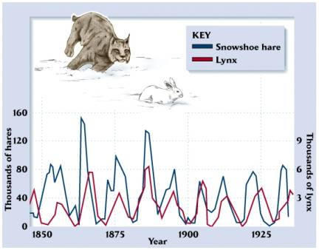
Example: Positive or negative?

Slide 12
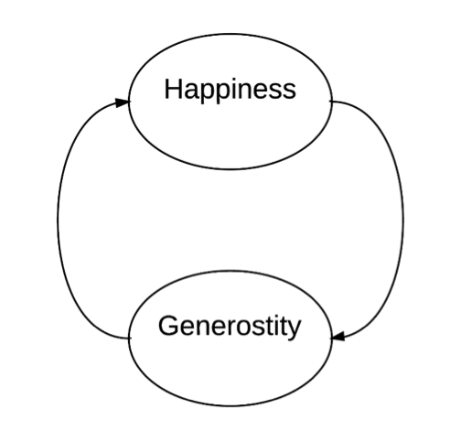
Positive or Negative Feedback Loop?

Slide 13
Modeling feedback loops
Step 1: Underline what changes in the paragraph
Step 2: Fill in the boxes with what changes

Slide 14
Let’s review!
Which feedback loop is more stable: positive or negative?
Which one is more commonly found in nature? Why?

Slide 15
Homework
Research an example of a positive and a negative feedback loop
List your source!

