Slide 1
SWBAT perform a lab that simulates ocean acidification. Do Now: What information can be told from ice cores?
ES Unit 5 12/22/15
Lesson 10

Slide 2
Agenda
Homework Share out
Ocean acidification lab
Graph
Work on lab report

Slide 3
Announcement
Midterm on Friday Jan. 8th

Slide 4
Homework share
Share your question/research about climate proxies

Slide 5
Lab Roles
Person closest to the countertop grab your beakers/cups
Volunteers to pass out lab notebooks!
Lab notes:
Follow the directions!
You can pour the vinegar down the sink

Slide 6
Calculating percent change
[(Final mass- initial mass )/ initial mass] x 100

Slide 7
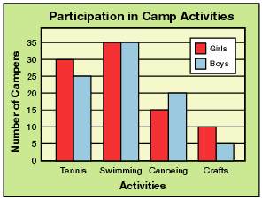
Graph

Slide 8
Results Summary
State any trends in your graph
As_____ increases/ decreases, _______ increases/decreases
It’s possible not to have any trends
Which shell lost the most mass?
Don’t offer any explanations or state whether or not your hypothesis was supported or rejected

Slide 9
Discussion
Analysis: Offer explanations as to why you received the results you did.
Which shell lost the most mass?
Conclusion: Do your results support your hypothesis? Why or why not?
Sources of Error:
What are some sources of error for this part of the experiment?
How might these sources of error have affect the results of your experiment?
How could the experiment be improved so that you can avoid these sources of error?
Suggestions for further investigation:
What remaining questions do you have after conducting this lab?
What experiment could you conduct in order to answer these questions?

Slide 10
Break Homework
Lab Report!
May be typed OR handwritten
Save the rubric!

