Slide 1
SWBAT identify ways in which humans are negatively impacting biodiversity. Do Now: What is the difference between an endangered and an extinct animal?
ES Unit 4 11/30/15
Lesson 9

Slide 2
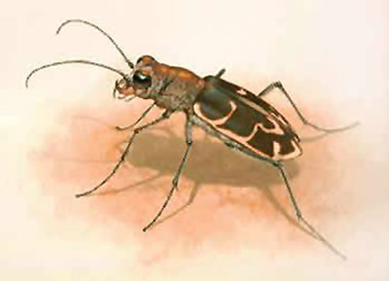
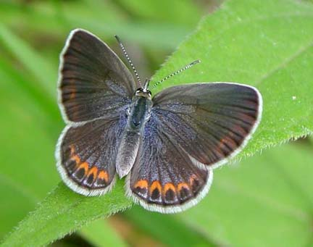
Vocab:
Extinction: complete disappearance of a species from the earth
Endangered: Few individual survivors that it could soon become extinct

Slide 3
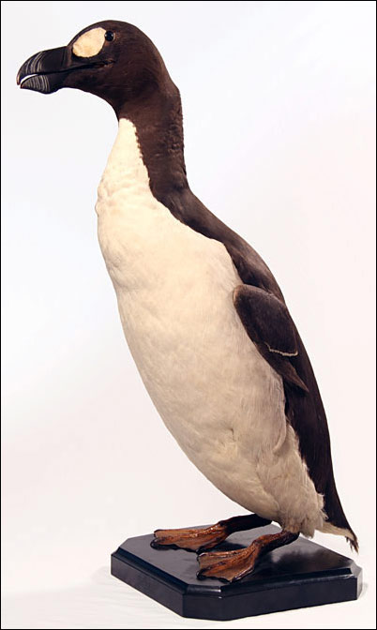
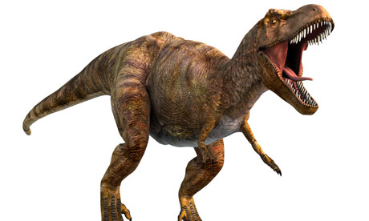
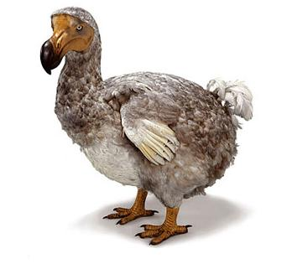
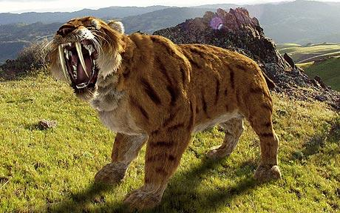
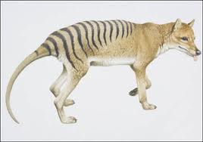
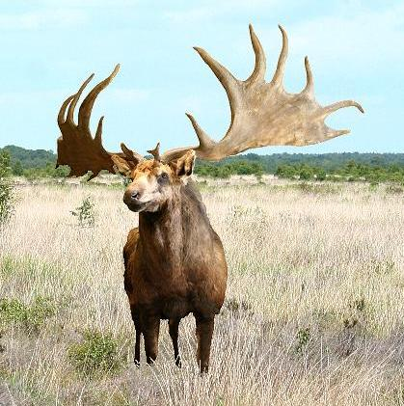
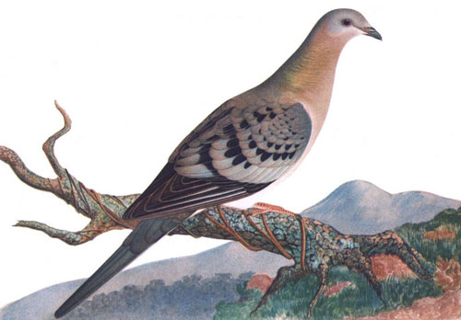
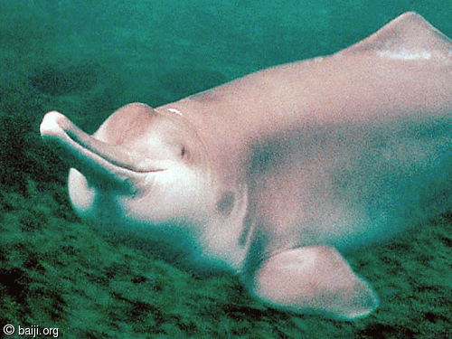
Extinct Animals
Dodo Bird
Tyrannosaurus Rex
Great Auk
Saber Tooth Tiger
Tasmanian Tiger
Baiji White Dolphin
Irish Deer
Passenger Pigeon

Slide 4
Homework Share
What is the evidence that supports that humans are an invasive species?
What is the evidence that does not support that humans are an an invasive species?
Do you believe humans are invasive species? Why or why not?

Slide 5
Reminder:
Last week of the marking period!!!!
Turn in Lionfish essay!

Slide 6
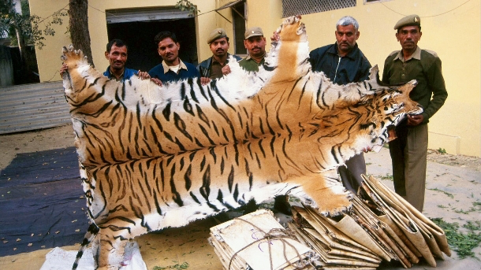
Poaching
Illegal hunting, killing, or capturing of wild animals.
Negative effects:
Possible extinction
Emergence of diseases passed between humans and animals (zoonotic diseases)
Ebola
HIV

Slide 7
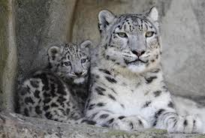
Case Study: Snow leopards
Only 4,000 to 6,500 left in the world
Poached for:
Fur for clothes
Other body parts for medicine

Slide 8
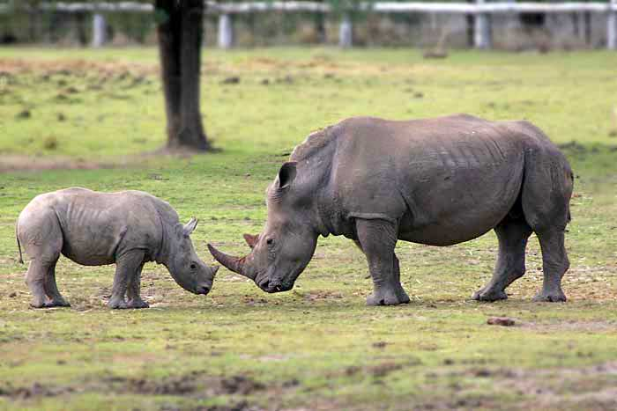
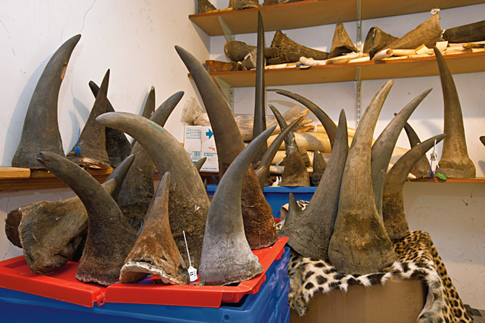
Case Study: White Rhinoceros
Originally 1 million, now only 11,000 in the wild
Poached for:
Horns are used for medicine in Asia

Slide 9
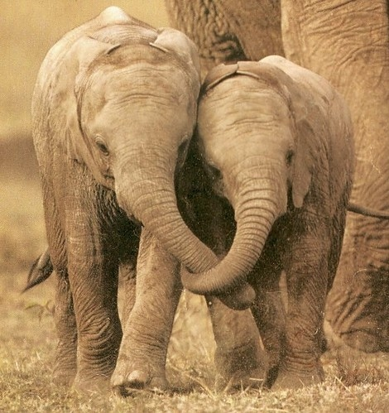
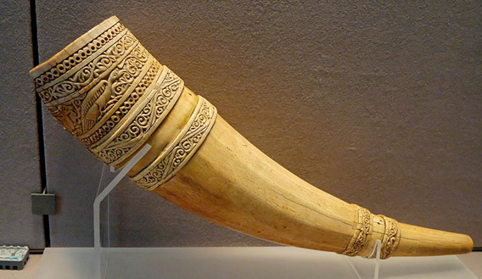
Case Study: Elephants
30,000 elephants are being poached every year.
Poached for:
Ivory tusks that are very valuable

Slide 10
How can we stop poaching?
Support the World Wildlife Fund (WWF)
Improve international and local law enforcement to end trade of animal parts
Create new protected areas and reservations

Slide 11
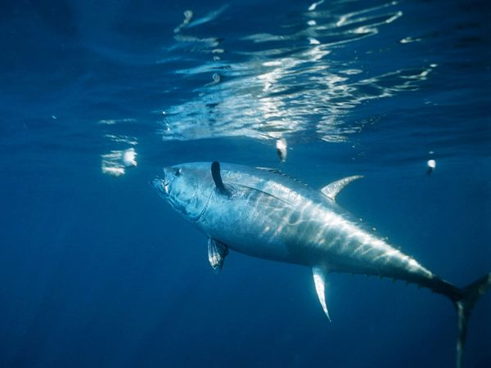
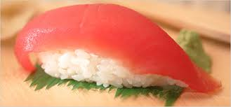
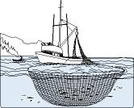
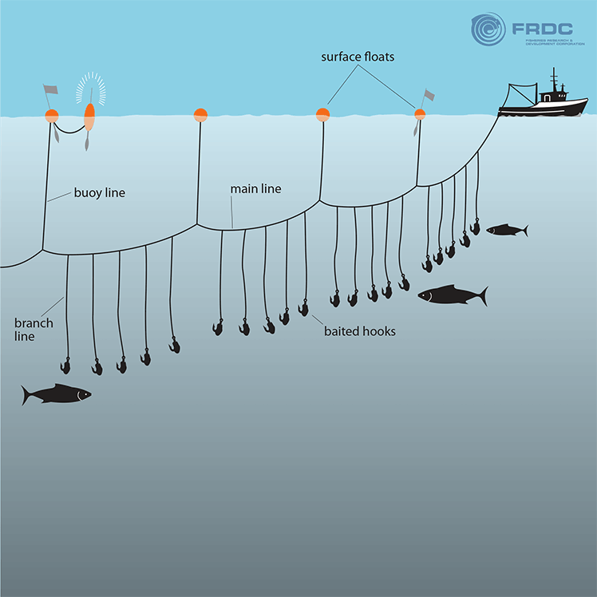
Bluefin Tuna

Slide 12
Video

Slide 13
Discussion:
Who do you think is more at fault: those who are poaching animals or those who are buying ivory, leopard skins, etc.?
Do you think poaching is more unethical than killing animals for food? Why or why not?

