Slide 1
SWBAT distinguish between explicit and inferred ideas in a text. Do Now: What is the difference between ciguatoxin and ciguatera?
ES Unit 4 11/20/15
Lesson 6

Slide 2
Announcement
Socratic Seminar on Monday- Quiz Grade!

Slide 3
Ciguatoxins vs. Lionfish Venom

Slide 4
Analysis
What is the difference between analysis and summary?

Slide 5
Questions for Analysis:
Why does this piece of evidence support your claim?
How does this evidence support your position?
How does this topic relate to something else we’ve learned this year?
Don’t just summarize!

Slide 6
Explicit vs. Inferred Ideas
Explicit ideas: Information that is stated directly in the text
Ex: lionfish venom degrades at room temperature
Inferred ideas: Reaching a conclusion about something from known facts or evidence.
Ex: If lionfish doesn’t contain ciguatoxin, it might be safe to eat after cooking.

Slide 7
Trait 3: Textual Analysis
Fill out your intro paragraph and the first paragraph of the outline in PENCIL

Slide 8
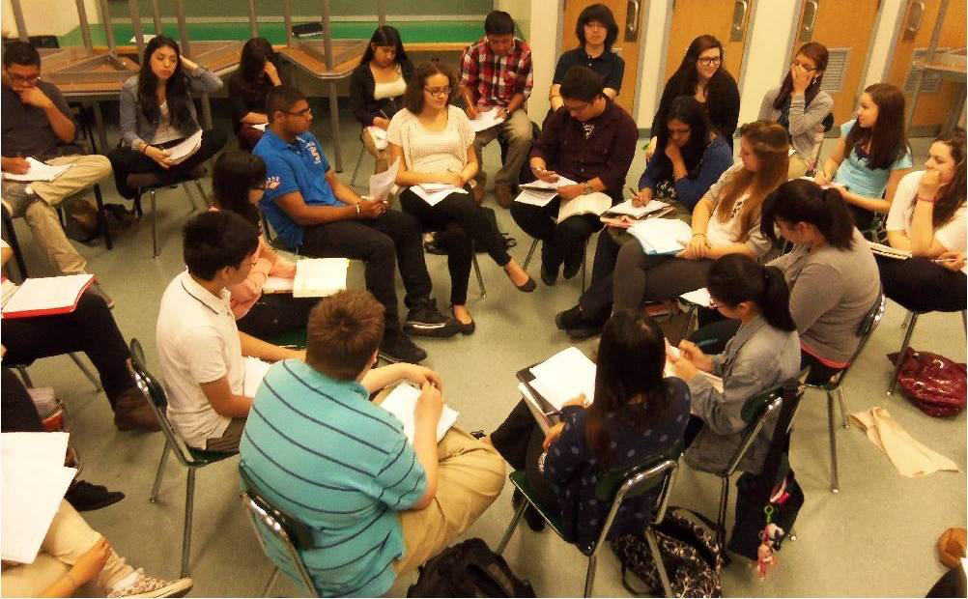
Socratic Seminar
Fishbowl style
Everyone speaks at least twice
No one should speak more than 5 times
Use evidence from the article

Slide 9
Homework
Write three questions for the Socratic seminar that will generate discussion AND answer the questions
Complete essay outline by Tuesday- It is a quiz grade!

