Slide 1
SWBAT perform a close reading to evaluate the impact of the lionfish as an invasive species. Do Now: The crazy eye beetle is an invasive species in upstate New York. The governor doesn’t want it to spread to other parts of the state. What method would you suggest to control the crazy eye beetle? Why?
ES Unit 4 11/19/15
Lesson 5

Slide 2
Homework Share
Turn and talk to share your homework research.

Slide 3
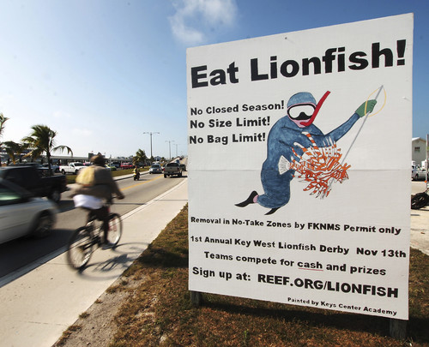
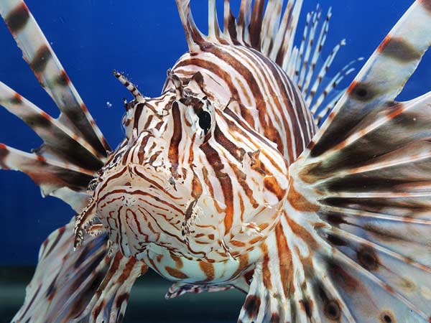
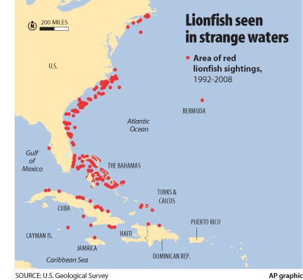
Lionfish

Slide 4
Close Reading: CNN article
Chunk #1: Underline what makes lionfish a successful species
Chunk #2: Underline how lionfish are affecting the economy and ecosystem
Chunk #3: Underline evidence for or against eating lionfish

Slide 5
Video
http://www.cnn.com/2012/04/24/us/lionfish/

Slide 6
Close Reading #2
Underline evidence for or against eating lionfish
Mark for evidence with +
Mark against evidence with -

Slide 7
Ciguatoxins

Slide 8
Homework
Fill out the introduction section of the essay outline ONLY (in pencil!)

