Slide 1
SWBAT describe the methods humans use to control invasive species. Do Now: What are three characteristics of invasive species that allows them to thrive?
Unit 4
Lesson 4
11/18/15

Slide 2
Agenda
Lecture
Article/Discussion
Pass Back Exams
Turn and Talk to share out the homework

Slide 3
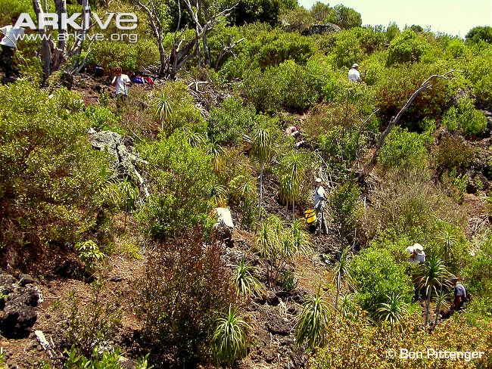
Controlling Invasive Species
Controlling invasive species is difficult and expensive.
There are four ways to control invasive species:
Physical control
Chemical control
Biological control
Prevention
Notes:
Controlling invasive species once they have become established can be difficult, and in some cases it may even be impossible.
Control is also usually very expensive!
There are four main ways that invasive species are controlled:
- Physical control
- Chemical control
- Biological control
- Prevention
These will be discussed in more detail on the slides to follow.
Image: A team of conservationists clearing Pleomele halapepe stand of invasive plants.

Slide 4
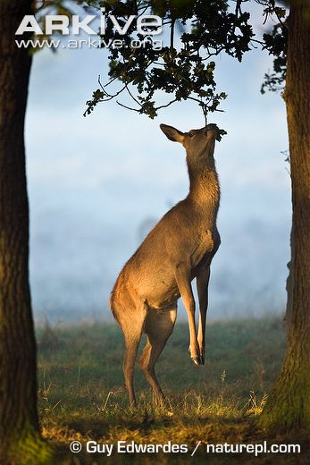
Physical Control of Invasive Species
Controlling plants:
Remove of plants by hand or machine
Installation of barriers
Controlling animals:
Trapping and hunting
Putting up barriers or fences
Notes:
Controlling invasive plants:
There are a number of approaches to physically controlling an invasive plant species. These can range from mechanical excavation or hand removal to the installation of growth barriers to suppress or stop invasive plants encroaching onto a site.
There are many things to consider when choosing an appropriate control method, and a single control method will not work for all species. For example, strimming plants can be effective in controlling some species, such as Himalayan balsam, but only if it is done to young plants before the seed heads have developed. Strimming would not be effective for woody species, such as rhododendron, as it does not affect root growth. Similarly, for species such as Japanese knotweed, strimming would result in the plant fragments being dispersed over a wide area, exacerbating the problem.
Controlling animals:
Culling – e.g. culling of the red deer in the UK to restrict the damage it causes to forestry, agriculture and the natural environment (e.g. browsing red deer (see photo) can prevent the regeneration of woodland)
Trapping and hunting
Putting up barriers or fences
Image: Red deer (Cervus elaphus) feeding on tree leaves. Red deer are native to most of Europe, southwest Asia and North Africa; however, it has been introduced to Australia, New Zealand and Argentina, as well as a range of other countries, where it can cause serious damage to native species and habitats. Even in the UK, red deer are periodically culled to prevent the population becoming out of control

Slide 5
Chemical Control of Invasive Species
Chemical control: Applying poison to eliminate invasive species
Use rodenticide (rat poison)
Insecticides & pesticides
to control insect pests
Herbicides (weed-killer)
to control plants
Notes:
Chemical control of species:
Eradication – e.g. removal of rats from islands where they are having devastating effects on nesting seabirds. A large scale eradication project was recently carried out on Henderson Island to protect the native seabirds such as the Henderson petrel, whose populations were in serious decline.
As rats are extremely prolific breeders, the only feasible way to achieve the eradication of the species on a large and rugged island such as Henderson is by spreading bait containing a rodenticide (rat poison).
On Henderson, Brodifacoum, the active ingredient in many household rat poisons, was used to eradicate the rats.
Video – rat predating on Henderson petrel chick: http://www.arkive.org/henderson-petrel/pterodroma-atrata/video-14
Find out more about the eradication of rats from Henderson Island: http://blog.arkive.org/2010/10/rat-eradication-planned-for-pacific-island/ & http://www.rspb.org.uk/ourwork/projects/details.aspx?id=tcm:9-241934

Slide 6
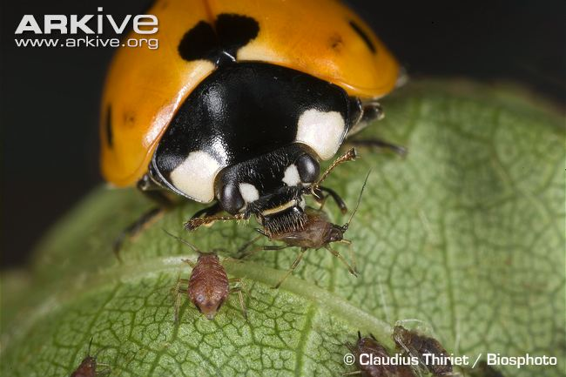
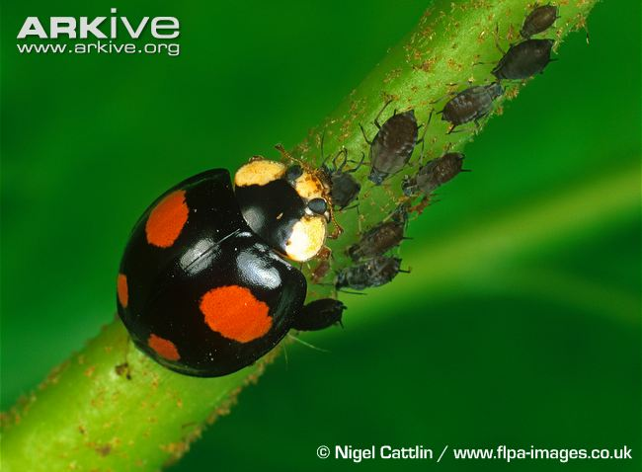
Biological Control of Invasive Species
Uses a living organism to control invasive species
May eat the invasive species or cause it to become diseased
Must ensure the control species will not become invasive itself
Seven-spot ladybird
Harlequin ladybird
Notes:
Biological control uses a living organism to reduce or eliminate the population of the invasive species.
The organism may eat the invasive species or cause it to become diseased - it relies on predation, parasitism, herbivory, or other natural mechanisms, but typically also involves an active human management role.
Control agents are often brought from the original habitat of the invasive species.
Images – L: seven-spot ladybird; R: harlequin ladybird – feeding on aphids
Ladybirds are often used as biological control agents to control aphids in greenhouse production of crops. Ladybirds are natural predators of aphids, and so one way of controlling aphid numbers is to release more ladybirds into an area to help control the aphid infestation. Depending on the level of pest infestation, as many as 5,000 to 200,000 ladybirds per acre (1 to 50 per square metre) per week could be mass-released.
However, biological control is risky. Proposals for biological control must be carefully assessed to ensure the control species does not become invasive and cause as much damage as the species to be controlled. One example of this is the harlequin ladybird. The harlequin ladybird spread to the UK after being imported from East Asia to Europe for commercial pest control of crops, and it is now affecting populations of the UK’s native ladybird species, as it is bigger than native species, better protected and able to outcompete native species for food resources.

Slide 7
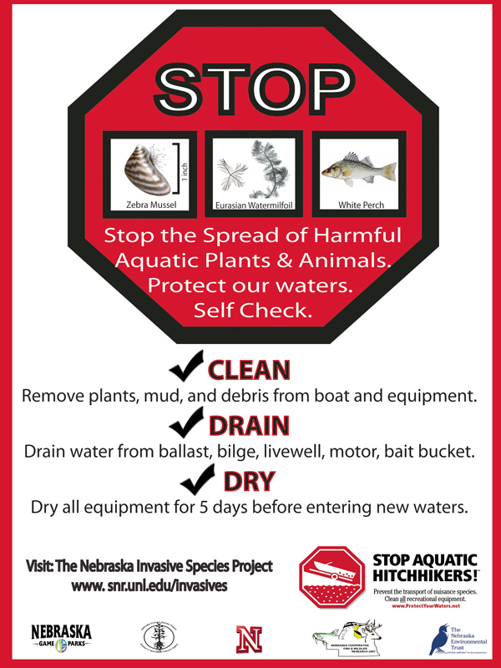
Preventing Invasive Species
Prevention is better than cure!
Prevention:
From being introduced in the first place
From spreading

Slide 8
Review
What are the four main methods that humans use to control invasive species?

Slide 9
Homework:
Research an example of when biological control was used for an invasive species and it failed.
List the species that was used
Cite your source!

