Slide 1
SWBAT identify characteristics that make an animal a good invasive species.
Do Now:
How can you measure biodiversity?
Unit 4
Lesson 3
11/16/15

Slide 2
Agenda:
Lecture
Independent Work
Video
But first– Homework Share!

Slide 3
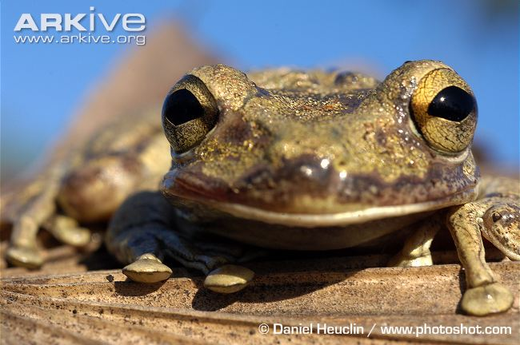
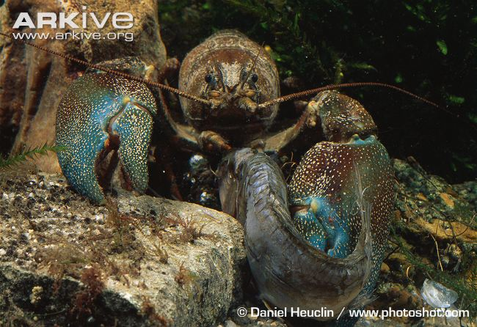
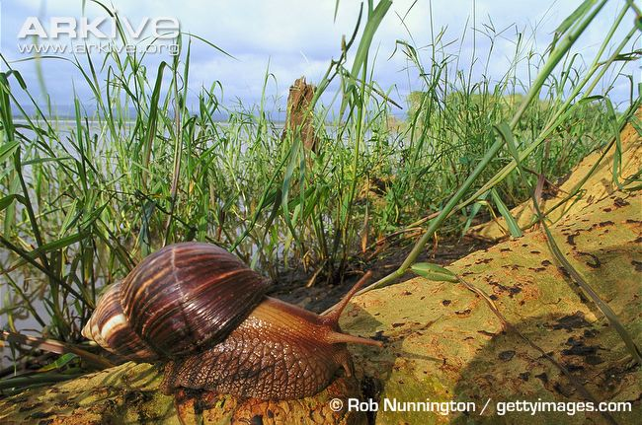
Invasive Species
Notes:
Introduce the session - today we are going to look at invasive species.
We will talk about:
What an invasive species is, and how it differs from introduced species
Some examples of invasive species
What characteristics make a successful invader
Different ways invasive species can be introduced to the environment
Impact of invasive species on the environment
Ways to control invasive species
Successful case studies, including a focus case study on Barrow Island, Australia
Research activity and preparation of invasive species case files
Images (L-R): a Cuban treefrog (Osteopilus septentrionalis), a very successful predator and invasive species; a common carp being fed on by an invasive species in British waterways, the American signal crayfish (Pacifastacus leniusculus); Giant African snail (Achatina fulica)

Slide 4
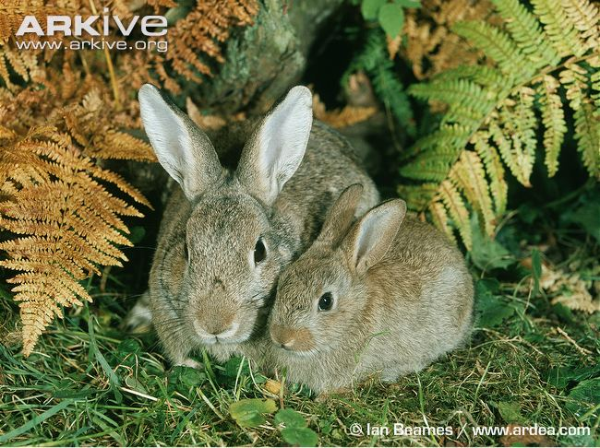
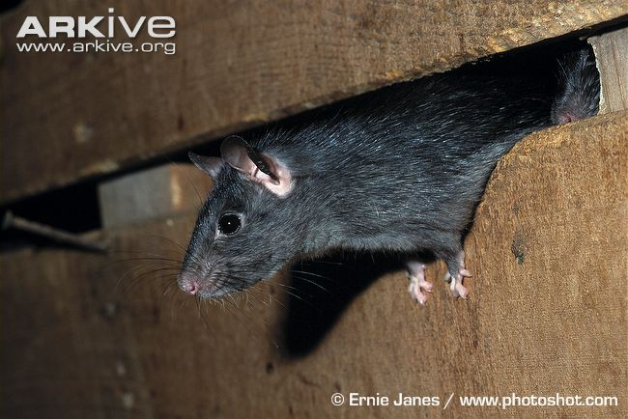
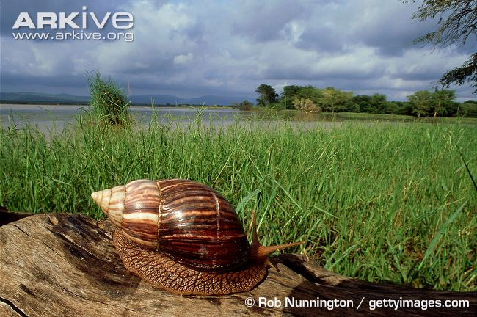
What is an Invasive Species?
A species that is not native to an environment
Invasive species are harmful to the local habitat or native species
Unwanted pest
Notes:
Ask the class: “What is an invasive species?”
A species (plant/animal) that has successfully established itself outside the range it is normally found in. Rabbits (Oryctolagus cuniculus) were introduced to Britain by the Normans in the 12th century and continue to thrive today.
Both invasive and introduced species (also know as alien, exotic, non-native or non-indigenous species) will generally have arrived outside their native distributional range as a result of human activity (either deliberate or accidental). However, whereas ‘introduced species’ is a general term for species that live outside their native range (encompassing those species which may have no negative effect on the environment, those that may be beneficial to the environment and those that have a damaging effect on the ecosystem), the term ‘invasive species’ invariably only applies to species that are considered harmful to the biodiversity of the local habitat or to native species.
Invasive species often outcompete resident species for food and other resources.
Invasive species can also have a direct effect on native species, as in the case of the introduced black rats (Rattus rattus) on islands with nesting seabirds. Rats will predate on eggs and chicks, which can drastically reduce the seabird population.
Many invasive species are also considered pests by farmers. The giant African snail (Achatina fulica) naturally occurs in East Africa but has been introduced to other areas of Africa, Asia and Australia where it feeds on crops, causing a huge amount of damage.
Read more about making the distinction between alien and invasive species: http://blog.arkive.org/2011/07/in-the-news-making-the-distinction-between-alien-and-invasive-species/

Slide 5
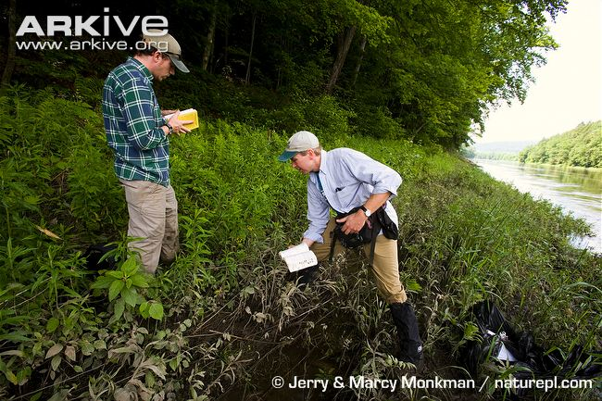
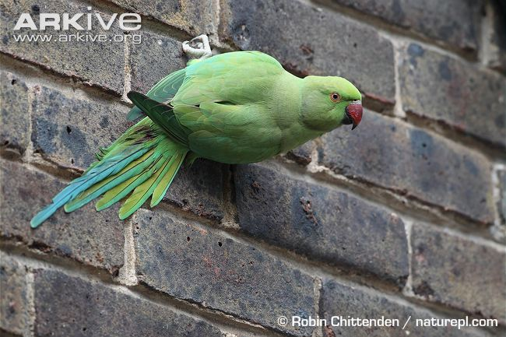
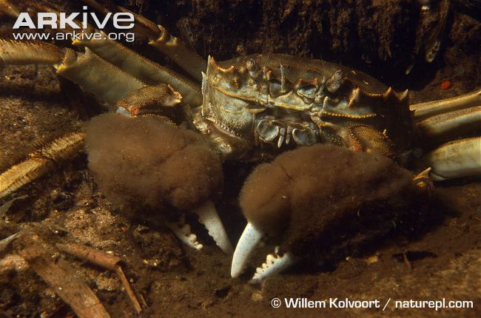
Different Routes of Invasion
Most invasions are due to human activities:
Plant or pet trade
Commercial shipping
Tourism
…and many other routes…
Notes:
In most cases of invasive species, human actions are to blame for their rapid spread.
Seeds that are imported from far away can grow and multiply rapidly in the wild to establish an invasive population. For example, Japanese knotweed (Fallopia japonica) has spread across the UK, outcompeting several native plants for space and light. Similarly, animals that are considered desirable pets often escape and establish feral populations, such as the rose-ringed parakeet (Psittacula krameri) in Richmond Park, London.
Ships move all over the world and have spread rats, mice and many other invasive species to numerous islands, which often has devastating effects on these islands’ biodiversity, and a particularly negative effect on nesting seabirds. Island species are very vulnerable to the threat of invasive species as many islands, such as Australia, New Zealand, Madagascar, the Hawaiian Archipelago, and the Galapagos have a high proportion of endemic and highly specialised flora and fauna which have evolved in isolation over hundreds of thousands of years. In the past, the geographic isolation of these islands has limited immigration of new species, allowing established species to evolve with few strong competitors and predators; however, with the advent of global travel and tourism, the transport of species from all over the world (both accidental and deliberate) has resulted in the introduction of invasive species to ecosystems that are often unable to cope. Islands are more prone to invasion by alien species because of the lack of natural competitors and predators that control populations in their native ecosystems. In New Zealand for example, the introduction of non-native species has caused an irreversible decline in many of the islands’ bird species, such as the kakapo, the world’s only flightless parrot.
Water discharged from ships can potentially transport a huge amount of invasive species. Numerous invasive species are thought to have spread this way, including the zebra mussel (Dreissena polymorpha) and Chinese mitten crab (Eriocheir sinensis).
Seeds of invasive plants can be transported hundreds of miles by cars, on clothes and under shoes. Areas that are visited more often by tourists are more likely to be at risk from the introduction of invasive species.

Slide 6
What Characteristics Make A Good Invader?
Rapid reproduction
Fast growth
High dispersal
Tolerant to many different conditions
Able to live off many different foods
Used by humans
?
?
Notes:
Ask the class: “What sort of characteristics make a species a good invader?”
Species which breed faster are better able to establish viable populations - e.g. rabbits (Oryctolagus cuniculus)
Species that grow faster are generally better able to outcompete others and take advantage of resources – e.g. grey squirrel (Sciurus carolinensis)
Species which are able to disperse seeds over great distances are likely to be better invaders - e.g. Japanese knotweed (Fallopia japonica)
Being naturally able to tolerate a wide range of environmental conditions allows for more invading potential
Not being a fussy eater allows a species to find food from many different sources e.g. black rats (Rattus rattus)
An association with humans is often the cause of a species becoming invasive. Many invasive species were introduced deliberately for food, fur or as biological control - e.g. cane toad (Bufo marinus)

Slide 7
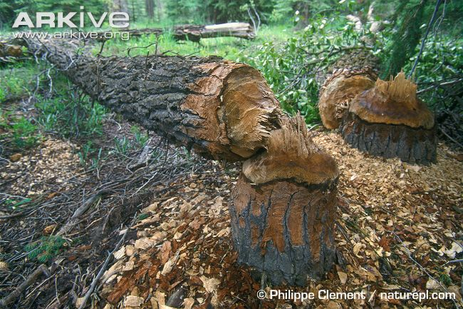
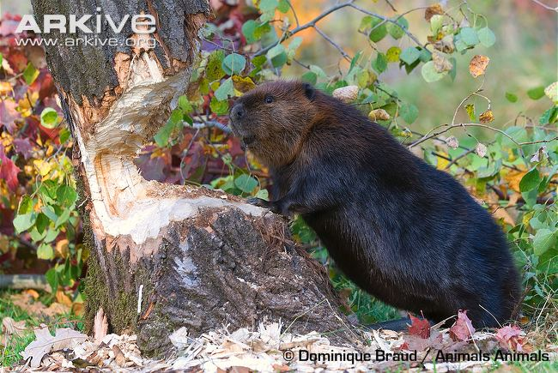
The Impact of Invasive Species
Ecological:
  Reduce native biodiversity
  Predators of local species
  Spread of disease
  Upset balance of local ecosystem
Notes:
Invasive species have a number of different impacts on local habitats and species:
Ecological factors include -
Reduced biodiversity – one invading species can displace a large number of native ones, e.g. Japanese knotweed (Fallopia japonica)
Direct interactions with native species (predation, parasitism, etc.) e.g. black rat (Rattus rattus)
Invasive species can bring diseases with them (an example being squirrel pox) that local species are more vulnerable too.
The complex and often delicate balance of many ecosystems is easily disturbed by invasive species, e.g. American beaver (Castor canadensis) deforesting areas and changing water flow.

Slide 8
The Impact of Invasive Species
Economics:
  Very expensive - cause many billions of dollars of damage every year!
  Very expensive to eradicate (remove) invasive species
Notes:
Economical factors include -
Agriculture is a massive worldwide industry. Invasive species that feed on crops cost nations vast sums of money.
Programmes to eradicate or control invasive species are often costly and are not always successful.

Slide 9
Video
http://www.animalplanet.com/tv-shows/other/videos/killer-aliens-war-on-invasive-species/

Slide 10
Let’s review
What is an invasive species?
How are invasive species introduced to areas?
How are invasive species bad for the ecosystem?
How are invasive species bad for the economy?

Slide 11
Homework
Research one invasive species in New York. Explain why it is considered an invasive species in your own words!
List your source

