Slide 1
Do Now: What is diversity?
ES Unit 4 Lesson 1 11/12/15

Slide 2
Unit 4: Biodiversity and Conservation
2 weeks
Essential Questions:
How does biodiversity create a balanced ecosystem?
How do humans affect biodiversity?

Slide 3
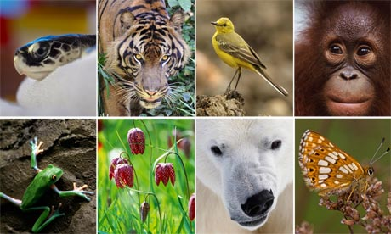
Biodiversity
Biodiversity is the variety of life that occurs within an ecosystem

Slide 4
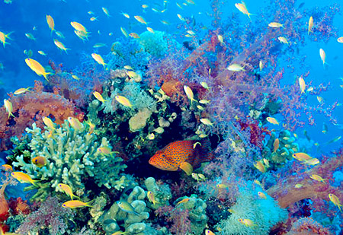

Slide 5
Biodiversity
Four different communities: A, B, C, D
Each type of bean represents a different species
Which community has the greatest biodiversity?
Do NOT mix the beans! Keep each group of beans in from of the appropriate cup

Slide 6
Measuring Biodiversity
Species Richness: The total number of different species present.
Community D had the greatest species richness
DOES NOT tell how number of each species is distributed.

Slide 7
Measuring Biodiversity
Abundance: The number of individuals present of each species relative to the total number of individuals.
# of individuals of a specific species divided by total # of individuals

Slide 8
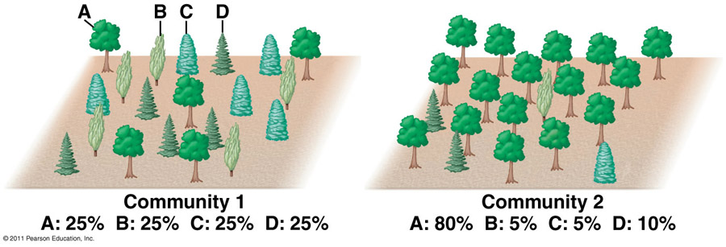
Species Richness vs. Species Abundance

Slide 9
Example: Measuring Abundance
Community A:
10 red kidney beans, 10 white beans, 10 black eye peas
30 individuals total
Abundance= 10/30 = .333
.333 x 100
Each species has an abundance of 33.3%

Slide 10
Your turn!
What is the species richness of ecosystem B?
Ecosystem B | Species abundance
Black-eyed beans
Pinto beans
Red beans
Green beans

Slide 11
Objective
SWBAT evaluate the biodiversity of an ecosystem by calculating species richness and species abundance.

Slide 12
Homework
Find an article online about biodiversity and summarize it in on paragraphs (5-7 sentences).
The paragraph needs to be in your own words!

