Slide 1
SWBAT evaluate methods for conservation. Do Now: Which is the best method of conservation: restoration, rehabilitation or preservation? Why?
ES Unit 4 12/3/15
Lesson 12

Slide 2
Turn and talk
Share out your homework!

Slide 3
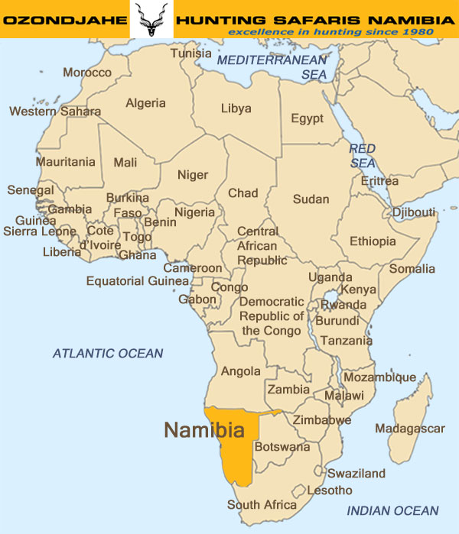
The Rhino Hunter

Slide 4
Homework
Review Sheet
Questions for popcorn discussion

