Slide 1
SWBAT evaluate in situ and ex situ remediation as conservation strategies. Do Now: Explain three ways in which deforestation negatively affects the environment.
ES Unit 4 Lesson 11 12/2/15

Slide 2
Announcements
Unit 4 exam on Monday, Dec. 7th
Review sheet will be due on Friday

Slide 3
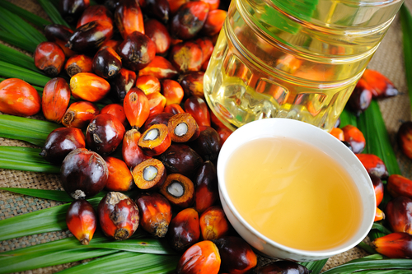
Homework Share
Turn and talk to share out your research on palm oil

Slide 4
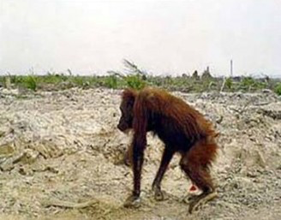
Palm Oil

Slide 5
Palm Oil

Slide 6
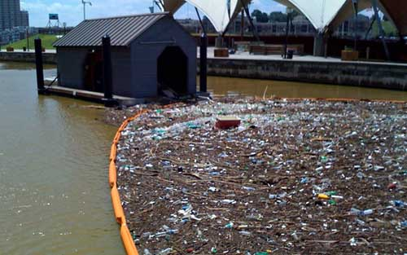
Vocab
Remediation: Reversing or stopping environmental damage

Slide 7
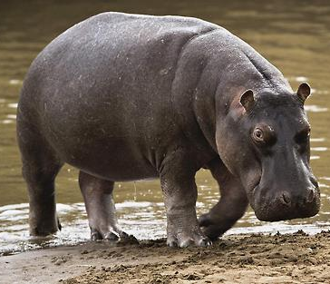
What Causes Extinctions?
Habitat destruction/degradation
Invasive species
Population Growth
Pollution (air, water, etc.)
Overhunting/overharvest

Slide 8
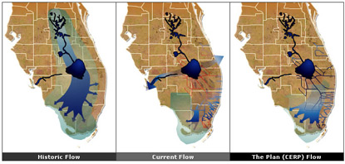
What can we do?
Restoration: Return an ecosystem to a condition similar to its original state
Ex: Florida Everglades

Slide 9
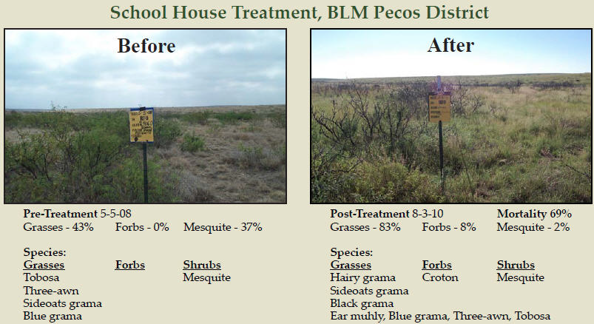
What can we do?
Rehabilitation: Turning a degraded ecosystem back to a functional one

Slide 10
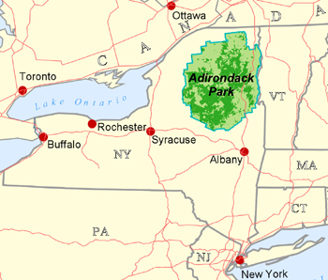
What can we do?
Preservation: setting aside or protecting undisturbed natural areas from harmful human activities.
Ex: Adirondack preserve in NY

Slide 11
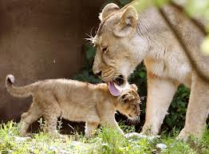
In Situ vs. Ex Situ remediation
In situ: Leave the animal where it lives but protect it
Ex situ: Take the animal out of its habitat and protect it

Slide 12
Minnesota State “Eagle Cam”
http://mnbound.com/live-eagle-cam/
Is the Bald Eagle Cam an example of in situ or ex situ remediation? How do you know?

Slide 13
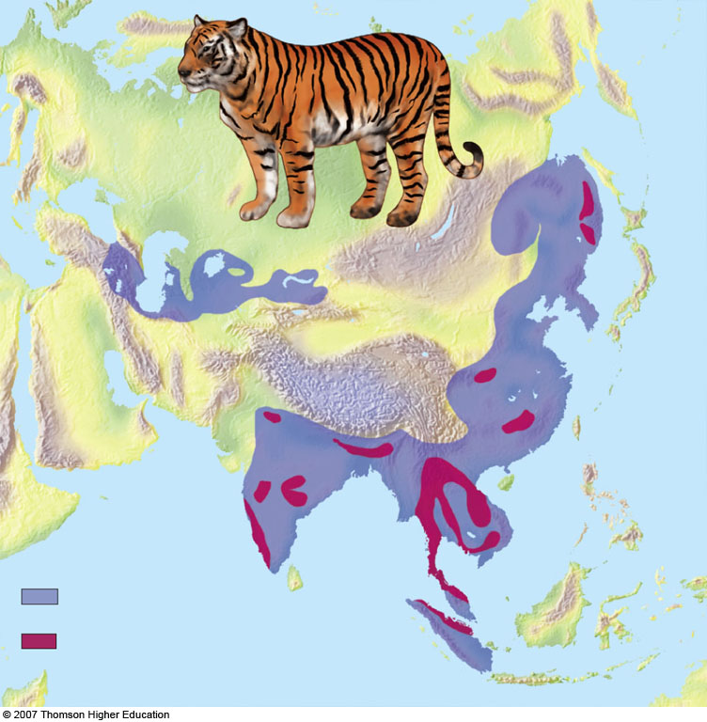
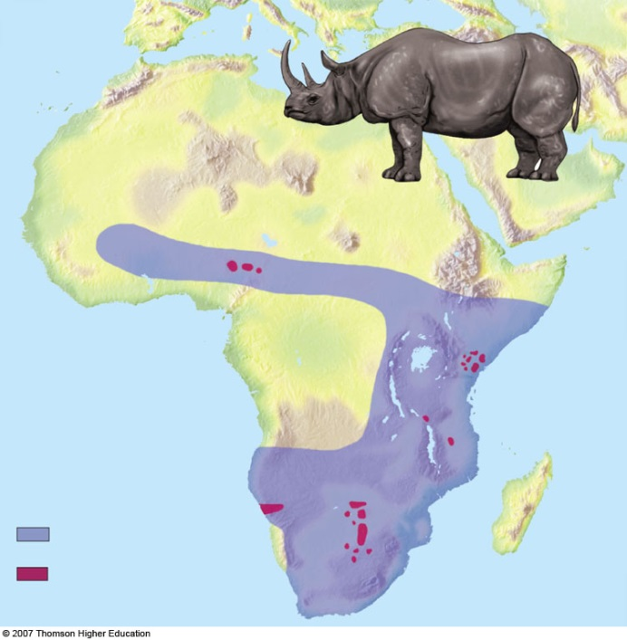
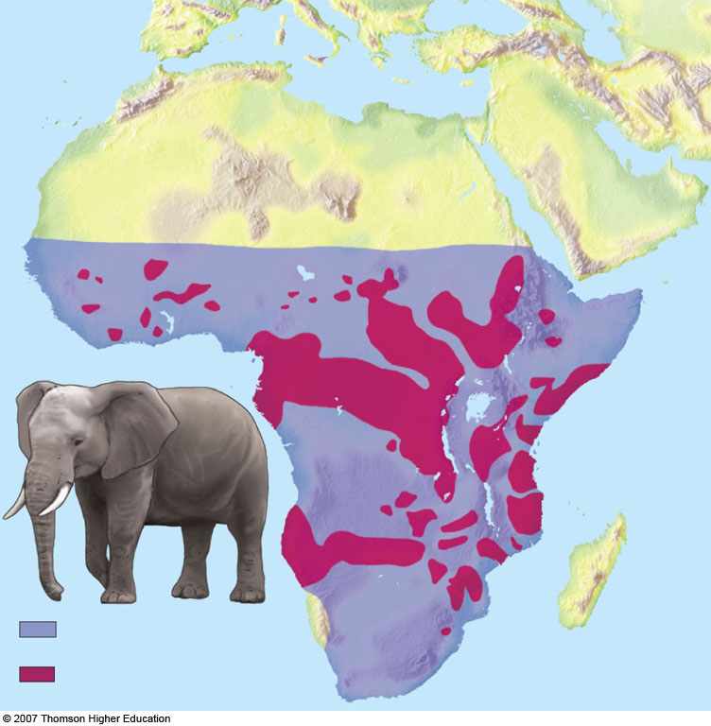

Slide 14
Let’s Review!
What’s the difference between rehabilitation and restoration?
What’s the difference between in situ and ex situ remediation?

Slide 15
Homework:
Research one successful example of in situ or ex situ remediation for an animal. Write a paragraph in YOUR OWN WORDS that describes how it was successful.

