Slide 1
SWBAT identify ways in which humans are negatively impacting biodiversity.
DO Now:
List what you know and want to know about deforestation.
ES Unit 4
Lesson 10
12/1/15

Slide 2
Do Now:
Know Want to Know

Slide 3
Homework Share
Turn and talk to your partner and share what you learned about endangered species that are being poached.

Slide 4
Agenda:
Mini-lecture
Video
Article

Slide 5
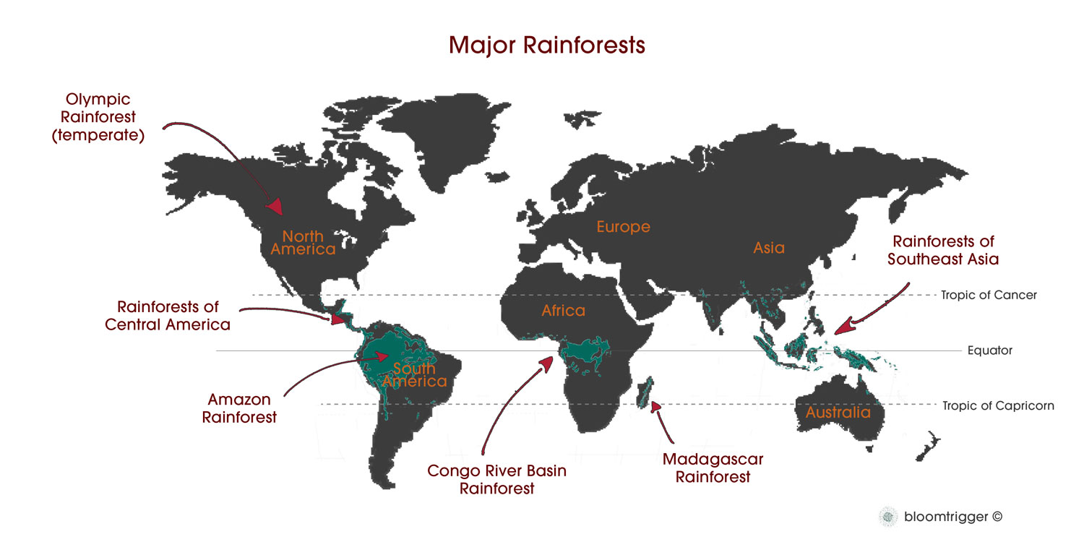
Largest Rainforests

Slide 6
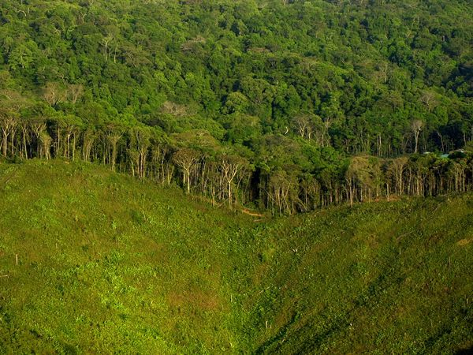
Deforestation
Clearing of earth’s forests on a massive scale
    Often results in damage to the quality of land.

Slide 7
Reasons for Deforestation
Growing crops
Raising livestock
Logging
Creating infrastructure (roads)

Slide 8
Effects of Deforestation
Extinction of plant and animal species due to loss of habitat.
Erosion
  Rain water washes nutrients in the top soil away.
Increase in greenhouse gases(CO₂).
Loss of cultural diversity.

Slide 9
Facts: The Damage
2.4 acres are lost per second (two U.S. football fields)
Brazil has the highest rate of deforestation
Central America has lost 50% of its rainforests.

Slide 10
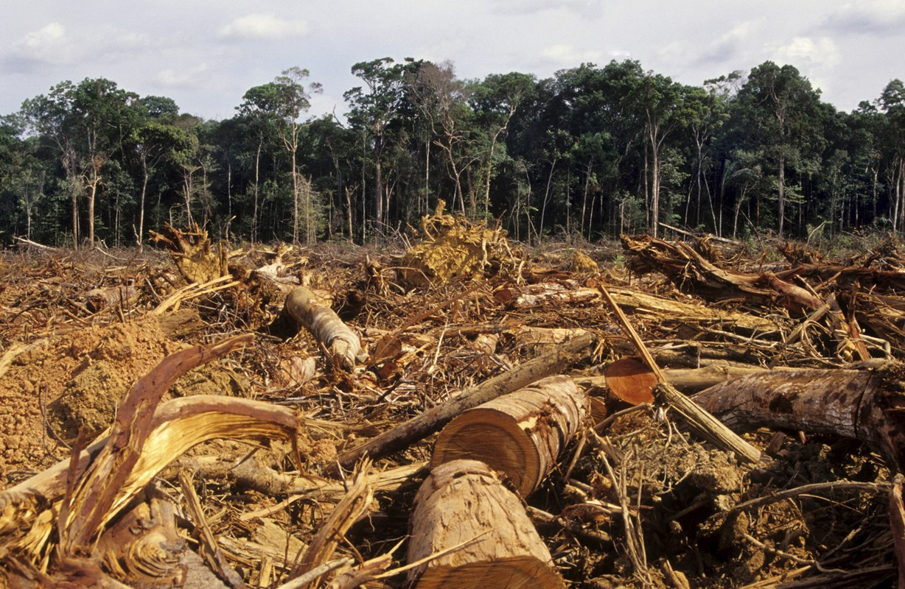
If Deforestation continues....
The world’s rain forests will vanish in 100 years

Slide 11
What can you do?
Plant a tree
Go paperless
Recycle and buy recycled products
Look for Forest Stewardship Council on wood products (FSC)
Eat more vegetarian meals

Slide 12
Discussion Questions
Who do you think is more at fault: large corporations or people who live on the land who cut down wood?
How do you think we could increase awareness of deforestation?

Slide 13
Review
What is the incentive behind deforestation?
What are the negative effects of deforestation?

