Slide 1
SWBAT define carrying capacity in terms of population growth. Do Now: There is a new disease that is killing bamboo plants in China. The Panda population is a suffering as a result. What type of limiting factor is this? How do you know?
Unit 3
Lesson 8
11/2/15

Slide 2
Agenda:
Mini-lecture
Group Work
Pass back quizzes

Slide 3
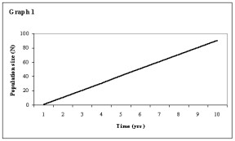
Linear Population Growth
Population increases by the same amount every year.
Slope = 1

Slide 4
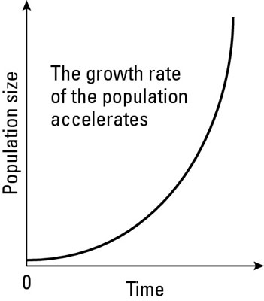
Exponential Population Growth
The population grows by more individuals every year.
J-shaped curve

Slide 5
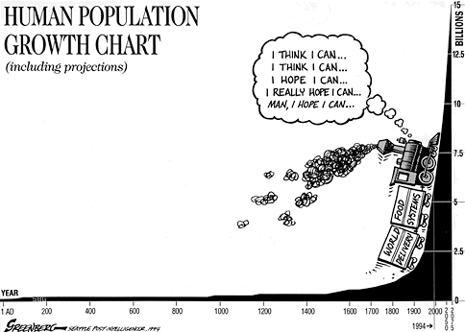
Exponential Population Growth
Rapid growth
There are plenty of resources for all organisms

Slide 6
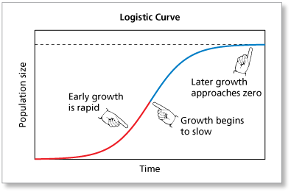
Logistic Population Growth
Occurs when the population becomes too large for the environment to support it.
S-shaped curve

Slide 7
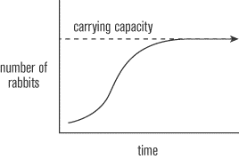
Carrying Capacity
The maximum number of individuals of a given species that an area’s resources can sustain.

Slide 8
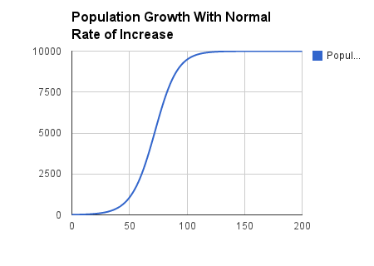
Carrying Capacity

Slide 9
Independent Practice
Ask three before you ask me!

Slide 10
