Slide 1
SWBAt identify the factors that cause a population to change. Do Now: What are some reasons that a population of mice might increase dramatically?
Unit 3
Lesson 8
10/30/15

Slide 2
Turn and Talk
Homework Share Out

Slide 3
Agenda
Mini-lesson
Independent practice
Wrap up

Slide 4
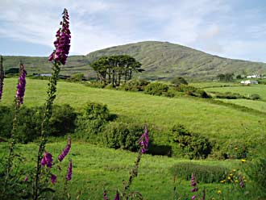
Ecosystem are Dynamic
Ecosystems are changing!

Slide 5
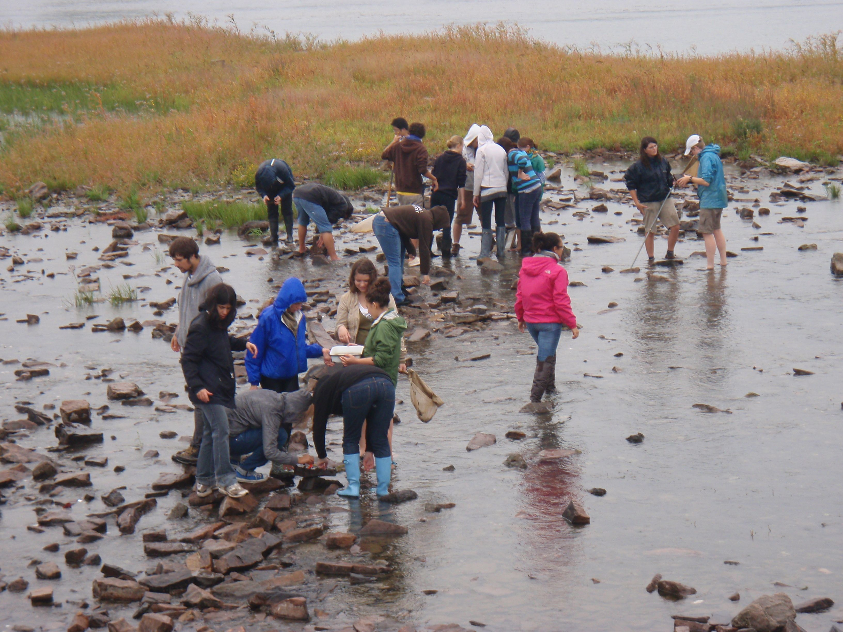
Populations are Dynamic

Slide 6
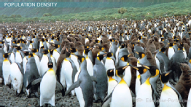
Vocab
Population Density: how many organisms are in a particular area.

Slide 7
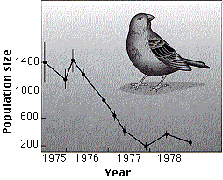
Vocab
Population growth: How the size of a population changes over time.

Slide 8
Population Growth
Birth Rate: number of births in a population
Death rate: number of deaths in a population

Slide 9
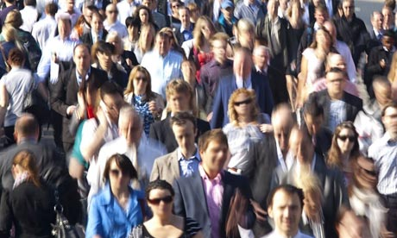
Population Growth
Birth rate > death rate = population increase
Death rate > birth rate = population decrease

Slide 10
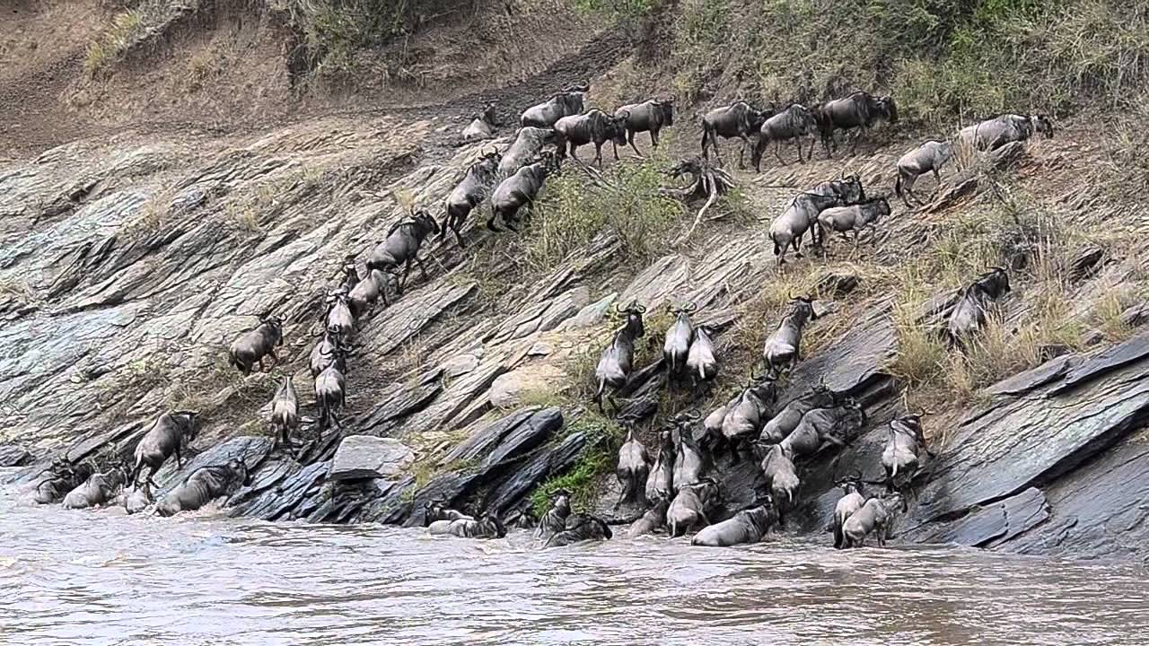
Changes in Populations
Immigration: movement of individuals into a population
Emigration: movement of individuals out of a population

Slide 11
Stop and Think
If a population is decreasing, which would be greater: emigration or immigration?

Slide 12
Population Ecology
A population cannot grow forever
Factors that limit population growth: death, emigration, competition

Slide 13
Population Limiting Factors
Density –Dependent limiting factors: influenced by population density
Density-independent limiting factors: not influenced by population density

Slide 14
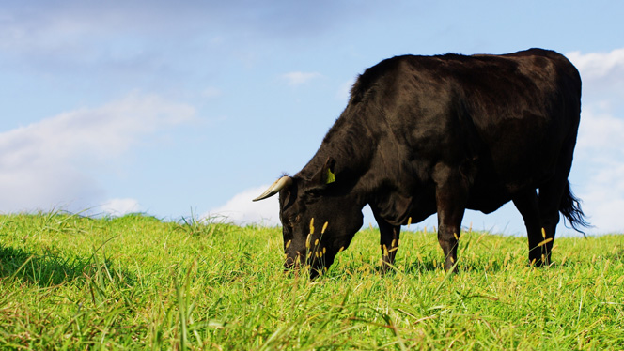
Density-dependent limiting factors
Resources
Food
Shelter
Water
Diseases and parasites
Predation
Competition

Slide 15
Density-Independent limiting Factors
Natural Disasters
Temperature
Sunlight
Human activities
Pollution

Slide 16
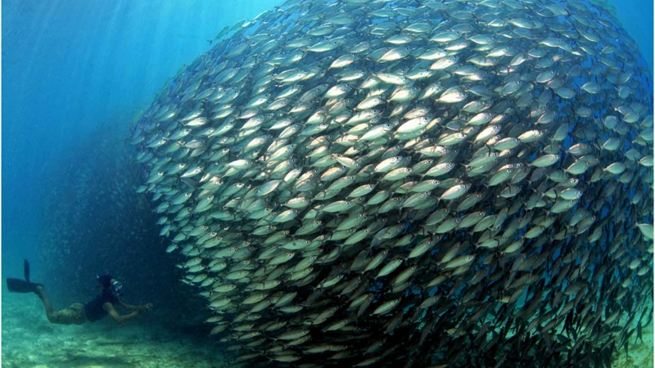
Density Independent vs. Density Dependent

Slide 17
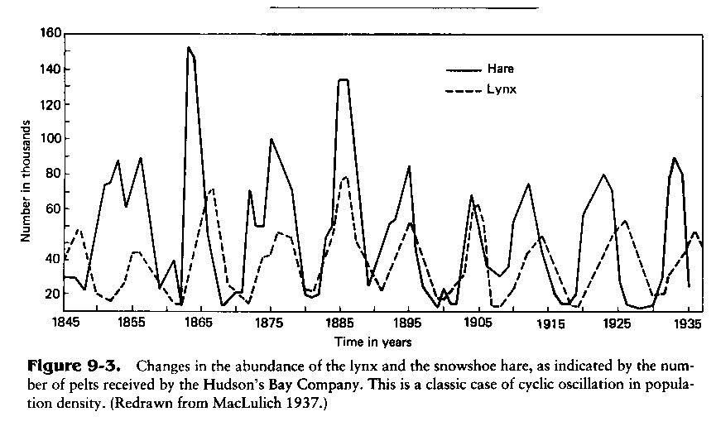

Slide 18
Homework
Find an example of a density dependent limiting factor and a density independent limiting factor that was NOT listed in the independent practice.

