Slide 1
SWBAT relate the competitive exclusion principle to ecological niches. Do Now: How can two species occupy the same habitat but have different ecological niches?
ES Unit 3
Lesson 7
10/29/15

Slide 2
Agenda
Homework Share out
Review
Video
Close reading
Discussion
Reminder: Make-up quiz from yesterday at the beginning of lunch!

Slide 3
Turn and talk
Share out your homework research

Slide 4
Review:
1. What is an ecological niche?
2. What happens when two different species occupy the same niche?
3. What is the competitive exclusion principle?

Slide 5
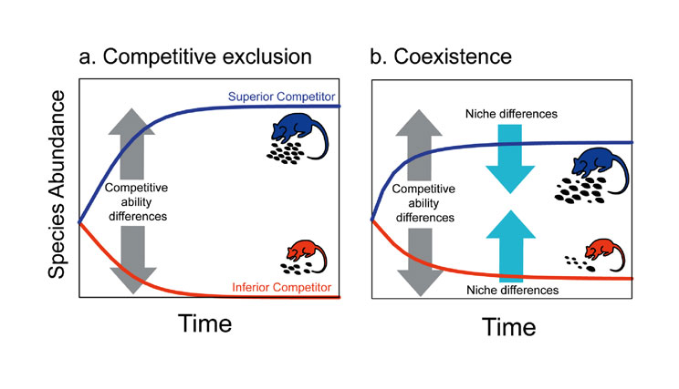
Competitive Exclusion Principle

Slide 6
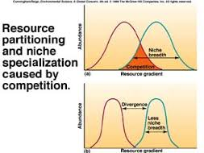
Competitive Exclusion Principle

Slide 8
Video:
How is this video an example of the competitive exclusion principle?

Slide 9
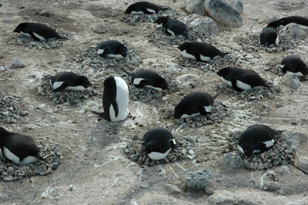
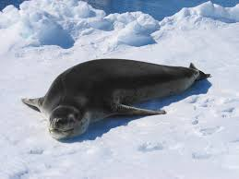
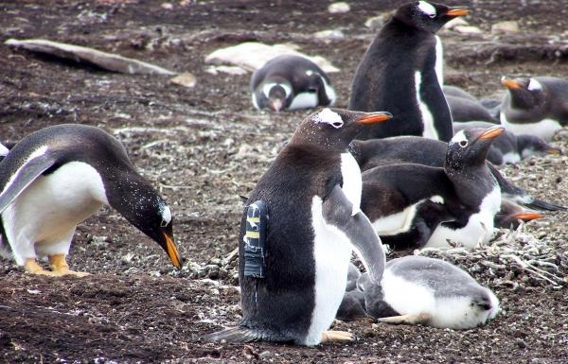

Slide 10
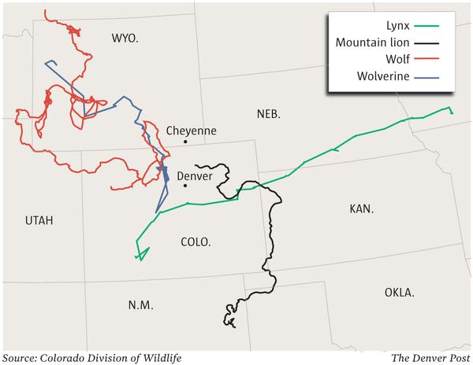
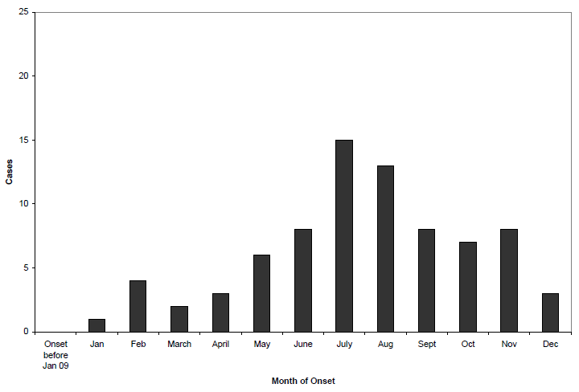

Slide 11
Stop and think:
Does the competitive exclusions principle apply to humans? If so, how?

Slide 12
Homework
Find one example of the competitive exclusion principle in everyday life (i.e. competing brands of lotion, etc.)
Explain how the two products/people/professions cannot coexist.

