Slide 1
Unit 3 10/20/15 Lesson 2 SWBAT distinguish among a species, community, population, and ecosystem. DO Now: Give a definition of a species

Slide 2
Classwork Review
Turn and talk to compare the answers in the table to your partners’ answers

Slide 3
Agenda
Definitions
Reading/Discussion
Exit Ticket

Slide 4
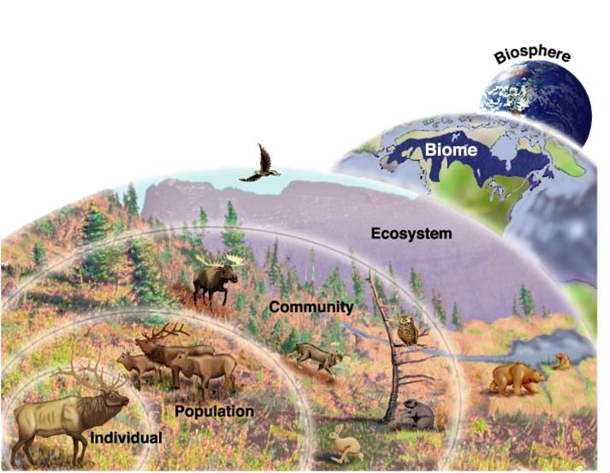

Slide 5
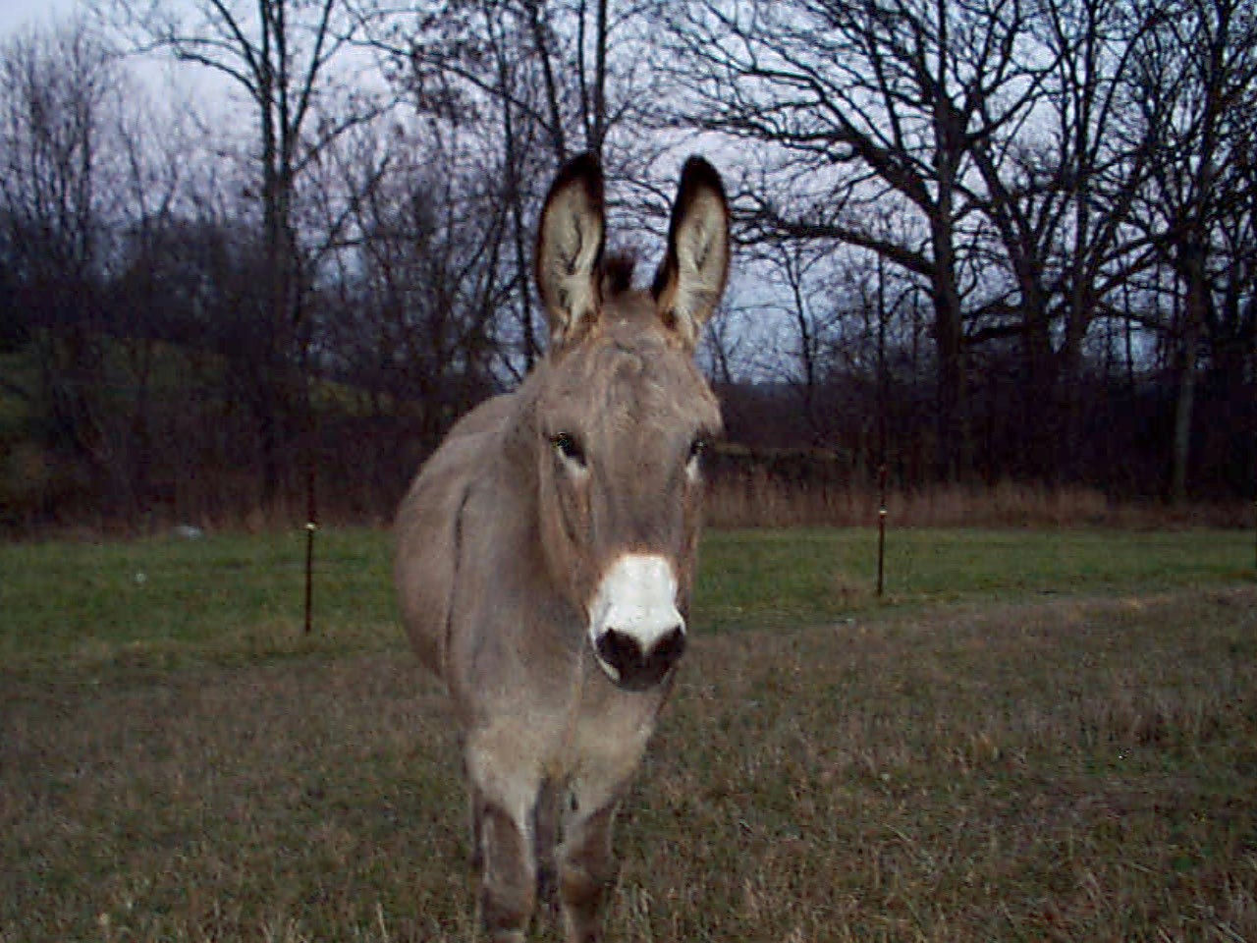
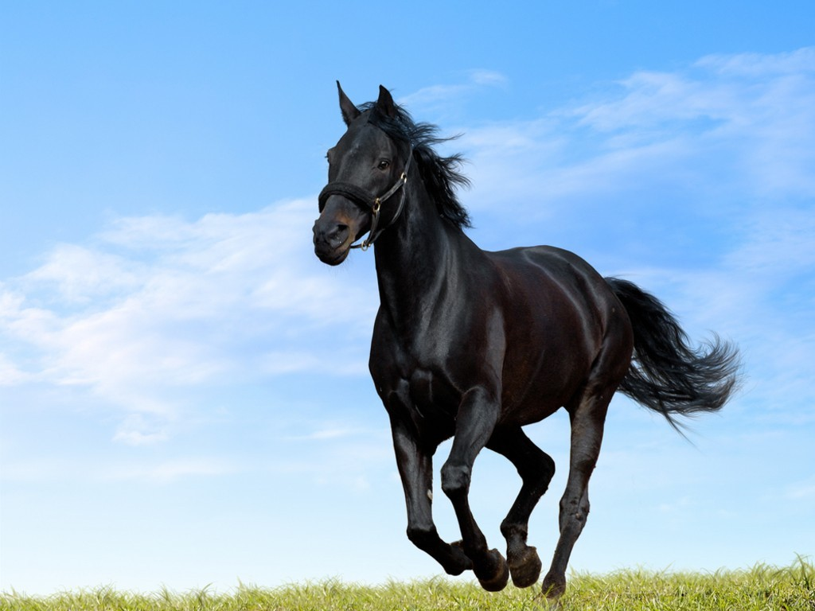
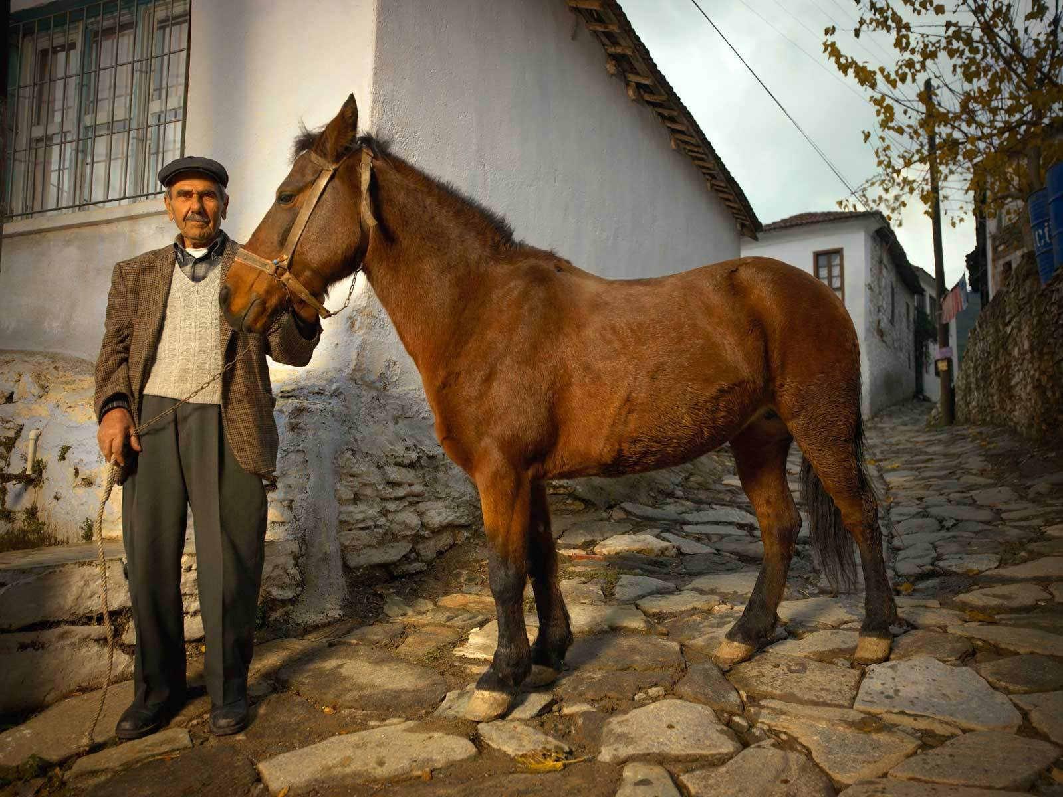
Species
A group of living organisms that can interbreed and produce fertile offspring

Slide 6
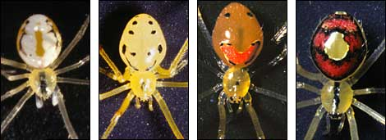
Common Misconception
All species look identical

Slide 7
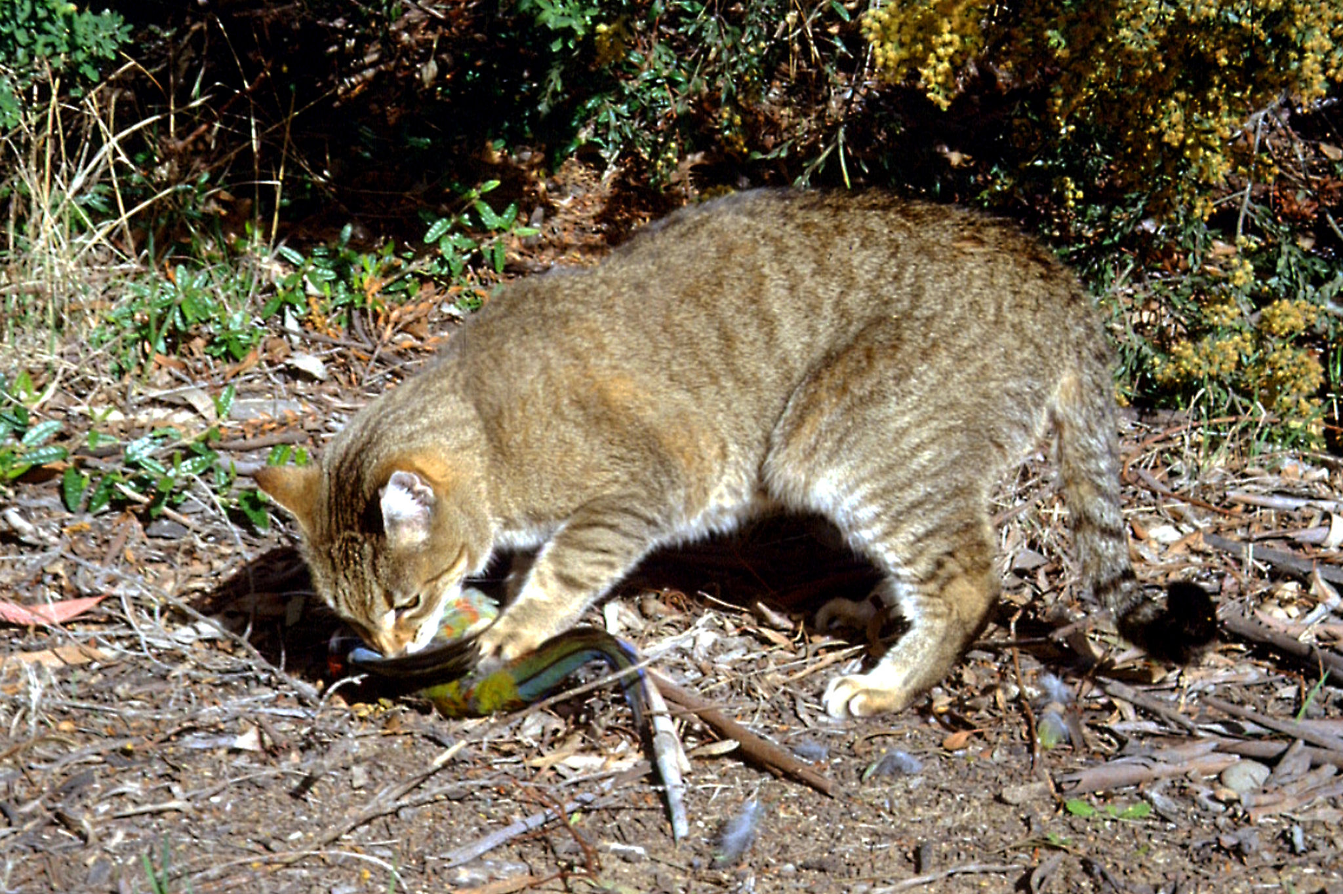
The Living Earth
Abiotic factors: non-living things
Biotic factors: living things

Slide 8
Let’s review!
What term describe all the biotic and abiotic factors in an area?
Which term describe all the organisms in the ecosystem that are the same species?
Which term describes all the interacting populations in an ecosystem?
What is the term for a group of living organisms that can interbreed and produce fertile offspring?

Slide 9
Exit Ticket
There are several gray mice that live in the closet of your apartment. Is this an example of a species, population, community, or ecosystem? Explain.

