Slide 1
SWBAT evaluate the importance of a keystone species in an ecosystem. Do Now: What are the possible outcomes if a keystone species is removed from an ecosystem?
ES Unit 3 10/9/15
Lesson 13

Slide 2
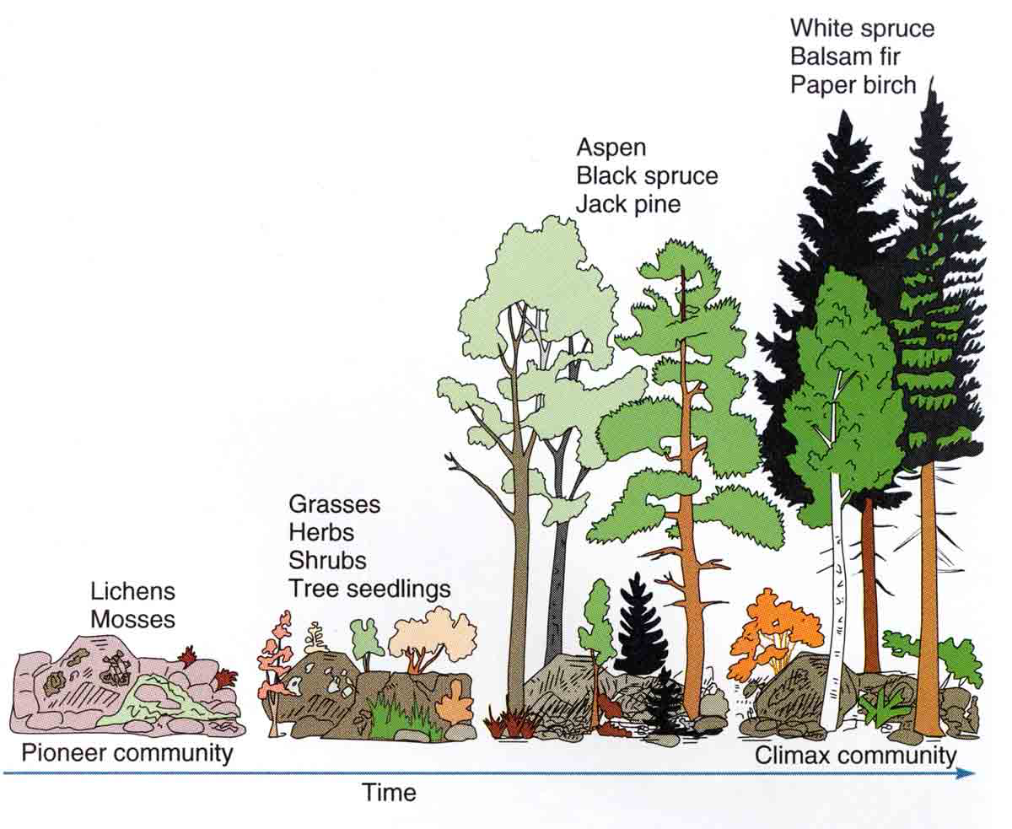

Slide 3
Reminder!!!
Exam tomorrow!
All late work from this unit is due tomorrow!!

Slide 4
Keystone Species Jigsaw
1. Read the same article in your expert group. Compare your answers to the questions.
2. Break off into your jigsaw group and explain your article to your new group
3. Class discussion

Slide 5
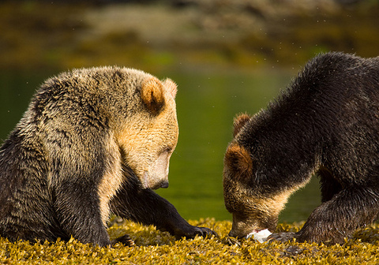
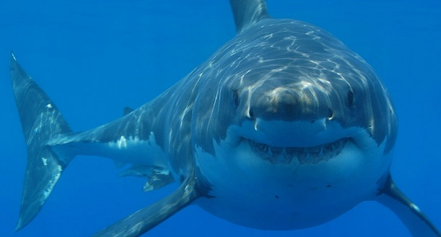
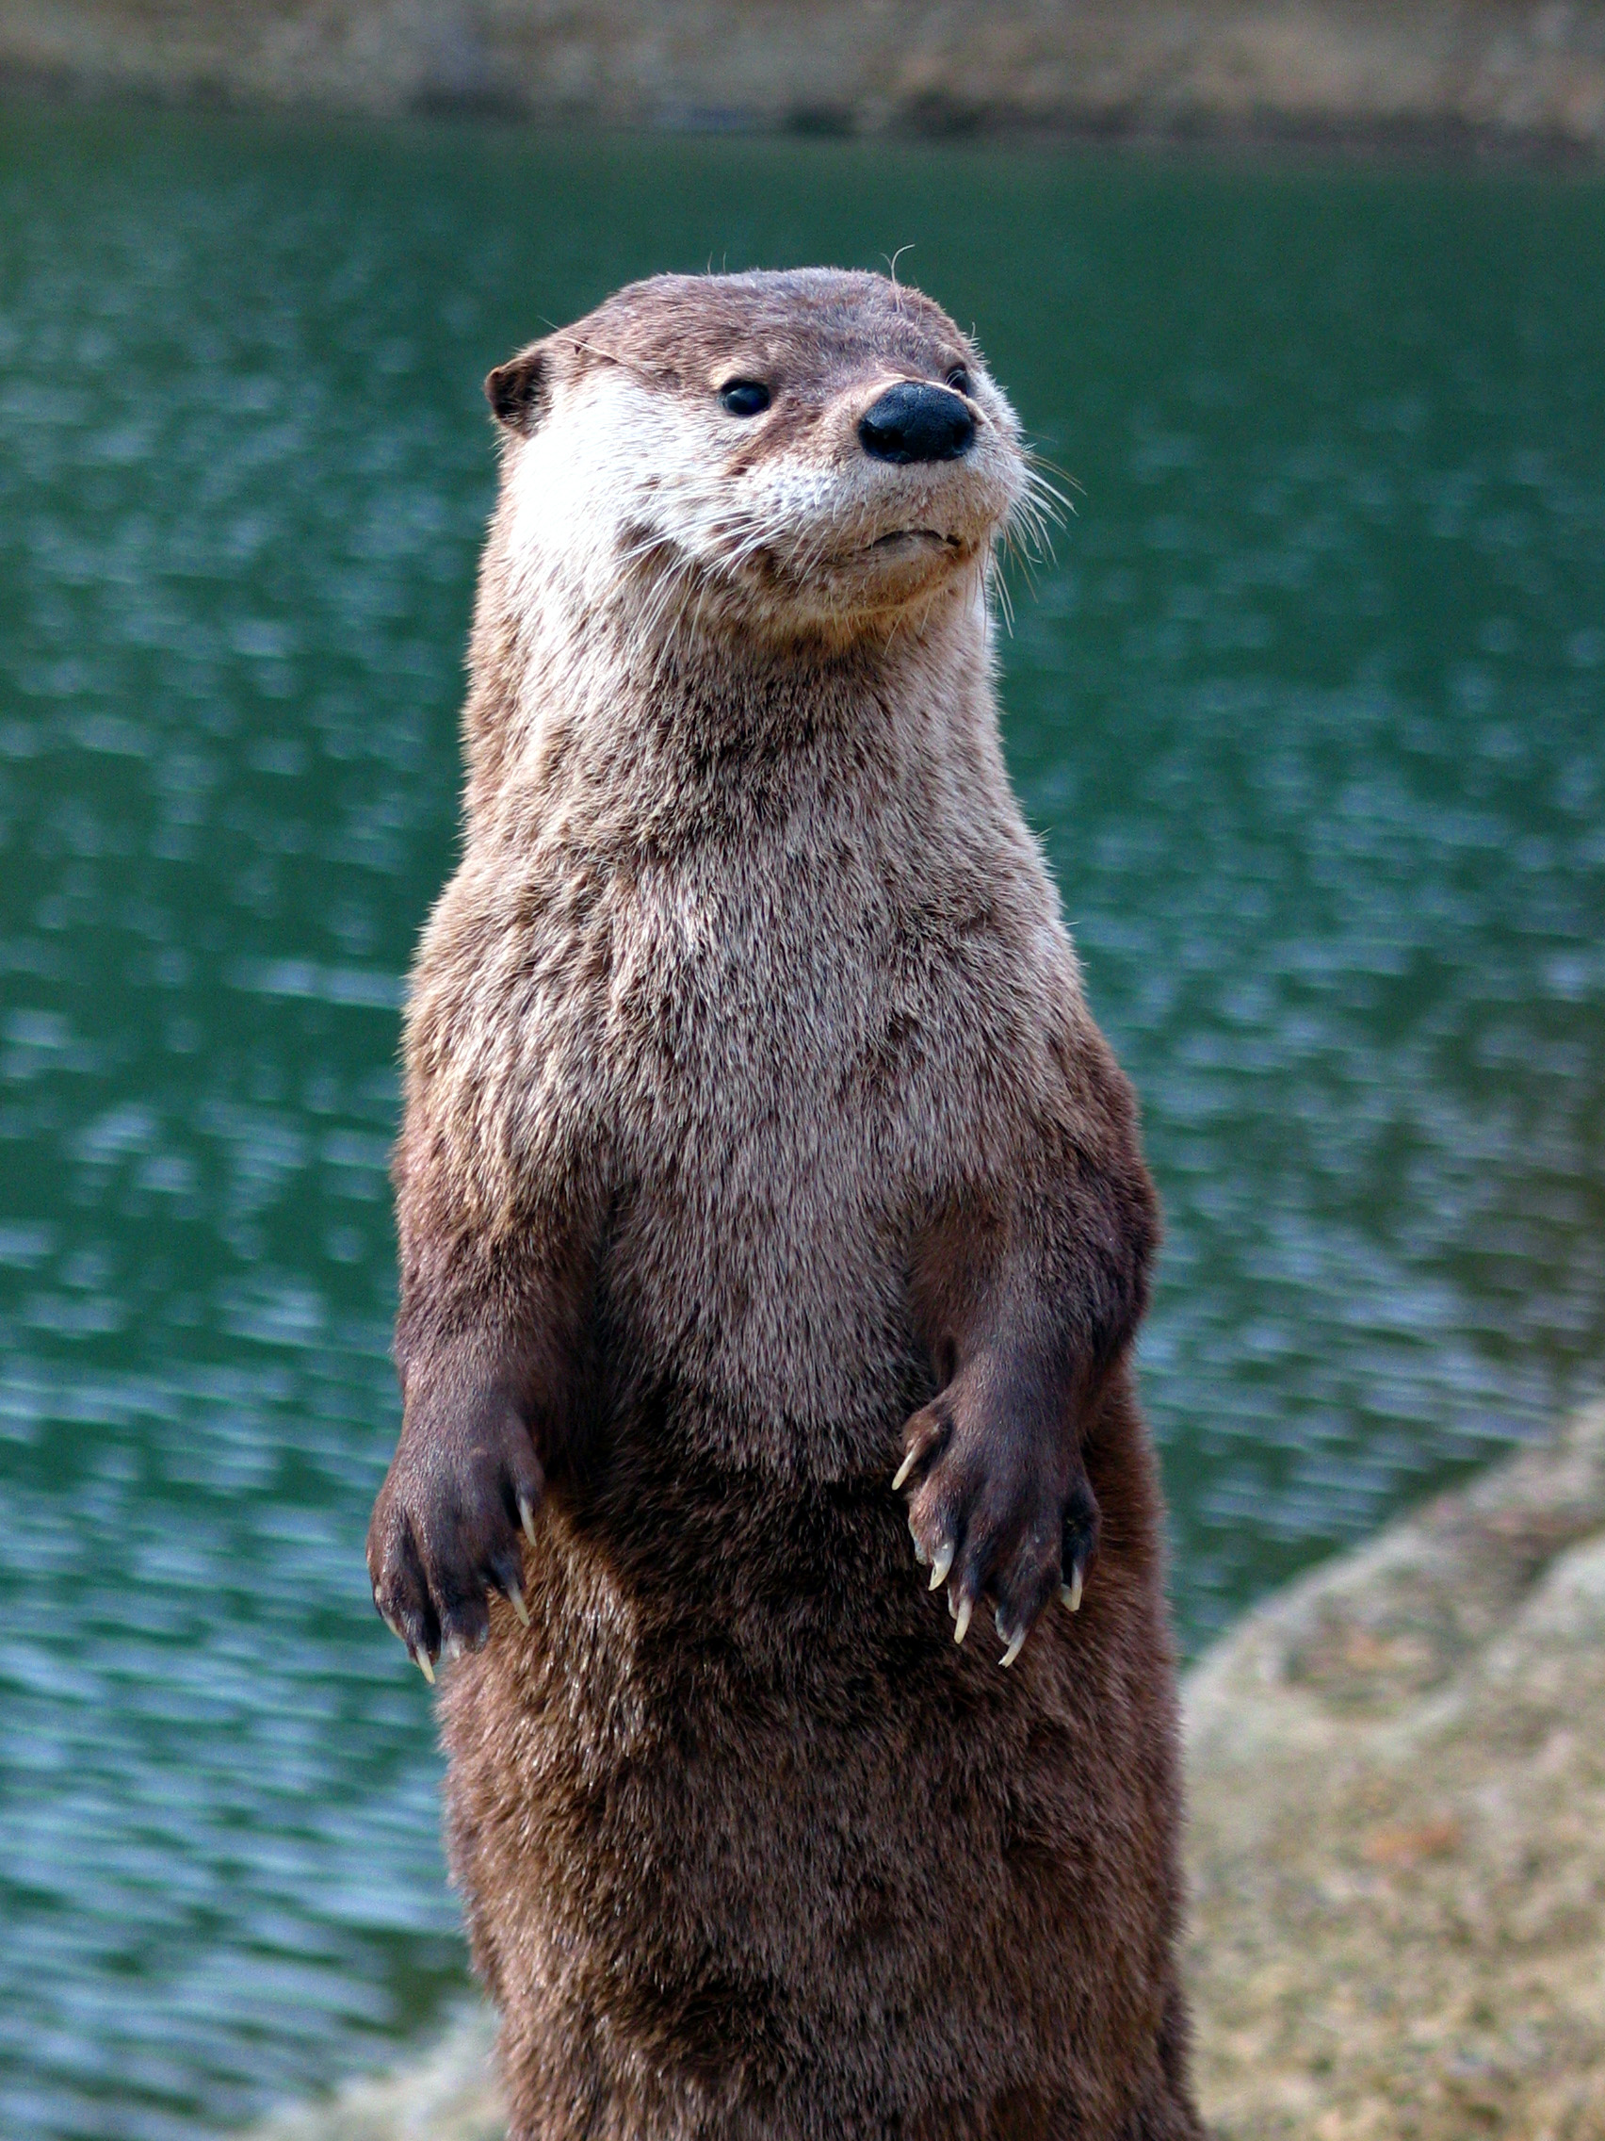

Slide 6
Group Discussion
Which keystone species do you think is the most important? Why?
Do you think humans should focus more on protecting endangered keystones species than other endangered species? Why or why not?

Slide 7
Homework
Study for your exam!

