Slide 1
Unit 3
11/6/15
Lesson 12
SWBAT identify the importance of keystone species in an ecosystem.
Do Now: Why is lichen a pioneer species in primary succession and not in secondary succession?

Slide 2
Agenda
Mini-lecture
Independent Practice
Homework

Slide 3
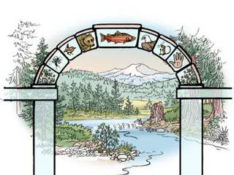
Keystone Species
A plant or animal that plays a unique role in the way an ecosystem functions.

Slide 4
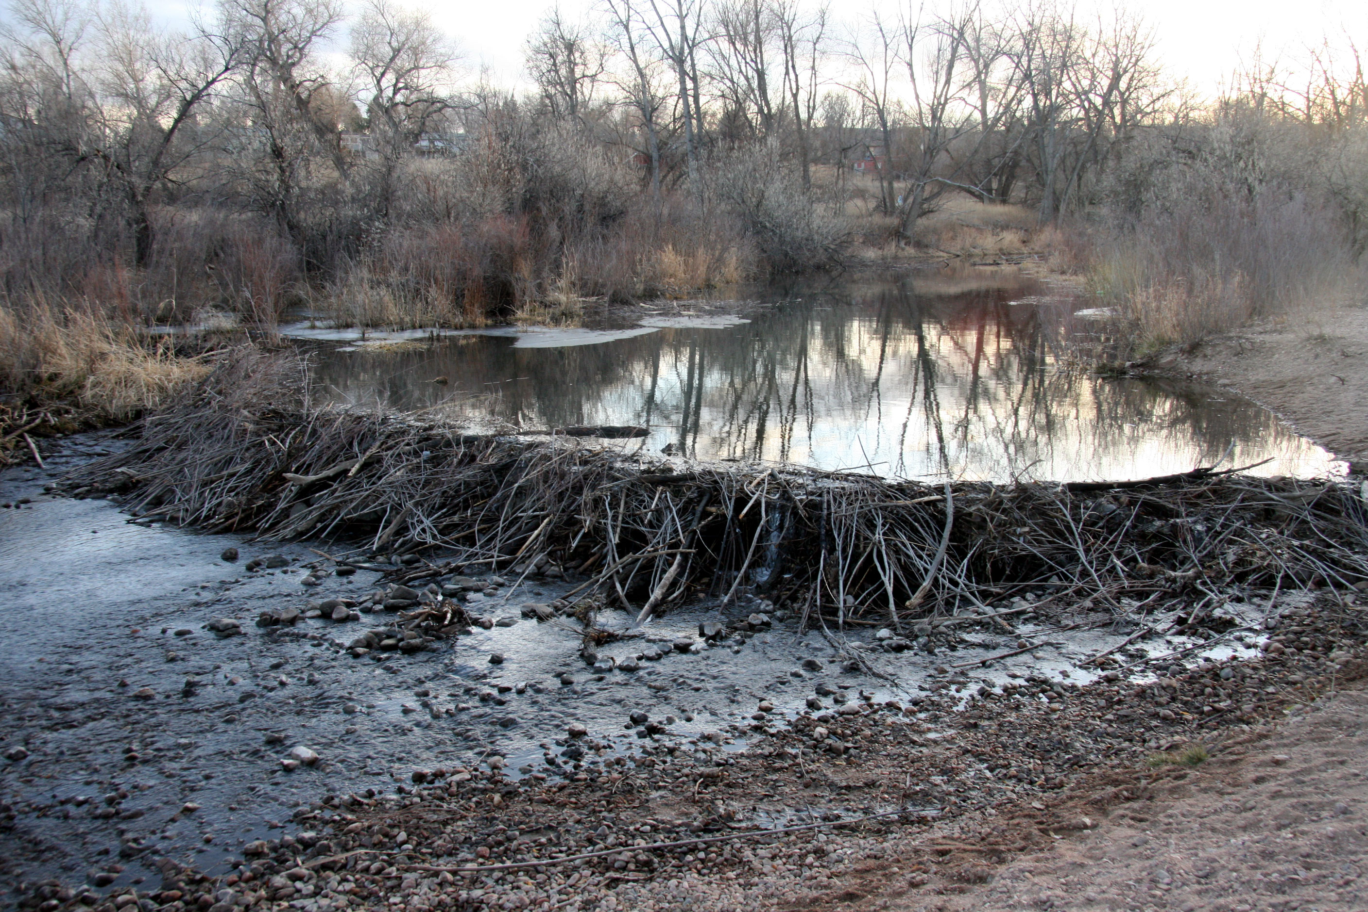
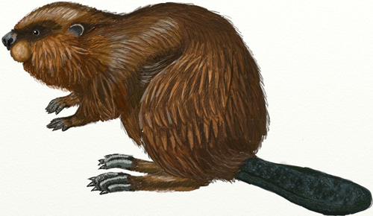
Keystone Species
Without a keystone species , the ecosystem would be dramatically different or cease to exist.

Slide 5
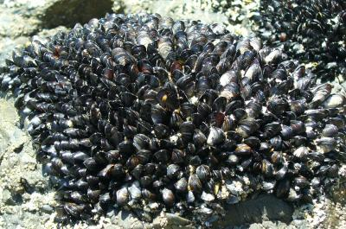
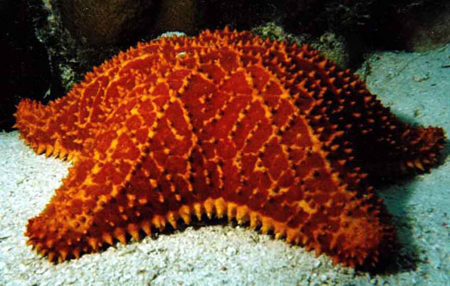
Keystone Species
The absence of a keystone species may cause:
Other species to go extinct
Increase in the population of other species

Slide 6
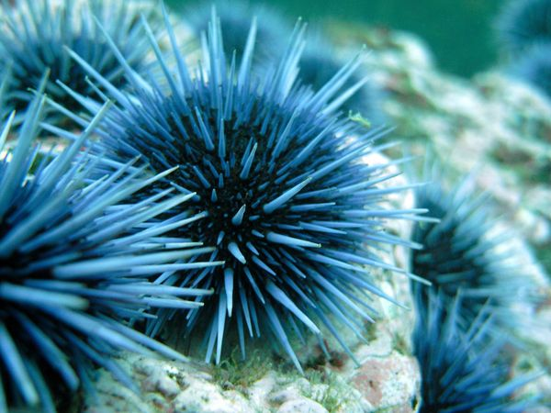
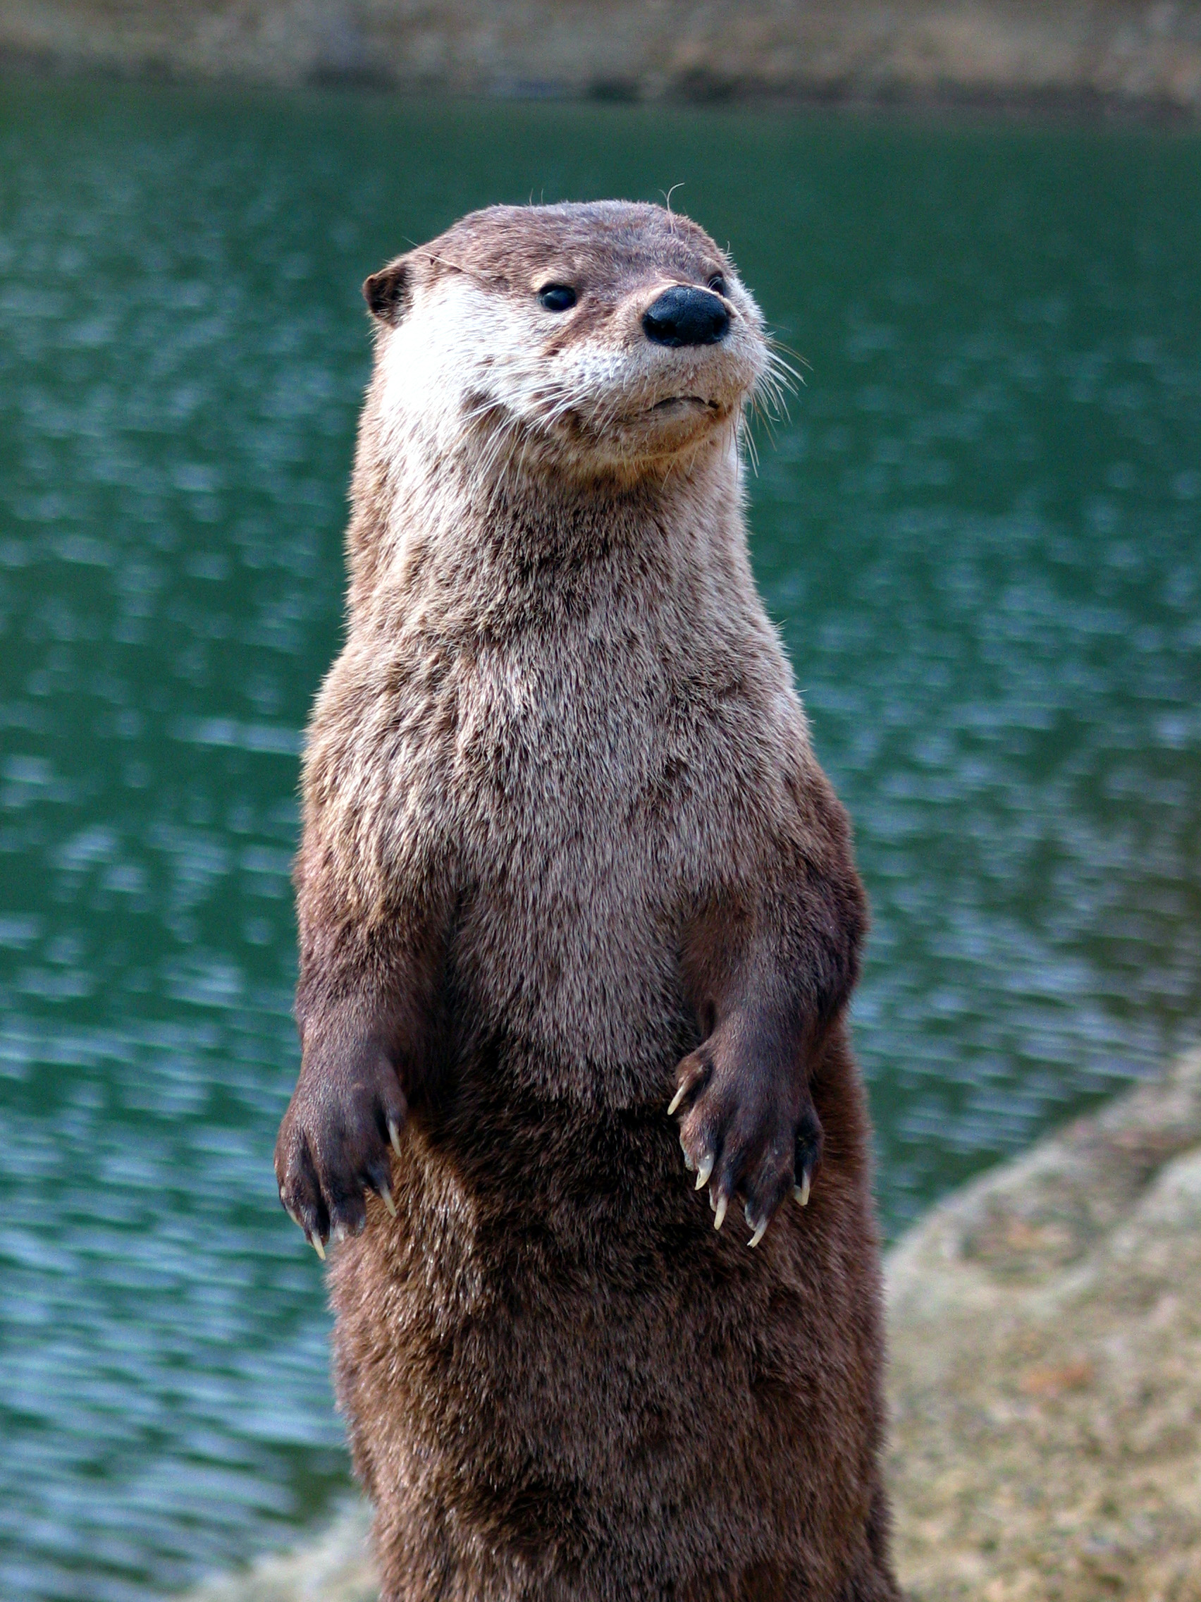
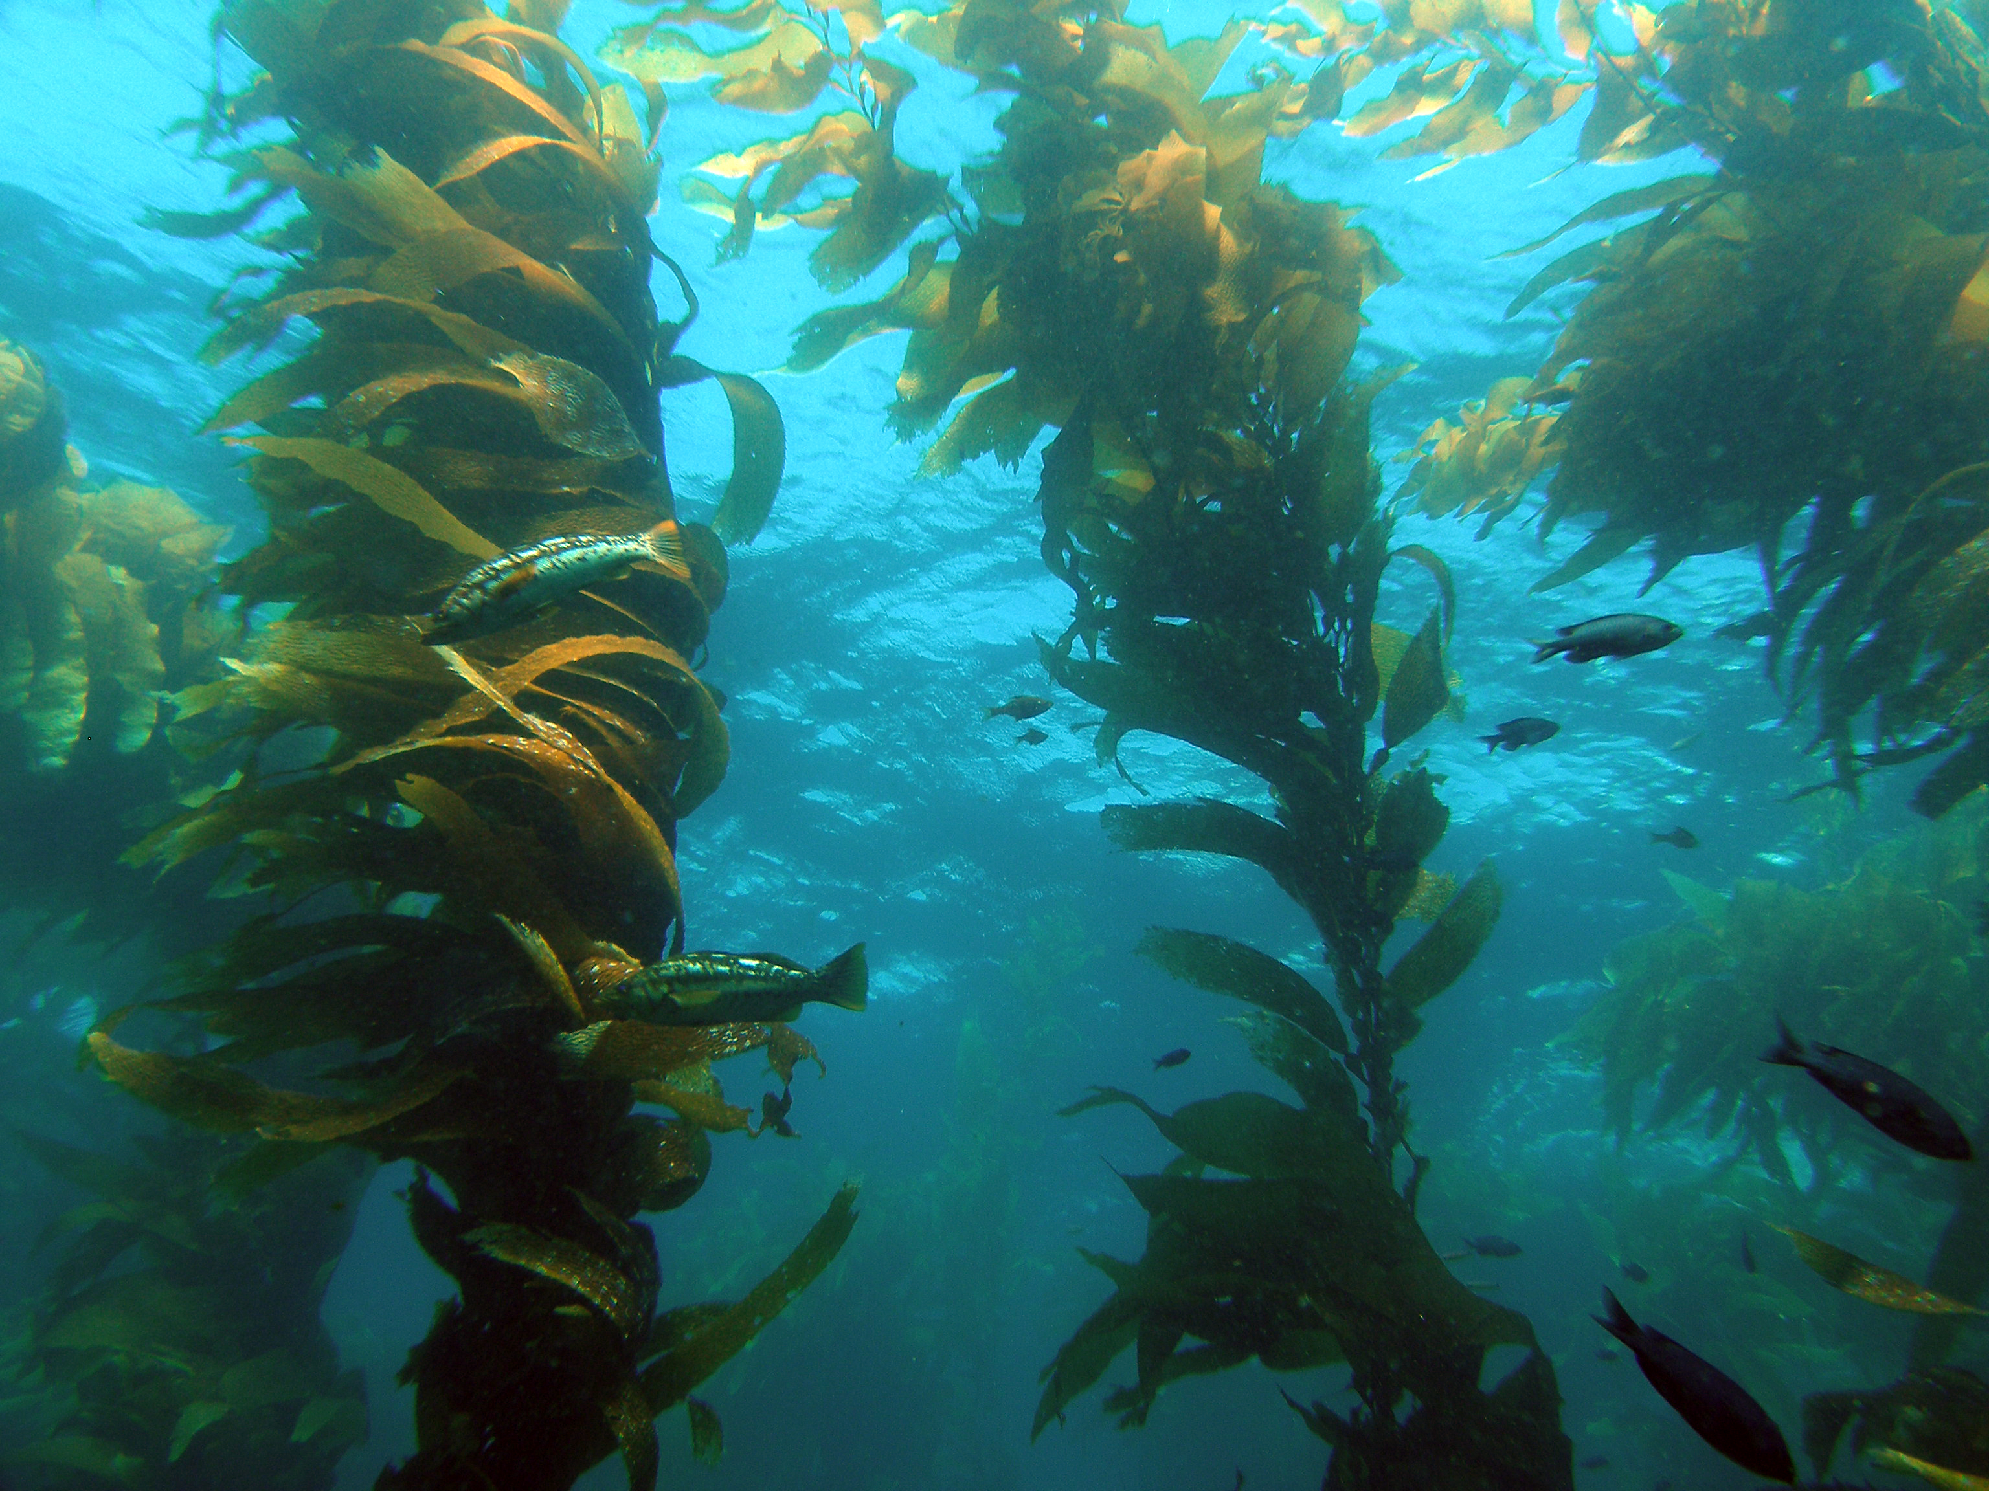
Example: Keystone Species
Sea urchin
Otters
Kelp

Slide 7
Example: Keystone Species
Sea urchin
Otters
Kelp

Slide 8
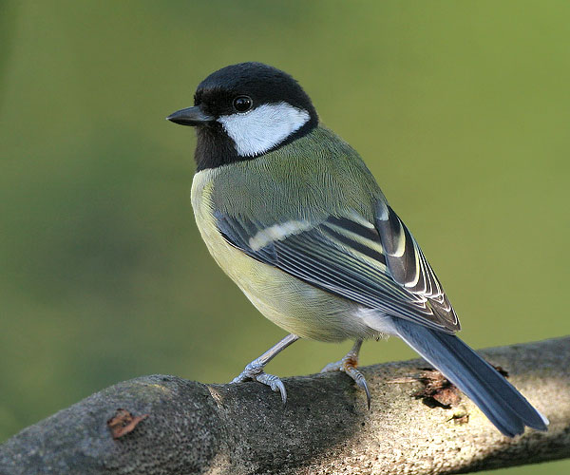
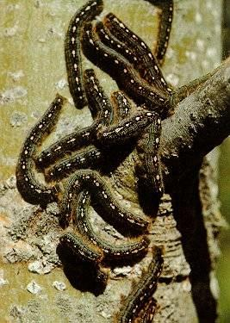
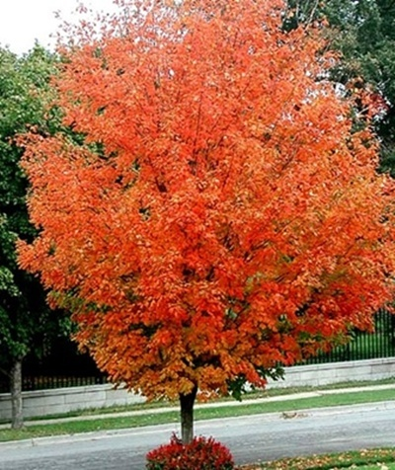
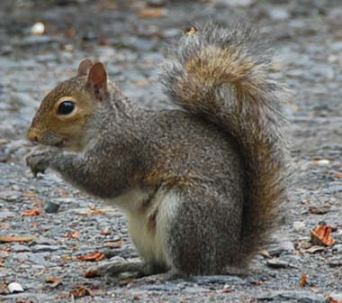
Example: Keystone Species
Sugar Maple

Slide 9
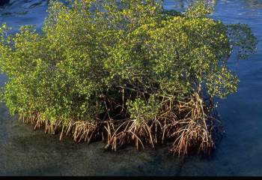
Example: Keystone Species
Red Mangrove
Protects soil from erosion
Provides protection for small fish
Notes:
What would happen if all the red mangroves died off?

Slide 10
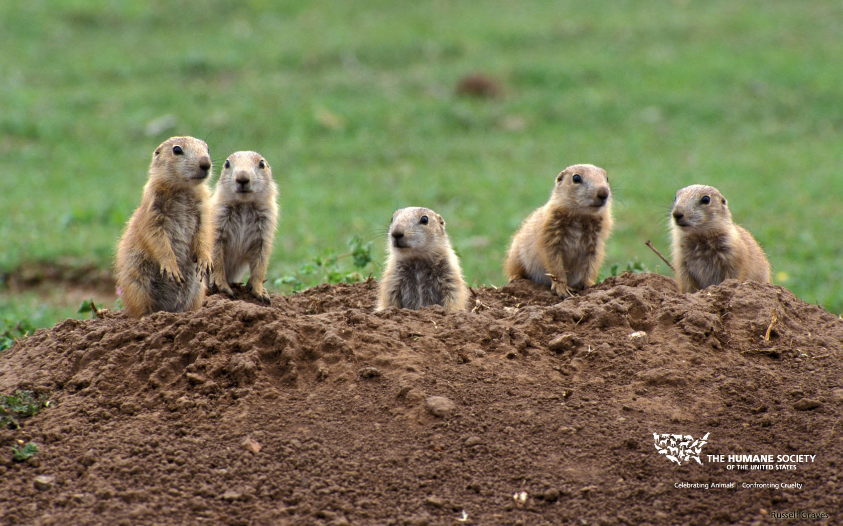
Example: Keystone Species
Prairie Dogs
Tunnel
Helps channel rain water into the water table
Burrow
Mixes different layers of the soil
Aerates the soil

Slide 11
Identifying Keystone Species
What would happen if it was removed?
How many species would be affected?
Write in COMPLETE sentences

Slide 13
Homework
Unit 3 Review sheet– No late review sheets will be accepted!

