Slide 1
SWBAT differentiate between primary and secondary succession. Do Now: Describe three things that can cause change to occur in an ecosystem.
ES Unit 3 11/5/15
Lesson 11

Slide 2
Agenda:
Mini-lecture
Virtual Lab

Slide 3
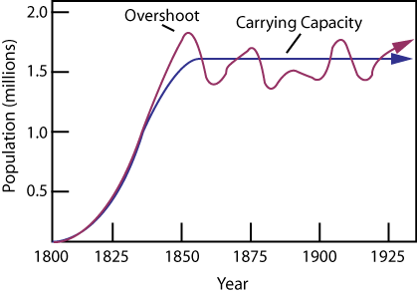
Carrying Capacity Lab

Slide 4
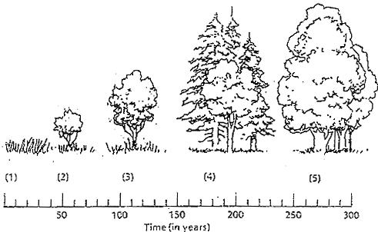
Ecological Succession
The gradual replacement of one plant community by another through natural processes over time

Slide 5
Primary Succession
Begins in a place without any soil
Side of volcanoes
Vacant parking lots
Bare rock
First, Lichens colonize rocks
Break down rock to form soil through weathering
Mosses grow to hold newly formed soil
Mosses and Lichens are pioneer species

Slide 6
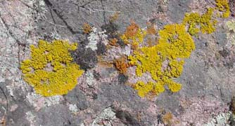
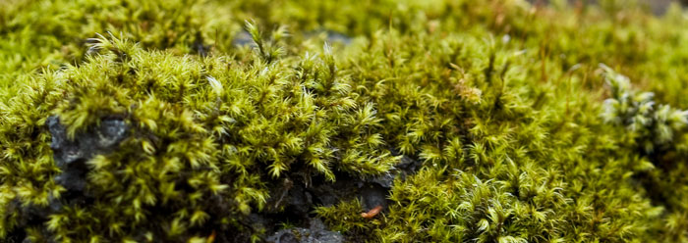
Pioneer Species

Slide 7
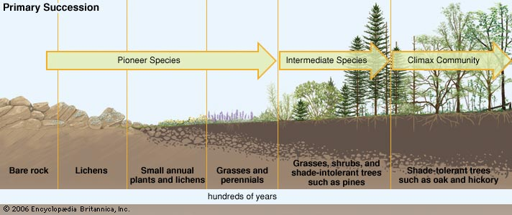
Primary Succession

Slide 8
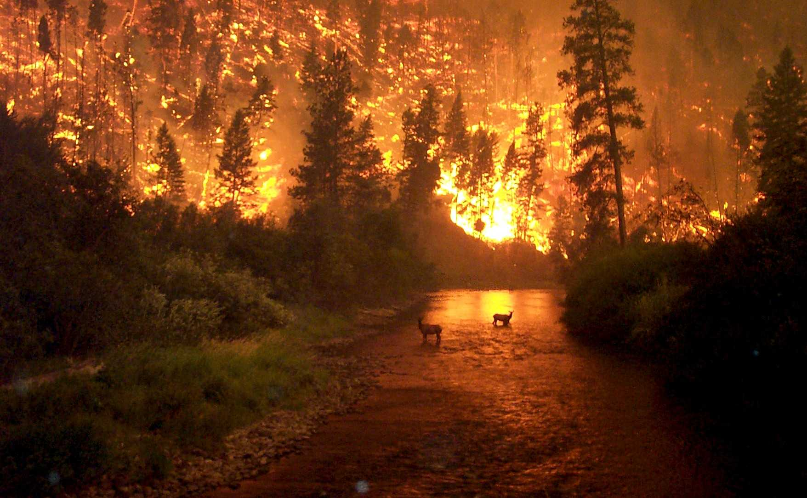
Secondary Succession
Begins in a place that already has soil
forest fires
Tornado
Hurricane
Abandoned agricultural field
Occurs faster than primary succession
Have different pioneer species than primary succession

Slide 9
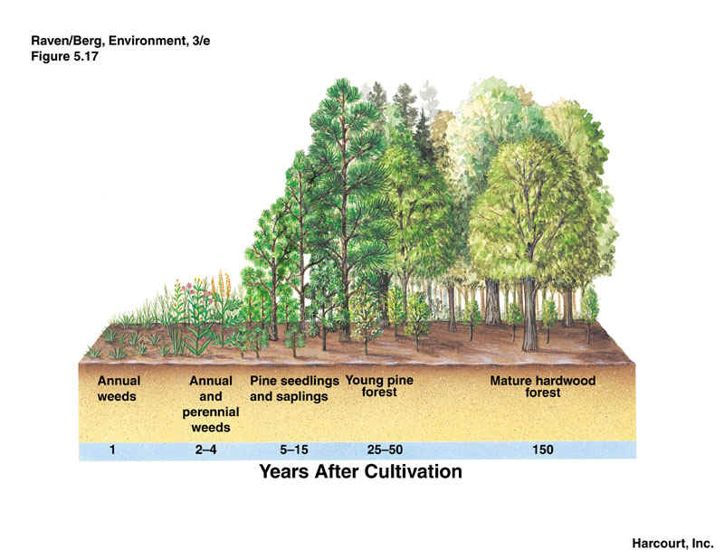

Slide 10
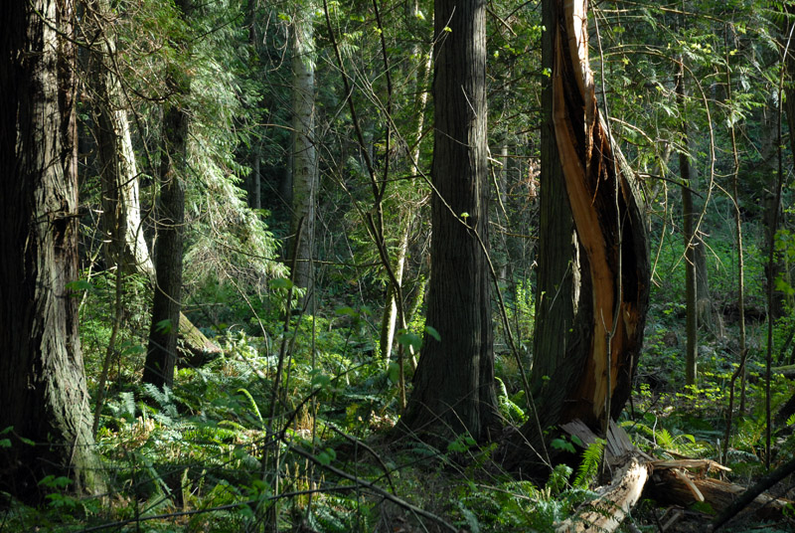
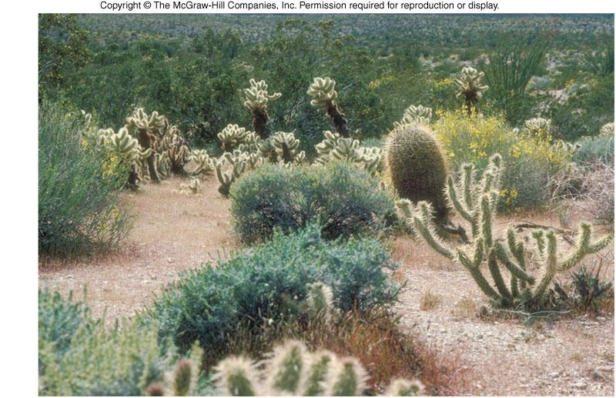
Climax Community
A stable group of plants and animals that is the end result of the succession process
Does not always mean big trees
Grasses in prairies
Cacti in deserts

Slide 11
Ecological Succession Lab
If your computer will not connect to the internet, restart it!

Slide 12
Homework
Find an example of secondary ecological succession in a biome.
List which species are the pioneer species
List which species characterize the climax community
Cite your source!

