Slide 1
Aim: How is carrying capacity represented in nature? Do Now: Once a population reaches carrying capacity, does it always stay at carrying capacity? Why or why not?
Unit 3 11/4/15
Lesson 10

Slide 2
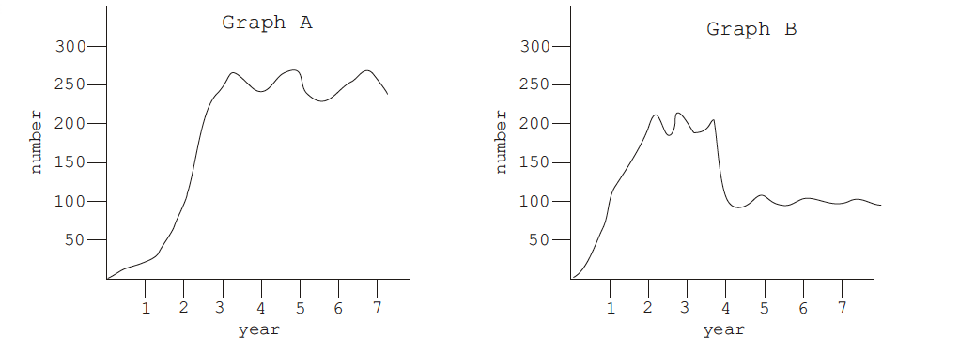
Homework Review
Why might the carrying capacity of a ecosystem suddenly change?

Slide 3
Agenda
Lab
Homework/wrap up
Announcement: Unit 3 Exam on Tuesday Nov. 10th
Exam review will be due on Monday (Quiz grade!) No late reviews will be accepted!

Slide 4
Oh Deer
What are the most essential things that a deer needs to survive?
Roles:
Data Tracker
Deer
Food
Water
Shelter
Remember your number!!

Slide 5
Lab Rules
No running!!
No grabbing/horseplay

