Slide 1
SWBAT perform a close reading to analyze whether the Biosphere 2 should have been built. Do Now: Identify three ways in which the biosphere and the atmosphere are connected.
ES Unit 2 10/5/15
Lesson 9

Slide 2
Agenda
Video
Close Reading
Discussion
Exit Ticket

Slide 3
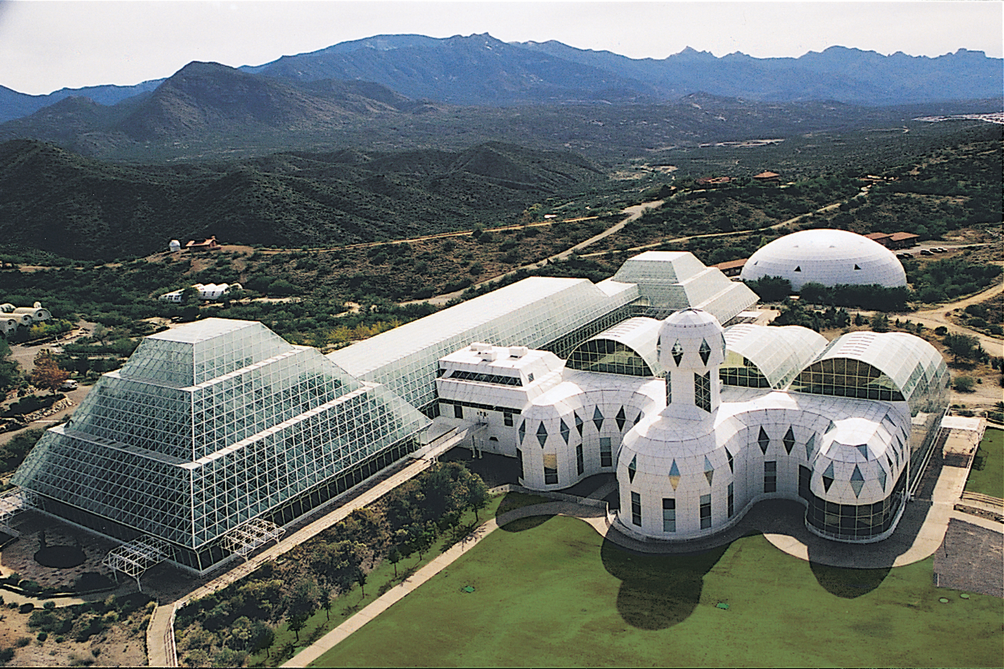
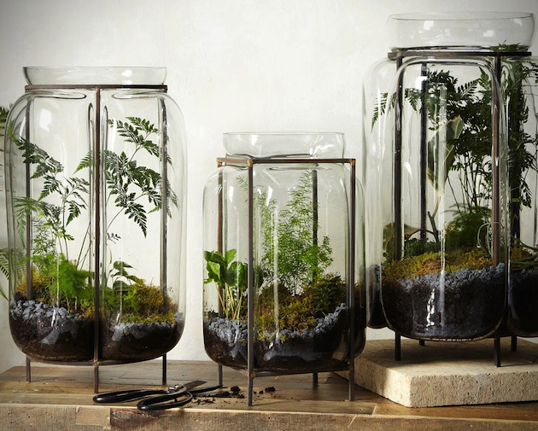
Terrarium
A miniature ecosystem

Slide 4
Video
http://www.nytimes.com/video/booming/100000002268243/biosphere-2-an-american-space-odyssey.html?module=Search&mabReward=relbias%3Ar
What is the biosphere and why was it built?

Slide 5
Annotation System
Bionauts=biospherians
Reading Purpose: Should scientists have built the Biosphere 2?
Environmental Science Annotation System
Underline main idea (MI)
? Questions or clarifying ideas
Box unknown vocab words
T/C Text to class connection with summary in margin.

Slide 6
Homework
Complete outline for the biosphere reading
Bring in black and white newspaper for compost!

Slide 7
Exit Ticket:
What do you think is the most important piece of evidence from the article that argues in favor of building the Biosphere 2? Why?

