Slide 1
ES Unit 2 Lesson 8 10/2/15
SWBAT identify how the biosphere interacts with the lithosphere and atmosphere.
Do Now: Explain why the worms won’t leave the compost bin even though there are holes.

Slide 2
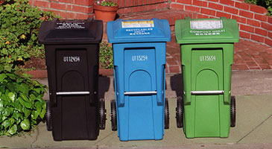
Compost Article:
Do you think composting in houses should be voluntary or mandated? Why?
Do you think people would separate organic food from trash and recycling? Why or why not?

Slide 3
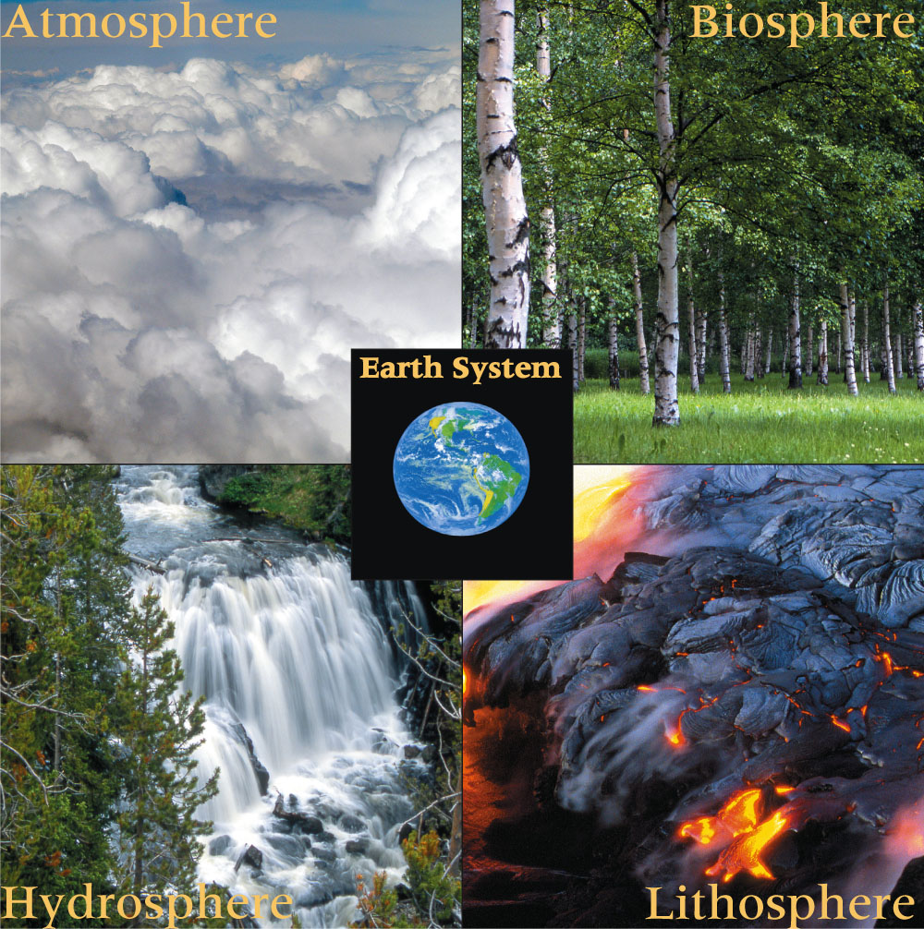
The Four Spheres
How do earth’s systems interact?
Biosphere, Lithosphere, Atmosphere, Hydrosphere (BLAH)

Slide 4
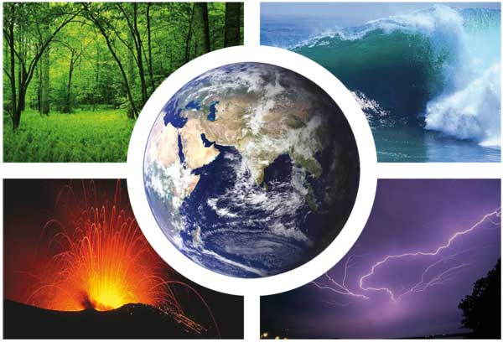
The Biosphere
The Biosphere includes all living organisms on the planet.
Notes:
This also includes organisms that are dead and decomposing

Slide 5
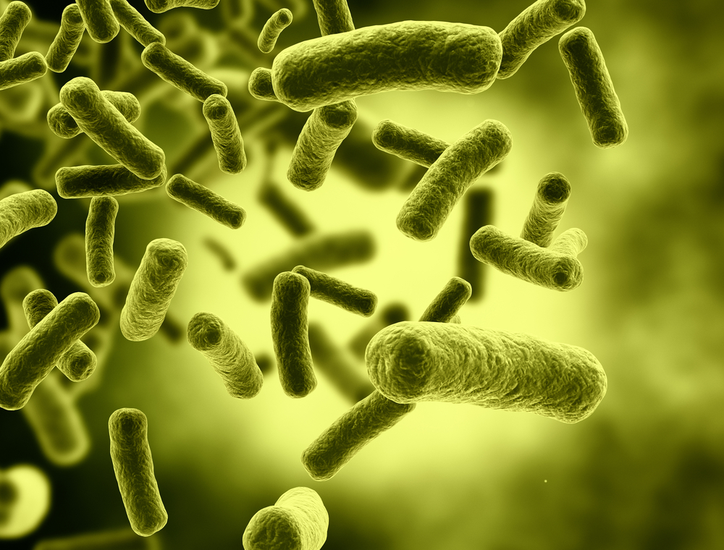
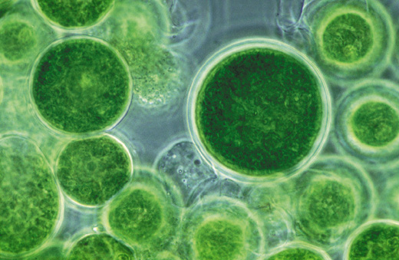
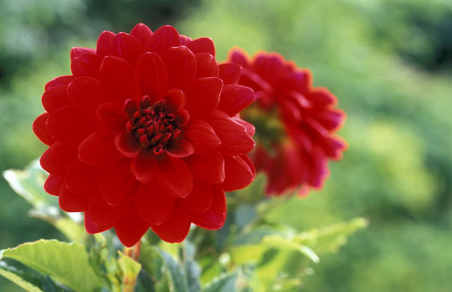
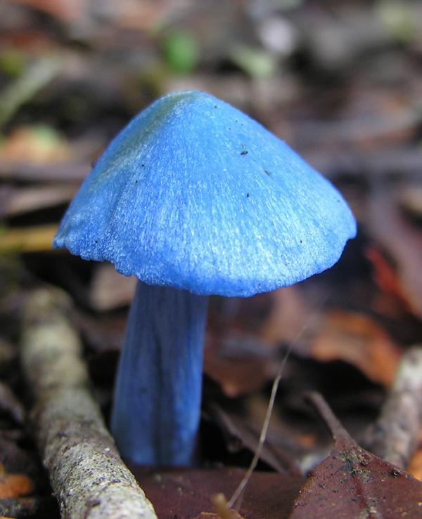
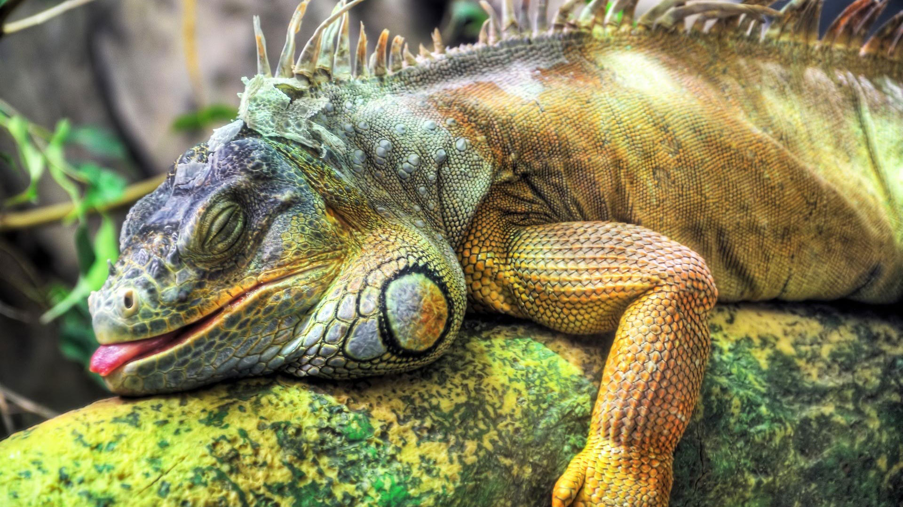
The Biosphere
Bacteria
Fungi
Protists
Plants
Animals

Slide 6
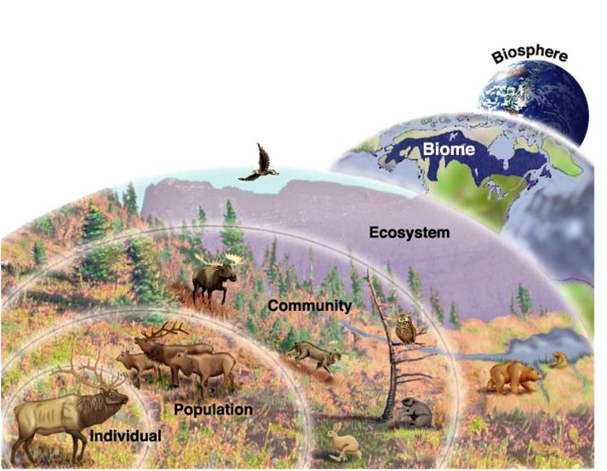
Biomes
The Biosphere is classified into different Biomes.
Organized by similar vegetation, geographic location, and climate.

Slide 7
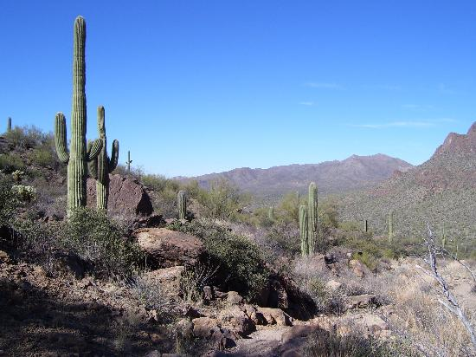
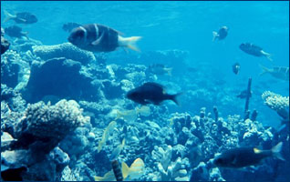
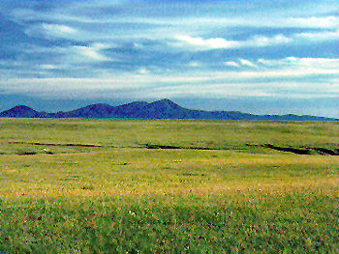
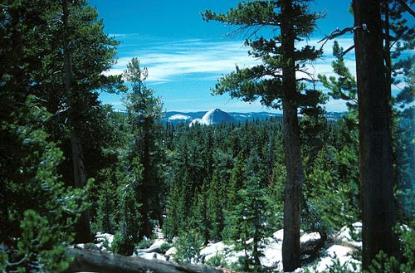
Biomes
Desert
Aquatic
Plains
Forest
Tundra

Slide 8
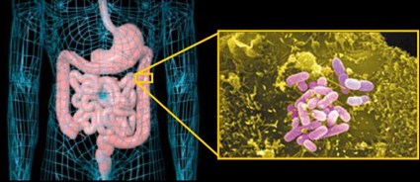
Interactions among organisms
Plants provide O₂ for animals
Bacteria living in the stomach of humans
Cow feces fertilizing grass

Slide 9
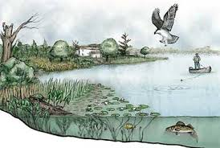
Interactions among the spheres
Lithosphere: soil
Atmosphere: oxygen, carbon dioxide
Biosphere: Human, Gull, frog, fish

Slide 10
Interactions among organisms and the spheres
Human fishing
Gull that is hunting fish
Plants providing O₂ for the animals
Fish that eat insects or smaller fish

Slide 11
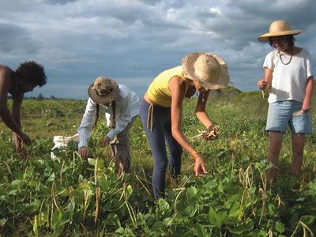

Slide 12
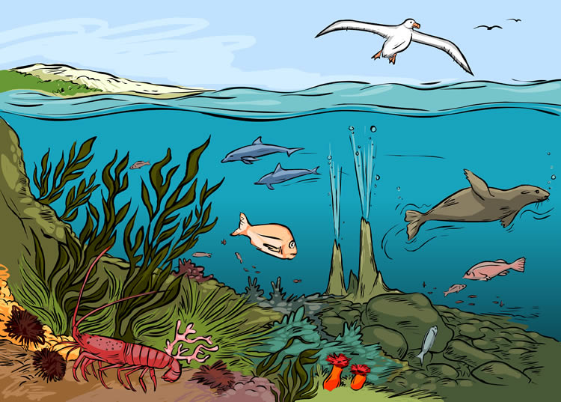

Slide 13
Homework
Current events summary
Must be 3 paragraphs!
Quiz Grade!

