Slide 1
SWBAT identify how soil composition affects soil fertility. Do Now: 1) Draw a picture of a soil profile that includes all five horizons and label them. 2) What is humus?
ES Unit 2 9/30/15
Lesson 5

Slide 2
Important minerals for fertile soil
Potassium
Nitrogen
Phosphorous
Calcium

Slide 3
Fertile Soil
Dark, crumbly, and holds water well

Slide 4
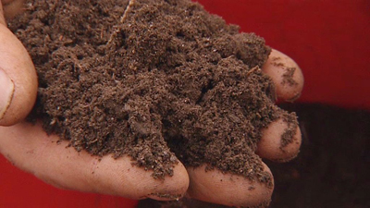
Composition of soil
Soils are diverse!
There are 12 main types of soil
Have different arrangements of the same basic components

Slide 5
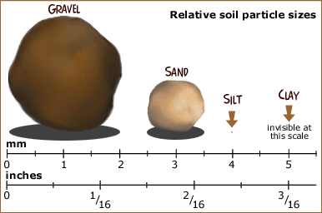
Soil Particles
Every soil type is a mixture of sand, silt, clay, and organic matter.
The amount of various soil particles define its texture.

Slide 6
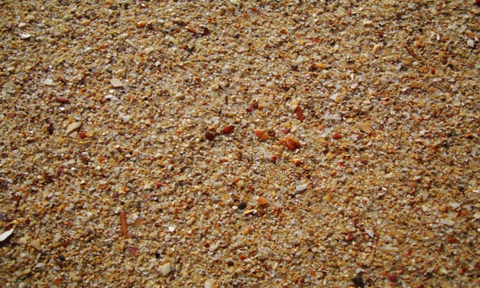
Sand:
Pros: | Cons:
Allow air into the soil | Too coarse (rough) Big spaces between particles = doesn’t hold water or nutrients Doesn’t stick together well

Slide 7
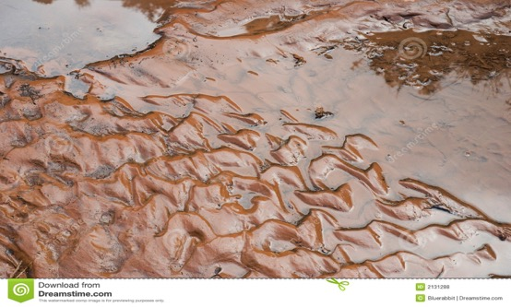
Silt:
Pros: | Cons:
Finer than sand Makes mud Excellent farmland | Too light Erodes easily Blown away in dust storms and carried down streams in floods

Slide 8
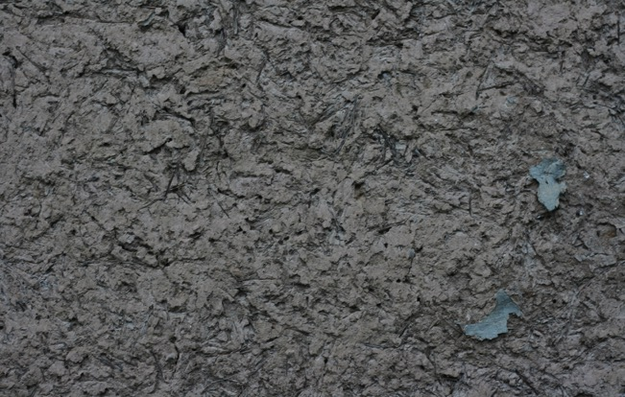
Clay:
Pros: | Cons:
Changes soil chemistry Gives off minerals and absorbs acids | When dry, it’s almost as hard as concrete Too fine Tiny Spaces between soil particles = no air can get through Plant roots can’t push through Most bacteria and organisms can’t live here (can’t breathe)

Slide 9
Stop and think
Why might it be beneficial to have a mixture of different particles in soil?

Slide 10
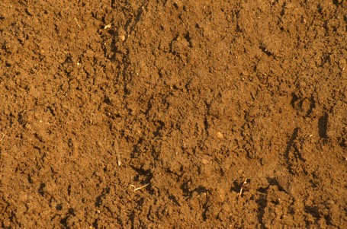
Loam: Ideal Soil
40% sand, 40% silt, 20% clay
Enough spaces for air and water
Plant roots can easily grow through spaces
Enough clay to let it stick together and hold humus

Slide 11
Making Compost on Monday
Bring in black and white newspaper!
Bring in food scraps (orange peels, apple cores, egg shells, vegetable scraps)

Slide 12
Homework
Research a country that is experiencing soil erosion and write a paragraph explaining how it is affecting the country

