Slide 1
ES Unit 2 Lesson 4 9/29/15
SWBAT explain the formation of soil by examining its profile.
Do Now: Is air pressure in the mesosphere higher or lower than air pressure in the thermosphere? Why? (use elevation in your response)

Slide 2
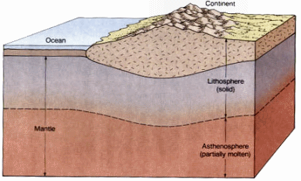
Vocab:
The lithosphere (geosphere): Outermost solid layer of the planet

Slide 3
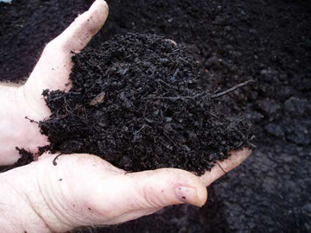
Vocab
Humus: organic substance that contains fully decayed animal or vegetable matter.

Slide 4
Turn and Talk
In what ways is soil an important part of your everyday life?

Slide 5
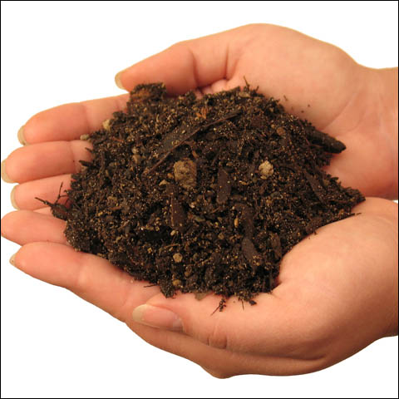
What is Soil?
A thin layer of material that covers the land
Mixture of:
Organic remains
Clay
Rock

Slide 6
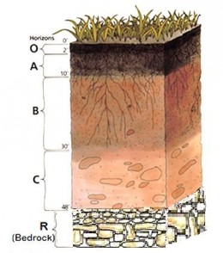
Horizons of Soil
Horizontal Layers:
0n
All
Birthdays
Cupcakes
Rock

Slide 7
O horizon - Ground Level
Plants grow and animals live here.
Composed of organic material:
Waste from organisms
Bodies of decomposing organisms
Live organisms

Slide 8
A horizon - TopSoil
Plants extend their roots into this layer
Made up of previously decomposed humus from the O layer and weathered rock.

Slide 9
B horizon - Subsoil
Mix of mineral particles and some humus near the top
Brown and red color
Clay

Slide 10
C horizon – Parent Rock
This horizon can be very deep. There's no organic matter at all.
All rock particles, full of minerals.
Layers above are derived from this layer.

Slide 11
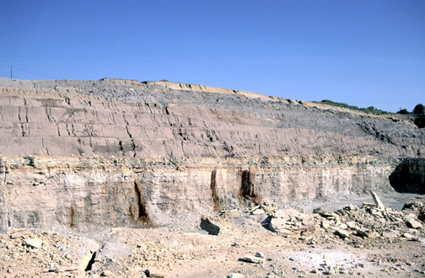
R Horizon- Bedrock
Masses of hard rocks

Slide 12
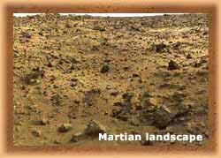
Why isn’t there soil on other planets?
They have plenty of rocks BUT no living organisms

Slide 13
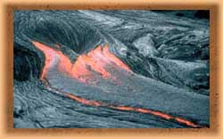
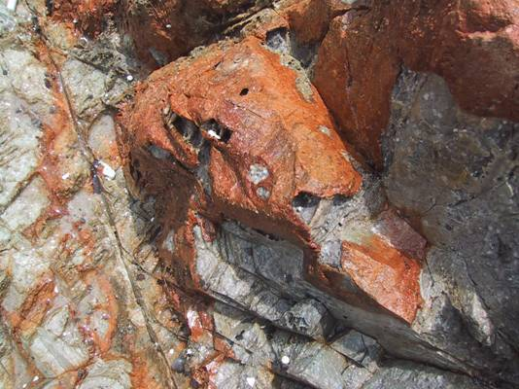
Recipe for soil
Rock
Physical weathering
Chemical weathering
Biological actions (decomposers!)

Slide 14
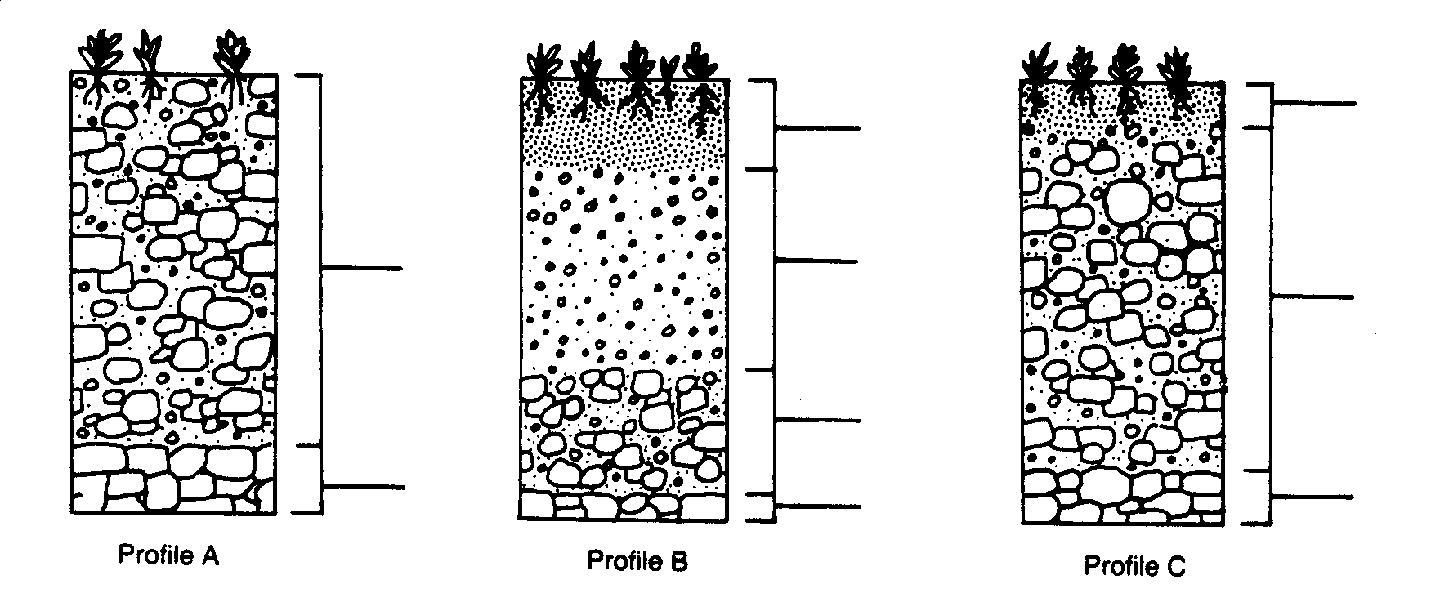
Classwork
Ask two group members before me!!

Slide 15
Review
What are the different horizons of soil?
What is the lithosphere?

Slide 16
Making Compost
Making Compost on Monday!
Start bringing in food scraps (vegetable peels, egg shells, apple cores).
Black and White newspaper

