Slide 1
9/28/15
Unit 2 Lesson 3
SWBAT Explain how pressure differs depending on the level of the atmosphere.
Do Now:
In which layer of the atmosphere are meteors destroyed?
Why is it more difficult to breathe as you ascend (go higher) in elevation?

Slide 2
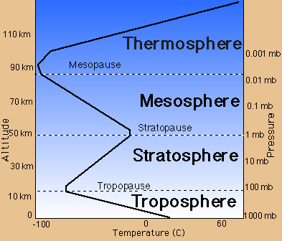
Homework

Slide 3
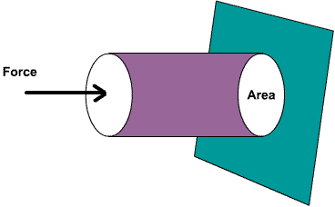
What is pressure?
Pressure is the amount of force per unit area
Notes:
Weight is a type of force. Pressure is the amount of force per unit area. If I use a textbook as an example and I put this textbook over my hand, I’m feeling equal pressure on all parts of my hand. However if I were to turn this textbook on its corner and magically balance it on my hand, I would only feel the pressure on this finger of my hand. That’s because The area which is receiving this force is small.

Slide 4
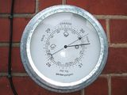
Air pressure
Air Pressure is a measure of the force of air pressing down on the earth’s surface

Slide 5
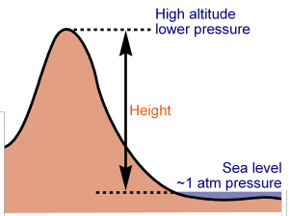
Air Pressure and Elevation
Air pressure changes with elevation or height above sea level.
As elevation increases, air pressure decreases

Slide 6
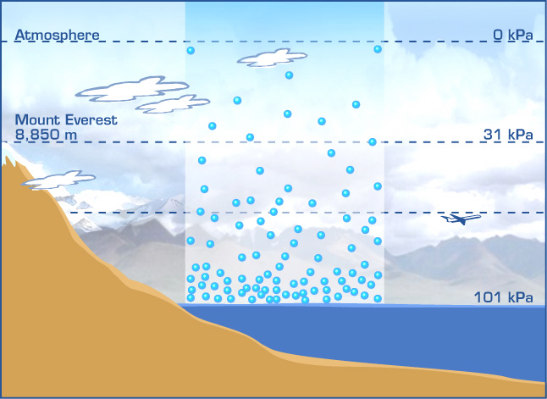
Low Air Pressure
Air molecules are farther apart with higher elevation (less dense)
Notes:
The weight of the air causes the molecules to push together, or to become more dense

Slide 7
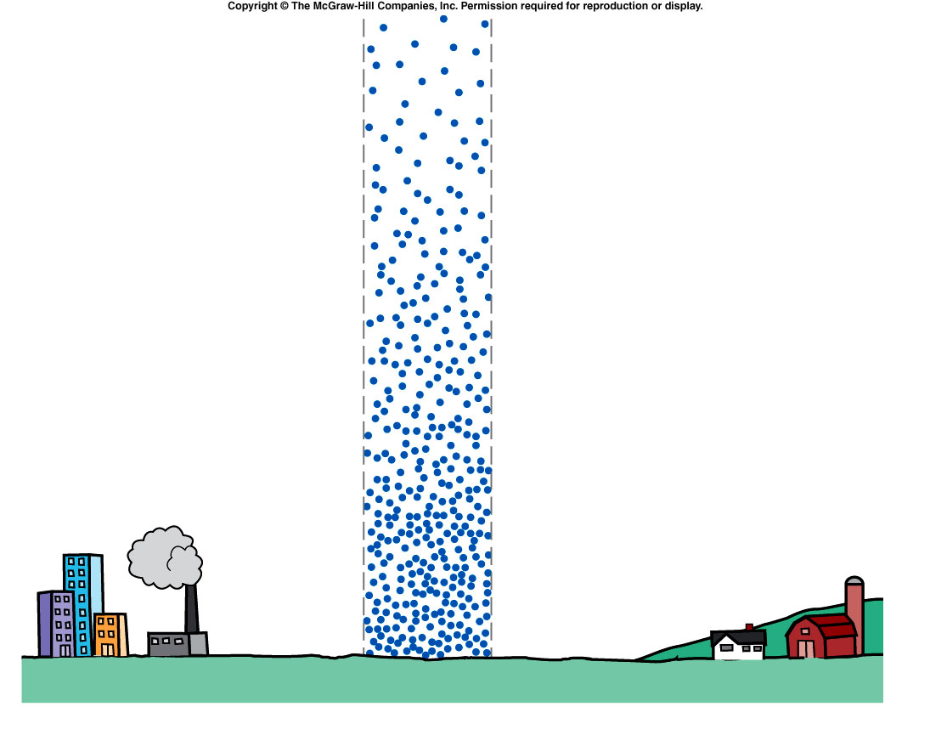
High Air Pressure
Weight of all the air causes more pressure towards the bottom
Air molecules are closer together (more dense)
Less pressure
More pressure
Notes:
Weight of all the air causes more pressure towards the bottom since the weight is accumulative.
This weight causes all the pressure towards the bottom of the

Slide 8
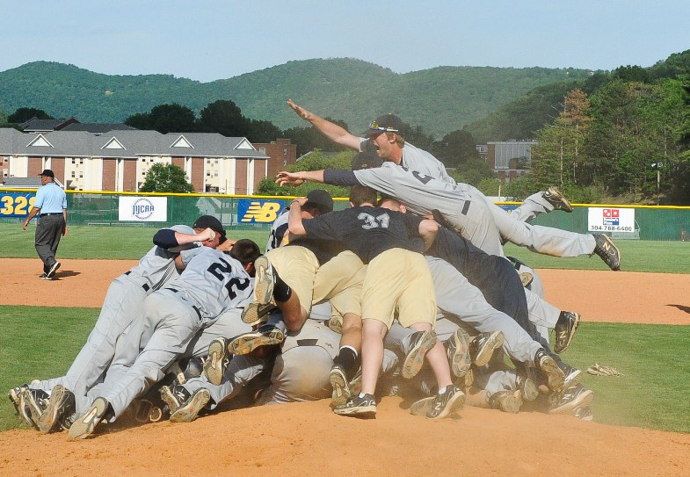

Slide 9
Turn and Talk
How is air pressure related to the layers of the atmosphere?

Slide 10
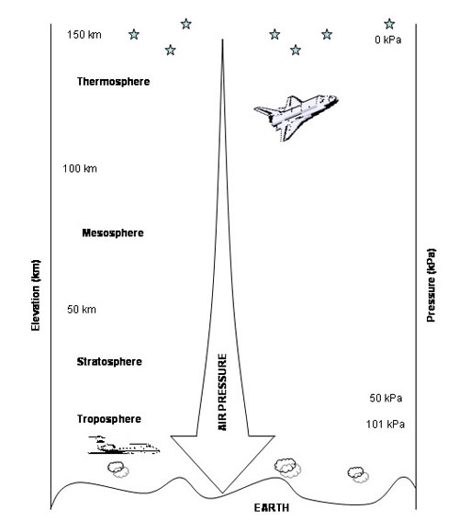

Slide 11
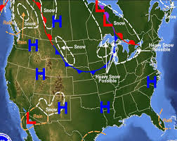
Air Pressure and Weather

Slide 12
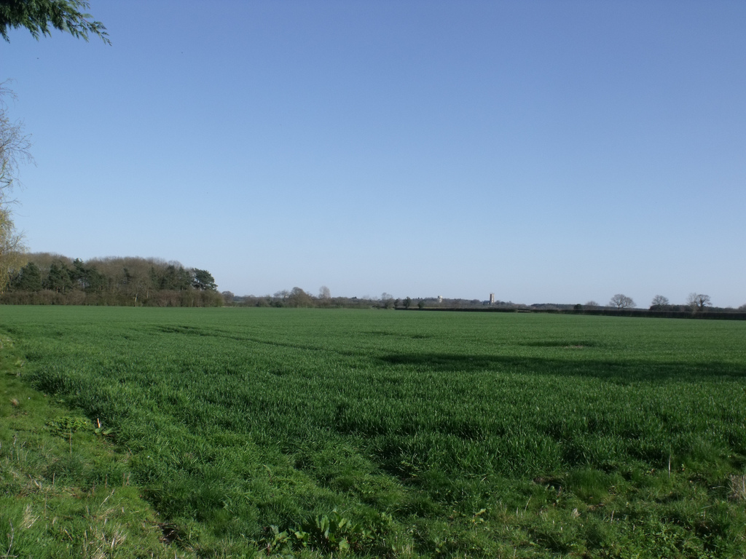
Air pressure predicts weather
High pressure system means cooler temperatures and clear skies

Slide 13
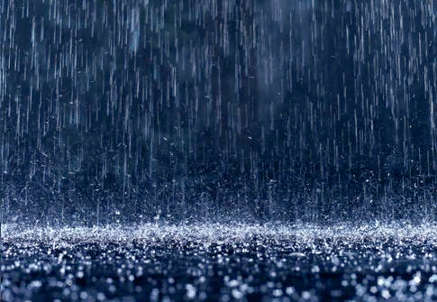
Air pressure predicts weather
Low pressure system means warmer weather, storms, and rain.

Slide 14
Demo!

Slide 15
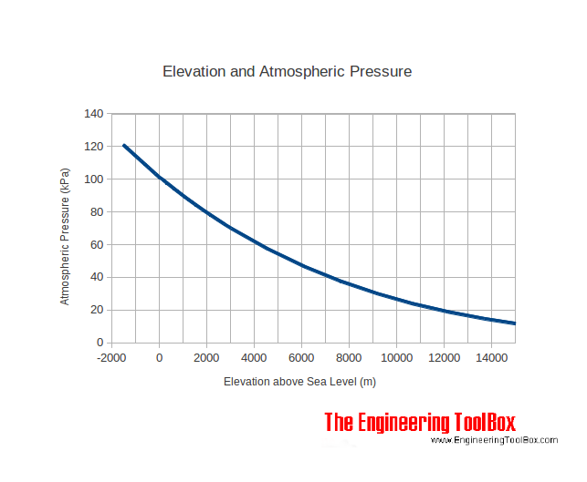

Slide 16
Writing Trends
As _____________ increases/decreases _________________ increases/decreases
Ex: as the amount of fertilizer increases, the height of the plant increases

Slide 18
Exit Ticket
You are standing on top of a Mt. Everest. Is the air pressure high or low? Why?

