Slide 1
ES Unit 2 Lesson 2 9/24/15 SWBAT identify how the layers of the atmosphere are divided by graphing the temperature range of each layer..
Do Now:
What are two changes to the early atmosphere that allowed life to exist?

Slide 2
Agenda
Mini-lecture
Graphing Activity
Pass back quizzes

Slide 3
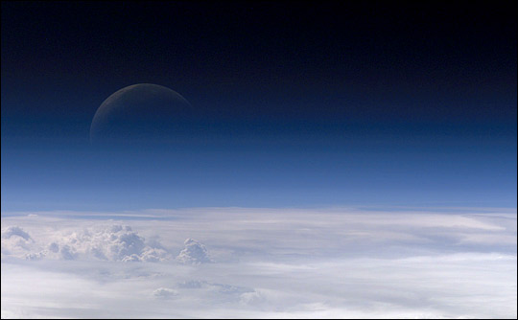
Why is the atmosphere important?
It blocks UV rays
Contains oxygen
It traps heat from the sun

Slide 4
The Atmosphere
The atmosphere contains 4 layers

Slide 5
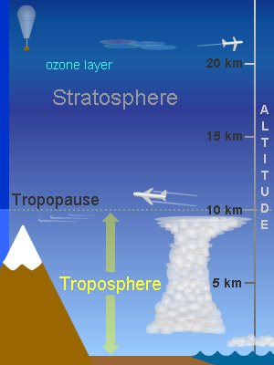
The Troposphere
Closest to the earth
Contains the majority of water vapor
Contains clouds
Weather occurs in this layer

Slide 6
The Stratosphere
Temperature is nearly constant
No weather
Contains the ozone layer
Airplanes travel in this layer
Notes:
Why do you think airplanes travel in this layer?

Slide 7
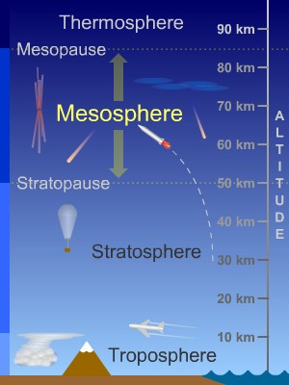
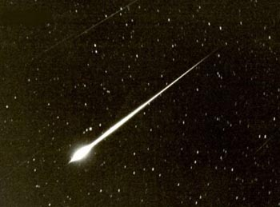
The Mesosphere
Colder temperatures
Where meteors are destroyed
Notes:
40 tons of meteors would enter the earth each day.
We don’t know much more about the mesosphere because we can’t get scientific instruments up there to measure it.

Slide 8
The Thermosphere
The largest layer
Low air density

Slide 9
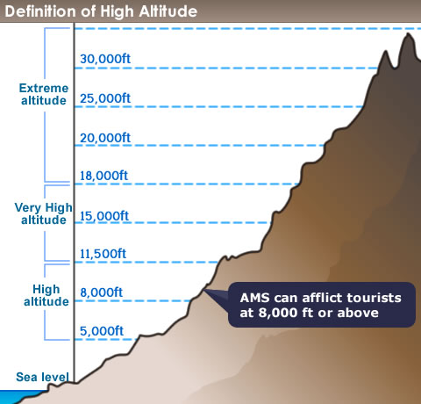
Worksheet Vocabulary
Altitude: the height of an object or point in relation to sea level or ground level.

Slide 10
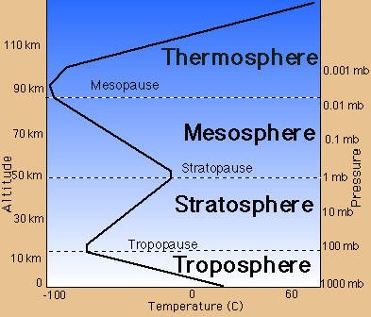

Slide 11
Scientific Method Quizzes
You may retake the quiz if you scored below a 70% for no higher than a 70% today or Monday at lunch
Core Cash Opportunity: Come up at lunch to help me grade ☺

