Slide 1
ES Unit 2 9/22/15 Lesson 1
SWBAT identify how the changes in the earth’s atmosphere resulted in conditions fit for life.
Do Now: Approximately how old is earth?
Notes:
Answer: The earth wasn’t hospitable to living organisms. It has undergone many changes that has made it able to support life.

Slide 2
The Four Spheres
Biosphere, lithosphere, atmosphere, and hydrosphere (BLAH)
~ 3 weeks
Lab: making compost!!
EQs:
How are the four spheres connected?
How does water cycle throughout the four spheres?

Slide 3
Agenda
Reading/Graphing
Mini-lecture

Slide 4
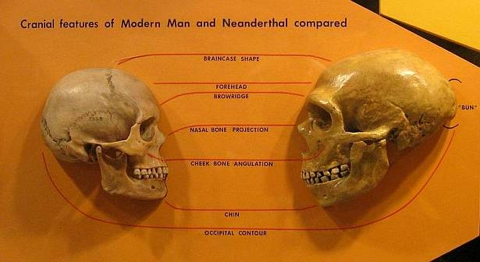
Earth formed 4.6 billion years ago
Humans arrived 195,000 years ago
Notes:
The Earth formed 4.6 billion years ago. However, humans didn’t arrive until 195,00 years ago. For the majority of the time that earth has been in existence, we have not been present on earth. This is because the conditions on earth have not always been conducive to the development of humans.

Slide 5
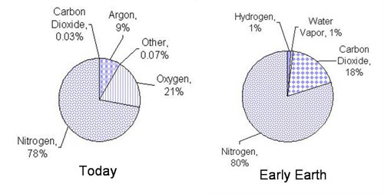
Atmospheric Changes
4.6 to 2.3 billion years ago
No oxygen!
Notes:
What are some major changes you see between these two maps?
If Earth had 18% Carbon Dioxide when it first formed, why are humans concerned with a CO₂ content of .03% today? Humans weren’t alive when

Slide 6
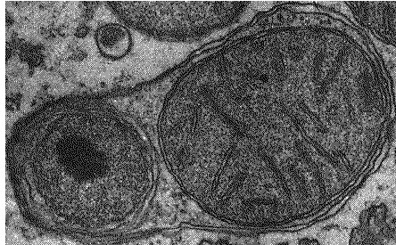
Life during oxygen deficient earth
Prokaryotes that obtained energy through fermentation were the only organisms.
Fermentation does not require oxygen!
Notes:
The only organisms that inhabited earth when earth was oxygen deficient were prokaryotes that obtained energy through fermentation. Prokaryotes are simple, single-celled organisms.

Slide 7
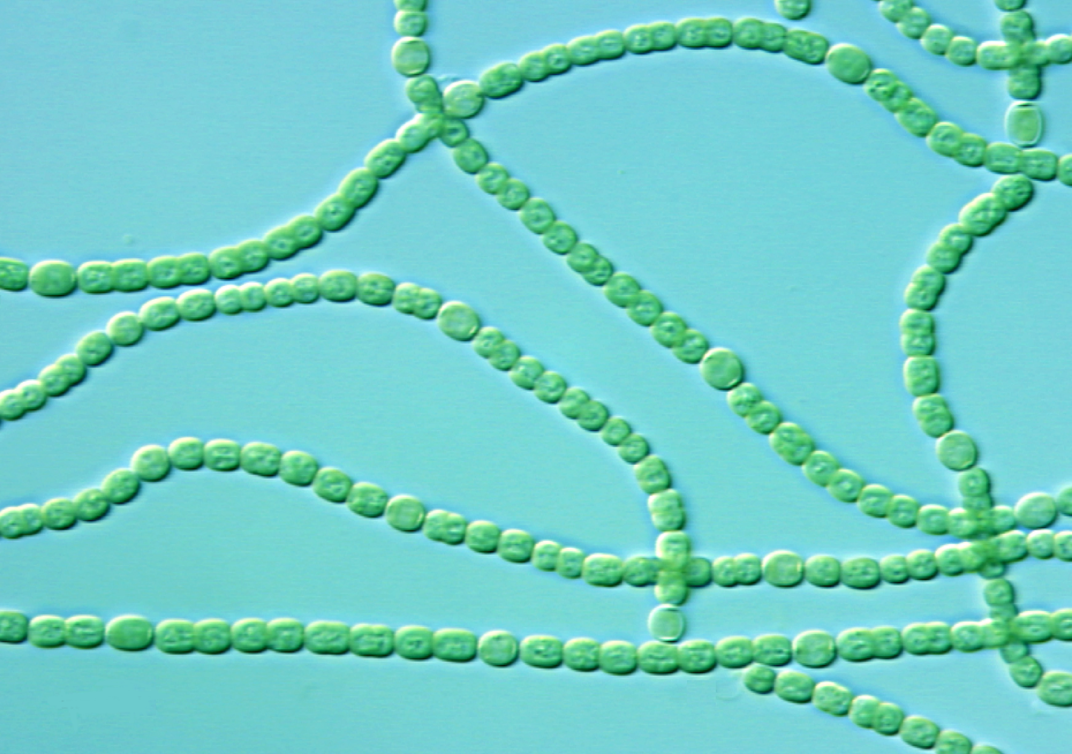
The Introduction of Oxygen
Cyanobacteria produce oxygen through photosynthesis
6CO₂ + 6H₂O ------> C₆H₁₂O₆ + 6O₂
^{Sunlight energy}
Notes:
Cyanobacteria began producing oxygen through photosynthesis. Through photosynthesis, Cyanobacteria removed CO₂ from the atmosphere and added oxygen (0₂).

Slide 8
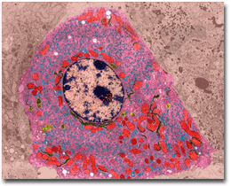
New life
Evolution of eukaryotes:
More complex cells and bodies
Use oxygen for respiration
Contain a nucleus and other organelles
Many have multicellular body structures
Notes:
The increased levels of oxygen permitted the development of more complex organisms, eukaryotes.

Slide 9
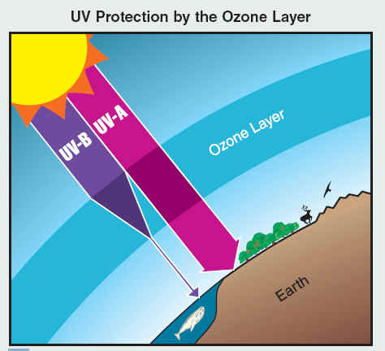
Formation of the Ozone Layer
The ozone layer (0₃) shields the earth from UV rays
Notes:
UV rays are harmful to humans as they are known to cause skin cancer. The ozone layer is extremely important because it shields the earth from UV rays.

Slide 10
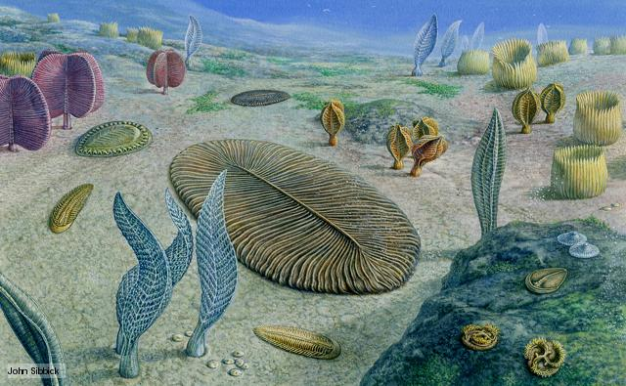
Early Life
All life was soft-bodied: no bones or shells
All life was aquatic

Slide 11
Exit ticket
List 2 changes that the early atmosphere underwent that allowed human beings to inhabit the earth
Notes:
Possible answers: Increased level of oxygen, decreased level of CO₂, formation of the ozone layer.

