Slide 1
SWBAT define the hydrosphere and identify the different components of the hydrosphere Do Now: What percentage of earth’s water is available fresh water?
ES Unit 2 10/9/15
Lesson 12

Slide 2
Announcements
Unit Exam on Friday (10/16)
All late work must be in by then!!!

Slide 3
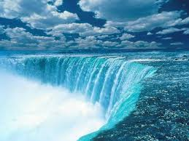
The Hydrosphere
Liquid water component of the earth
Covers 70% of the earth’s surface

Slide 4
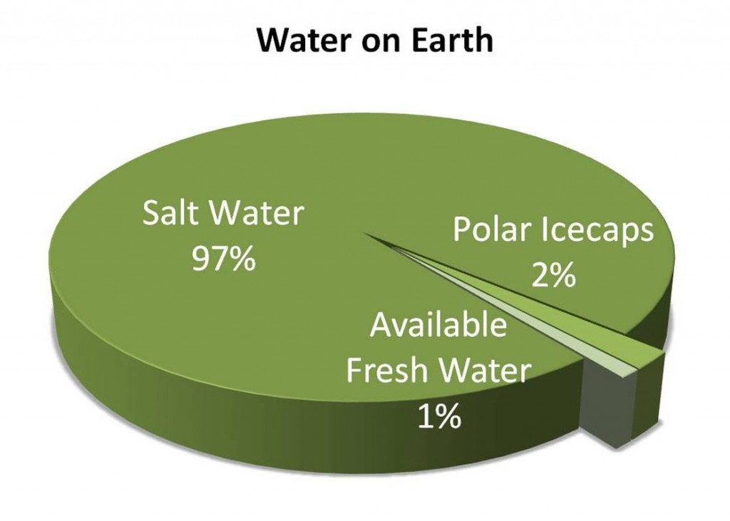
Percentage of water on earth

Slide 5
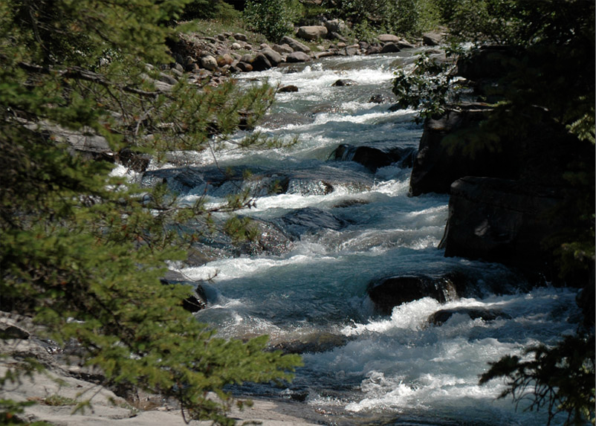
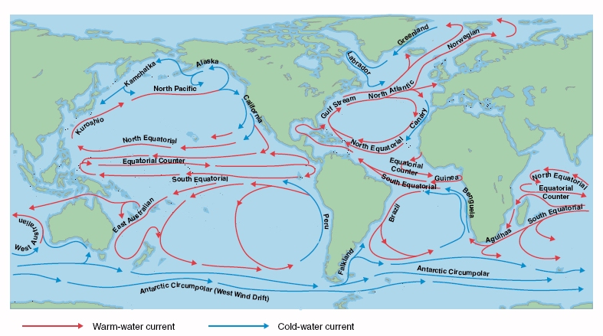
The hydrosphere is constantly in motion!
Rivers and streams
Lakes and ponds
Ocean currents

Slide 6
Ocean Currents
Temperature and salinity affect the motion
Less dense water rises: Warm water and less salty water
More dense water sinks: Cold water and salty water
Notes:
The ocean is constantly in motion

Slide 7
Ocean Currents
Notes:
It is the combination of temperature and salinity that decides whether the water sinks or floats

Slide 8
Groundwater
Ground water: Water that collects between rocks and soil that is stored underground.
The small spaces where ground water collects are called pores.
Groundwater may move through rocks and soil easily.
Notes:
The movement of groundwater occurs in pores.

Slide 9
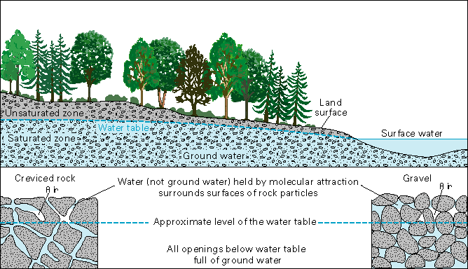
Water table
A layer of rock, below which the ground is saturated.

Slide 10
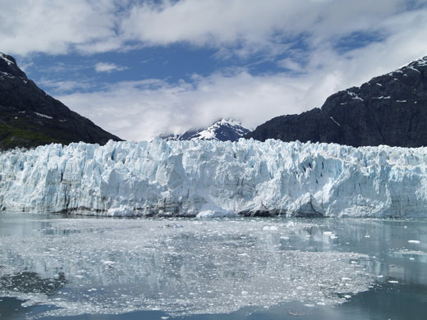
Glaciers
A Glacier is a moving river of ice and snow
Form in freezing temperatures where snow doesn’t melt

Slide 11
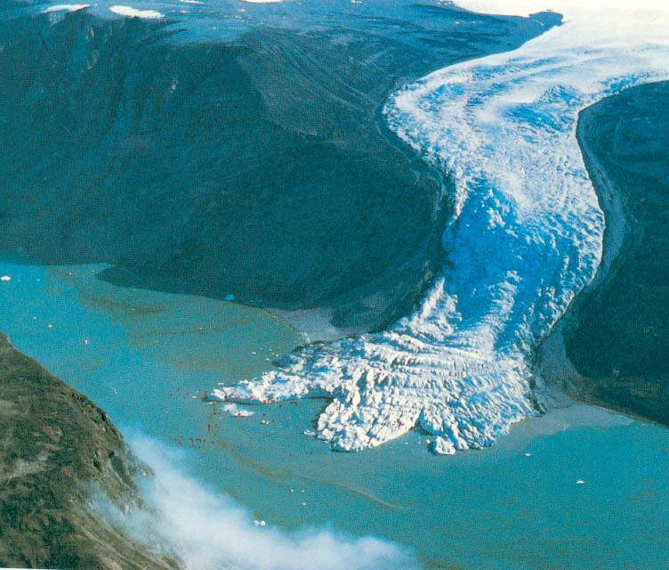
Glacier Movement
The weight of the snow and gravity cause the glacier to move.

Slide 12
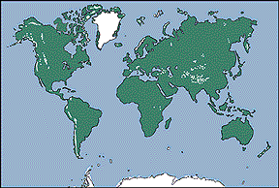
Where are glaciers located?

Slide 13
Discussion
Which of the four spheres is most important? Why?

Slide 14
To Review:
All water on the planet is part of the hydrosphere!
Water allows life to occur!

Slide 15
Exit Ticket
Explain one way in which the hydrosphere interacts with another sphere.

