Slide 1
SWBAT evaluate strategies for reducing the spread of the Zika Virus. Do Now: What do you know about the Zika virus?
3/17/16

Slide 2
Agenda
Close Reading
Video
Discussion

Slide 3
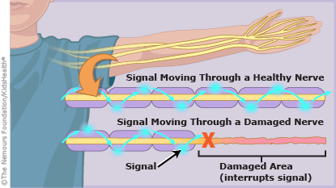
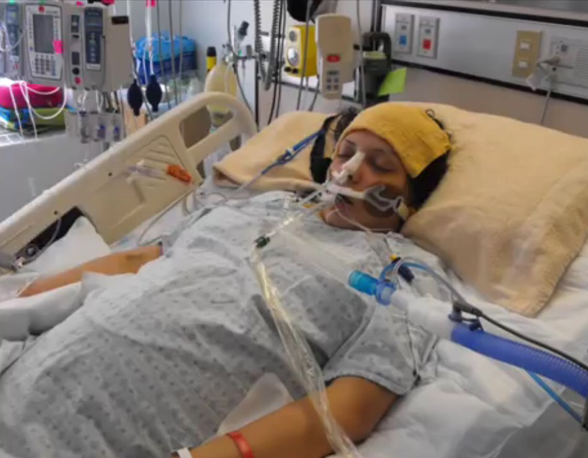
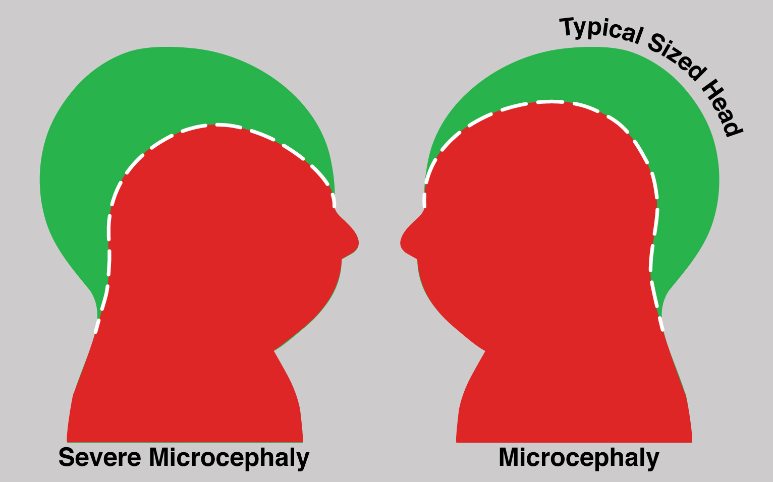
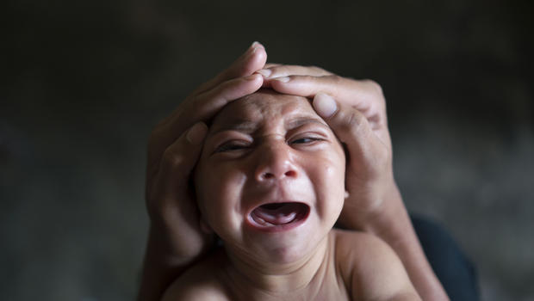
Zika Virus

Slide 4
Zika Virus Video
http://www.nytimes.com/video/world/americas/100000004185544/understanding-zika-virus.html

Slide 5
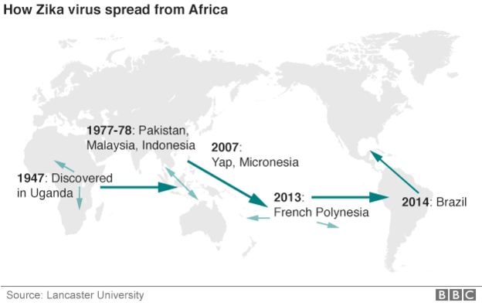
First Zika Virus Outbreak

Slide 6
Zika Virus Discussion
What are some similarities seen between Western nations’ response to Zika virus and the response to Ebola?
Knowing that the first outbreak of Zika virus was in 1952, do you believe research to find a test and a vaccine should’ve started earlier? Why or why not?
Do you think El Salvador is justified in recommending that women wait until 2018 to get pregnant? Why or why not?
Do you believe the 2016 Olympics in Brazil should be postponed or relocated? Why or why not?

Slide 7
Homework
Finish the paraphrasing worksheet

