Slide 1
SWBAT research environmental engineering projects for a group research project. Do Now: Do you believe technology is the answer to solving problems caused by climate change? Why or why not?
ES Unit 12 6/2/16

Slide 2
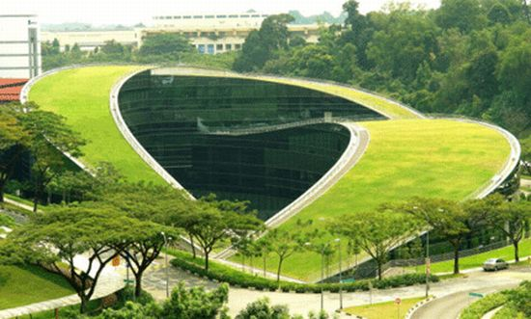
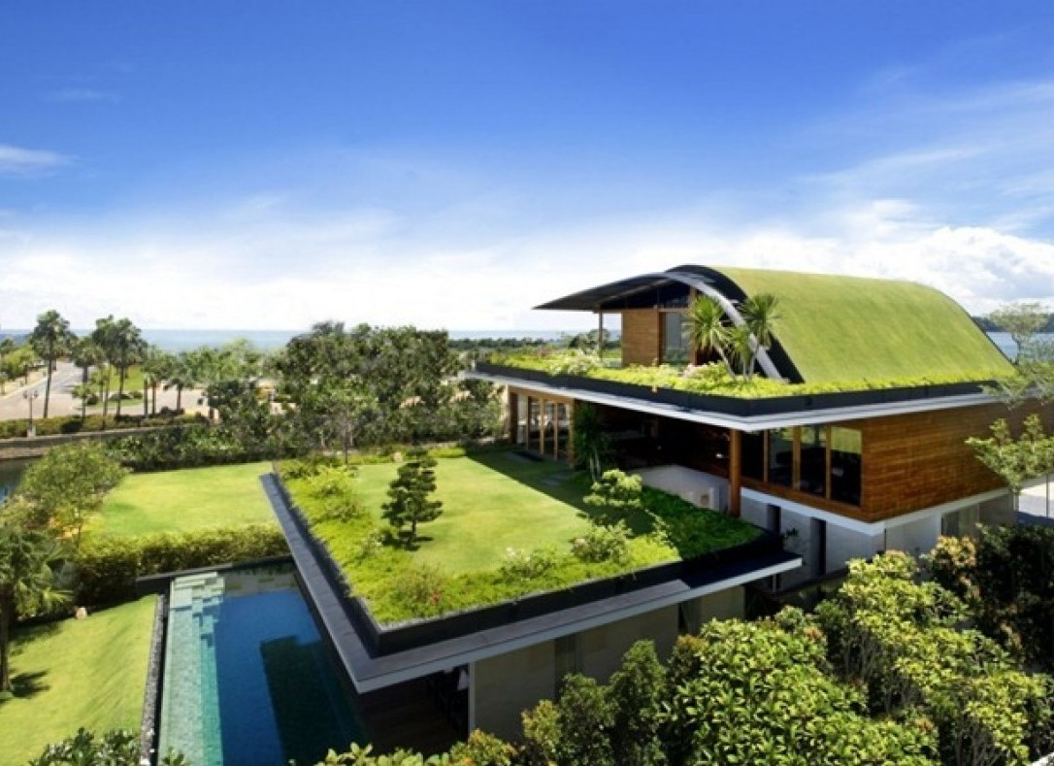
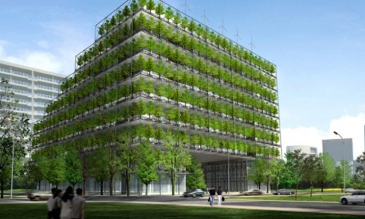
Environmental Engineering
EQ:
How is environmental design providing solutions to problems caused by climate change?

Slide 3
Environmental Science
Environmental science is a multidisciplinary academic field that integrates physical, biological and information sciences (including but not limited to ecology, biology, physics, chemistry, zoology, mineralogy, oceanology, limnology, soil science, geology, atmospheric science, geography and geodesy) to the study of the environment, and the solution of environmental problems. Environmental science emerged from the fields of natural history and medicine during the Enlightenment.^{[1]} Today it provides an integrated, quantitative, and interdisciplinary approach to the study of environmental systems.^{[2]}

Slide 4
Environmental Science
Interdisciplinary subject that includes:
Geology
Biology
Chemistry
Economics

Slide 5
Today
Choose group members ( must be groups of 3)
Select a technology and tell Ms. McDaniel
Start Research!

