Slide 1
SWBAT identify the advantages and disadvantages of using geothermal energy and hydroelectric power. Do Now: What is a photovoltaic cell? What is one disadvantage and one advantage of using solar energy?
ES Unit 11 5/24/16
Lesson 7

Slide 2
Announcements
Tomorrow is the last day to turn in any late Unit 10 projects!
Agenda:
lecture
Video
Discussion
Pass back work

Slide 3
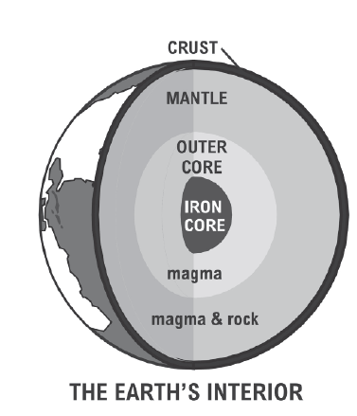
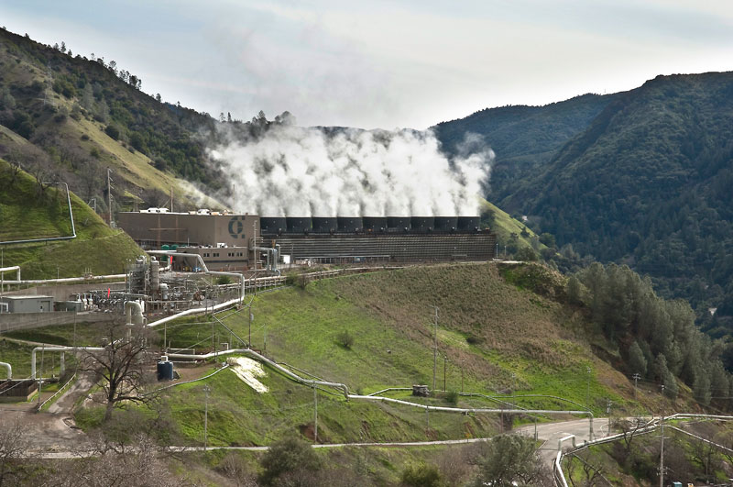
Geothermal Energy
Geothermal energy is heat from within the earth.
Energy is generated at the Earth’s core (4,000 miles below the surface).

Slide 4
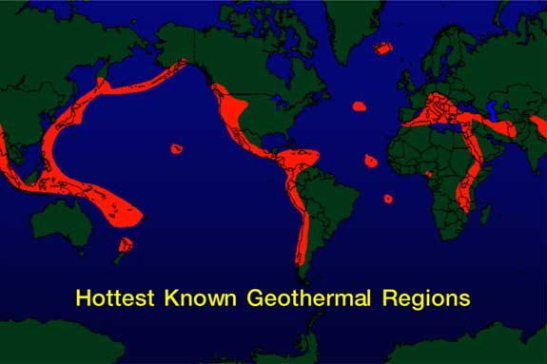
Finding Geothermal Energy
Geologists drill a well and test the temperature underground.
Most active geothermal areas found along plate boundaries where earthquakes and volcanoes are concentrated.

Slide 5
How it Works
Circulation of steam and/or water transfers heat from the depths to the surface.
Low temperature: Used for heating
High temperature: Used for electricity

Slide 6
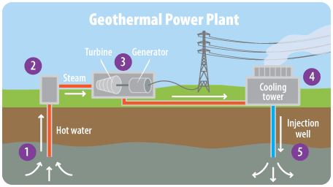

Slide 7
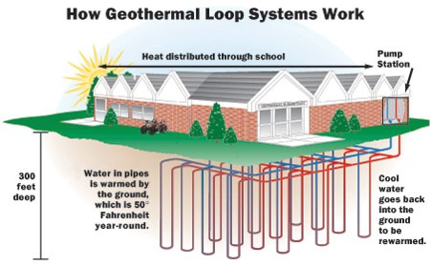

Slide 8
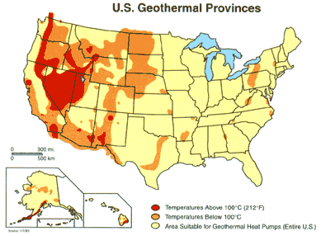
Geothermal Use

Slide 9
Advantages
Renewable energy source
Can be built anywhere (ground source heat pump)
Little cost to the environment
Low emissions

Slide 10
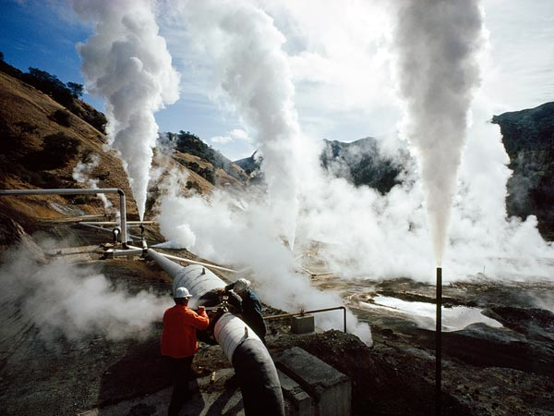
Disadvantages
Expensive
Emits hazardous gases and steam

Slide 11
Video
Take notes on the process of producing electricity from geothermal energy.

Slide 12
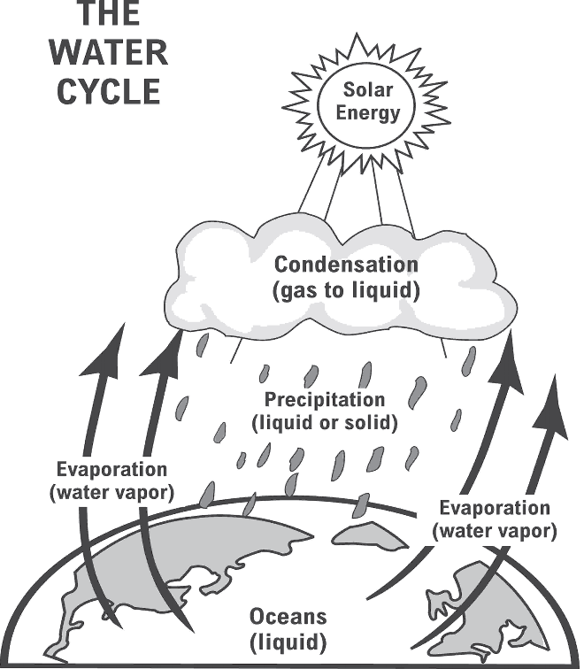
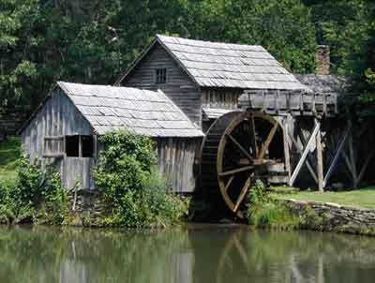
What is hydropower?
Energy that comes from the force of moving water.

Slide 13
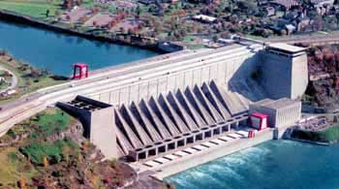
Hydroelectric Power
First Hydroelectric plant: Niagara falls
Hydroelectric plants need:
A reservoir where water is stored
A dam with gates that can open or closed to control water flow
A plant where electricity is produced

Slide 14
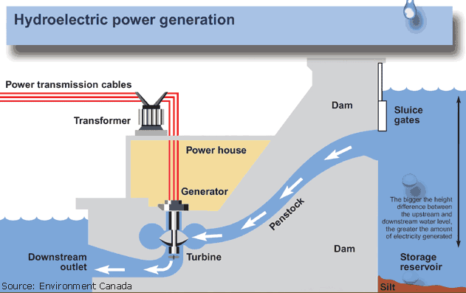

Slide 15
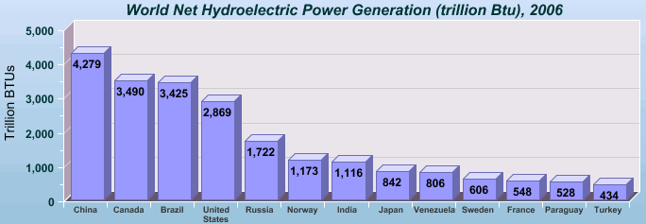

Slide 16
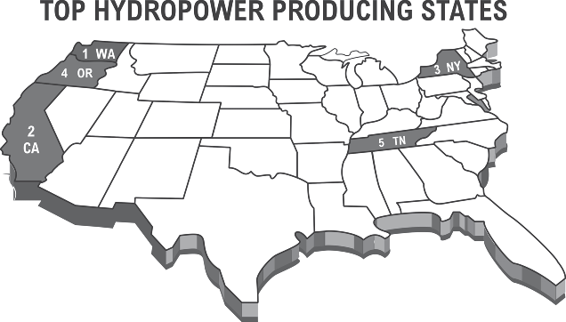

Slide 17
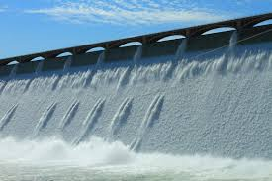
Advantages of Hydroelectric power
Controls floods
Renewable energy source
Clean energy source: no air pollution
Low cost to run

Slide 18
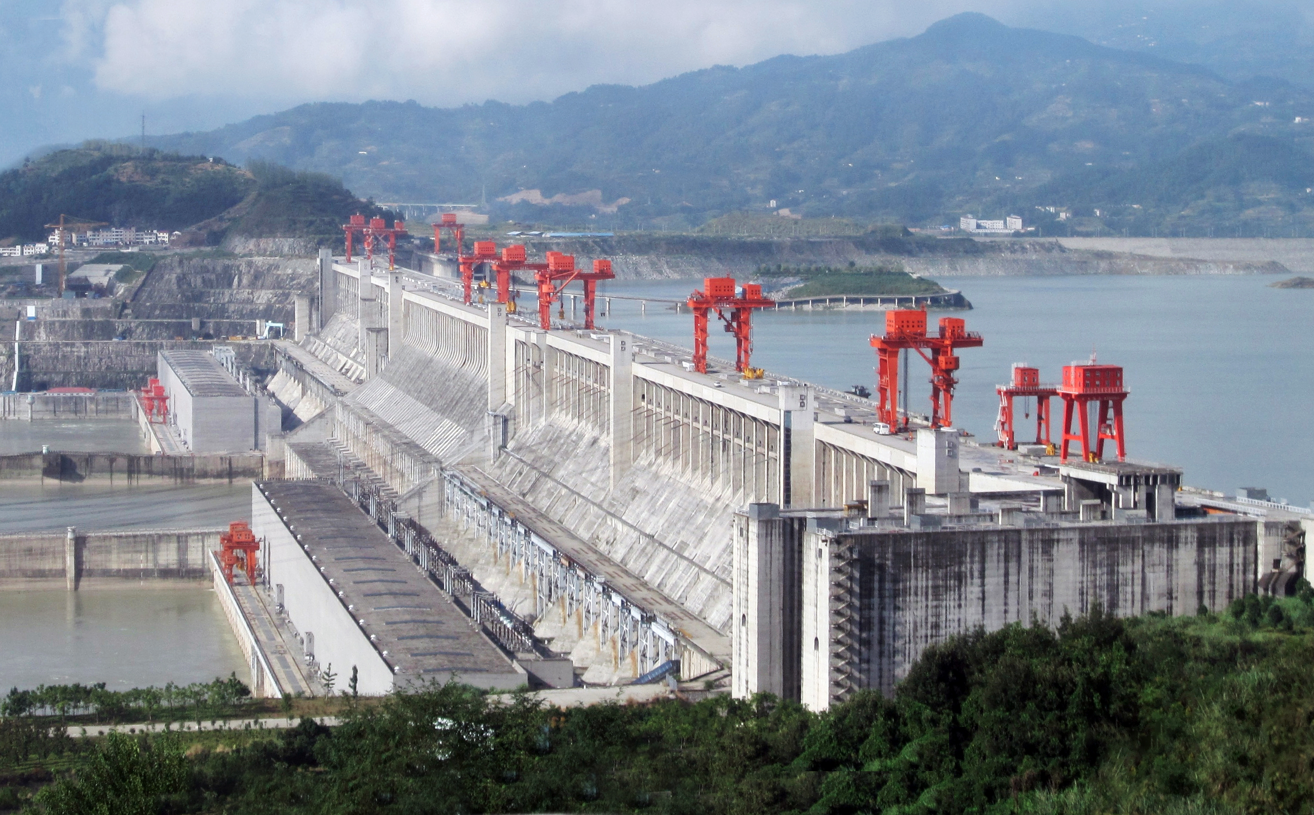
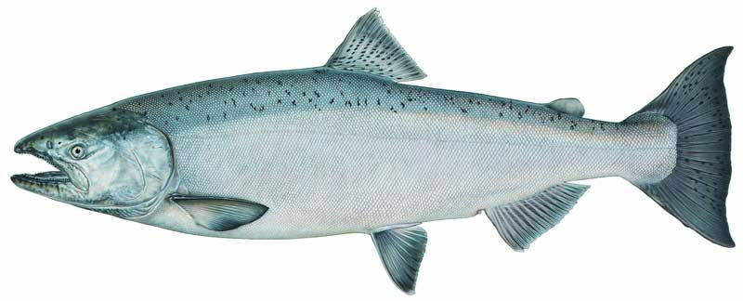
Disadvantages of Hydroelectric power
Damming a river changes water patterns
Fish may be prevented from swimming upstream
Displacement of local populations (people)
High investment costs

Slide 19
Stop and Think
What are some similarities between hydroelectric power and geothermal energy?
Which one do you think is better? Why?

Slide 20
Turn and Talk
Do you think we should focus on developing one source of renewable energy or multiple sources to replace fossil fuels? Why?

Slide 21
Homework
Find an article about geothermal or hydroelectric power
Summarize it in two paragraphs
Cite your source in APA format!

