Slide 1
SWBAT identify the advantages and disadvantages of using solar energy and wind power. Do Now: What are two disadvantages of nuclear power? What is the controversy surrounding Yucca mountain?
ES Unit 11 5/23/16
Lesson 6

Slide 2
Week Ahead
Thurs/Fri: Project with sub
Tues (5/31): Unit 11 Exam
Agenda for today:
Lecture
Videos!
Reading

Slide 3
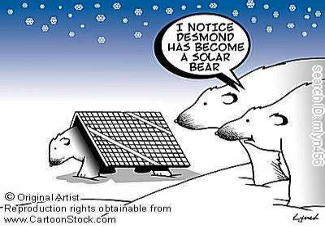
Solar Power

Slide 4
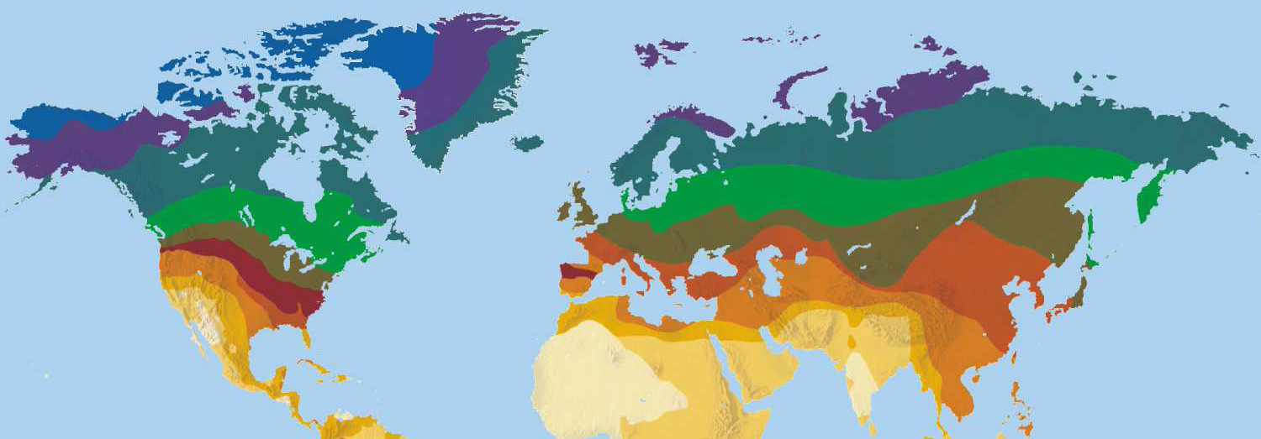
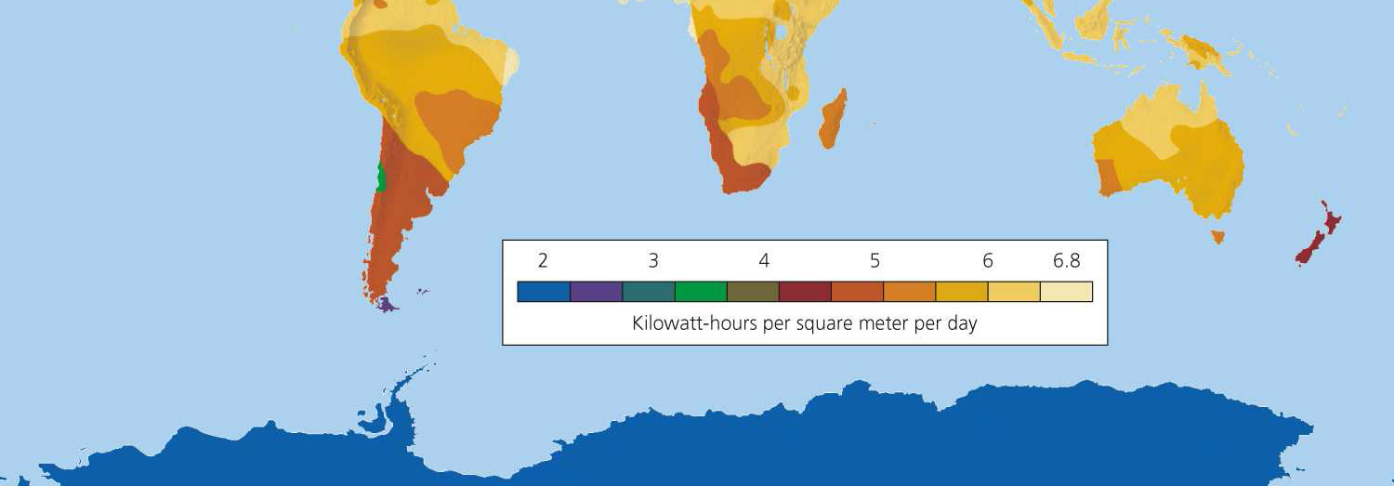
World availability of solar energy

Slide 5
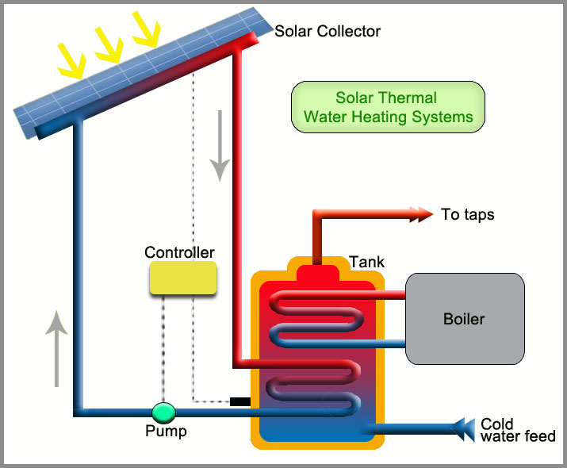
Solar Thermal Systems
Collects sunlight to boil water→ generates hot water

Slide 6
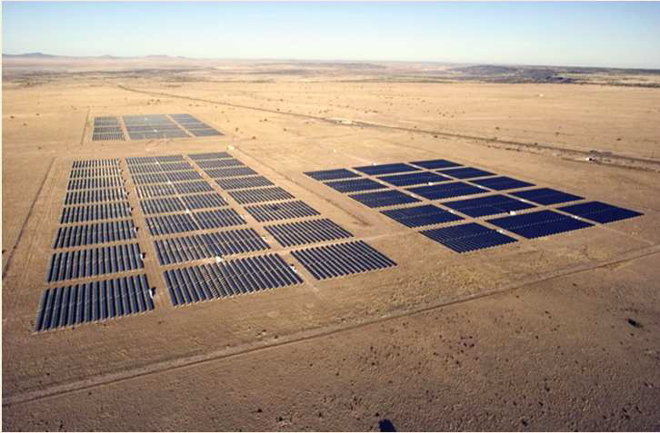
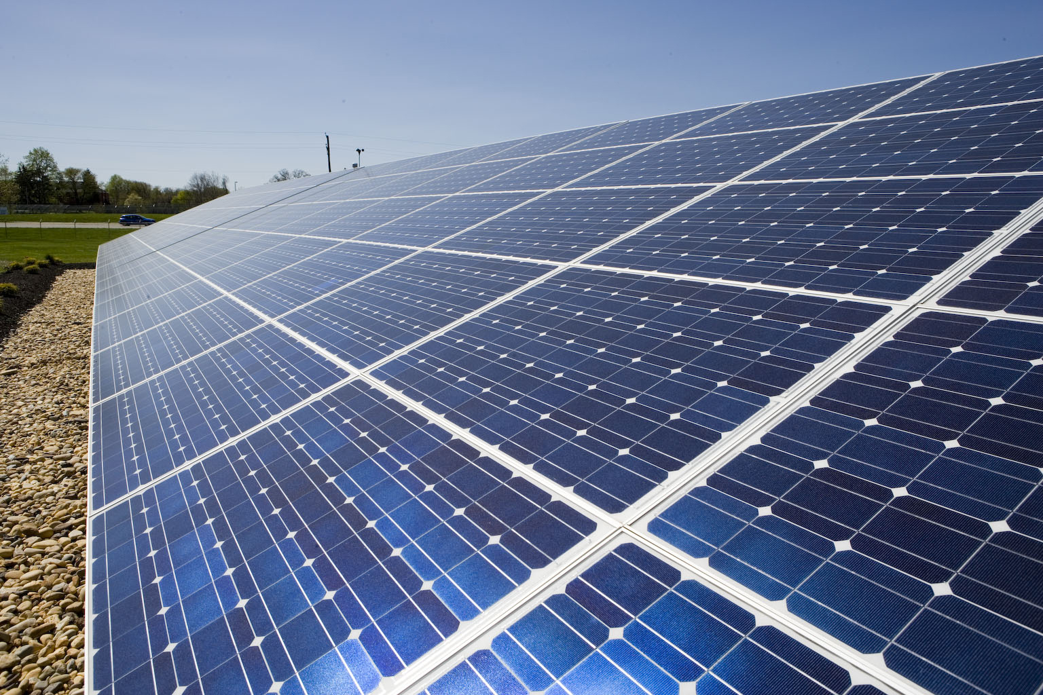
Photovoltaic Cells
Use sunlight to produce electricity
Sunlight hits cells and releases electrons into wires.
Fastest growing source of energy in the world.

Slide 7
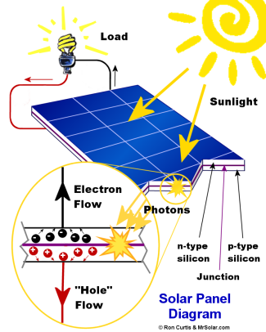

Slide 8
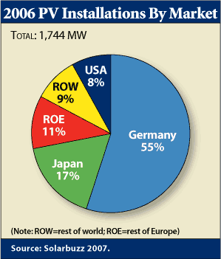

Slide 9
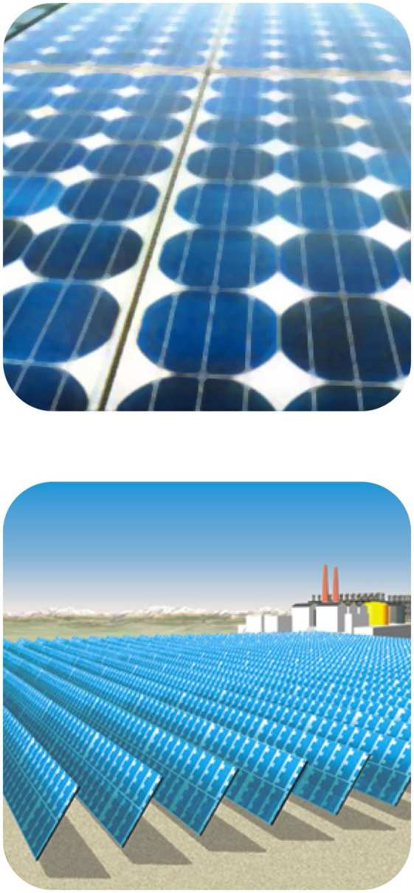
Advantages
No emission of CO₂ and other pollutants
Easy to install
Competitive cost for newer cells

Slide 10
Disadvantages
Panels contain toxic materials
Need access to sun
High cost for older systems

Slide 11
Turn and Talk
Do the pros of solar energy outweigh the cons? Why or why not?

Slide 12
Solar Energy!
https://vimeo.com/8788429

Slide 13
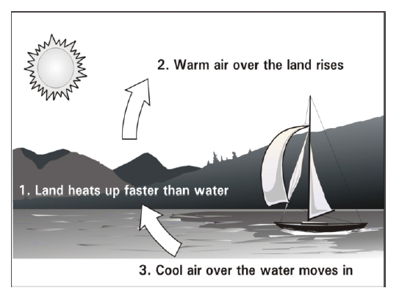
What is wind?
Air in motion!
Caused by uneven heating of the earth’s surface by radiant energy from the sun.

Slide 14
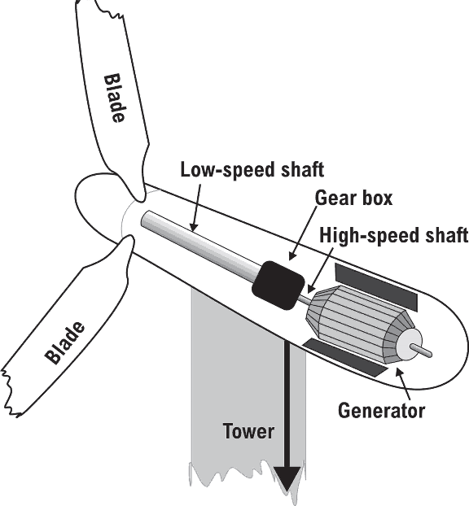
Wind Turbines
Wind spins the blades of the turbine
Power a generator
Produce electricity
Electricity sent through a cable to a transmission line

Slide 15
Wind Energy
U.S. has largest source of wind energy generating capacity in the world

Slide 16
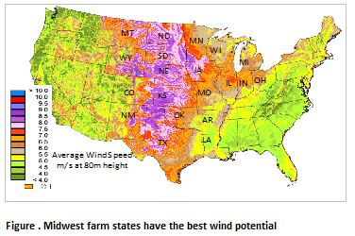
Wind Energy

Slide 17
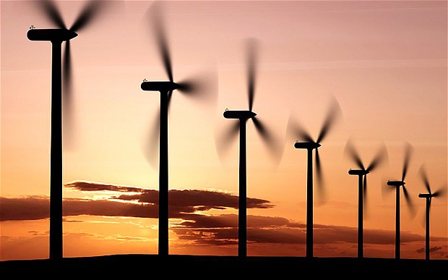
Advantages
Cheapest form of alternative energy
More jobs!
No CO₂ emissions
No air pollution
Wind is free!

Slide 18
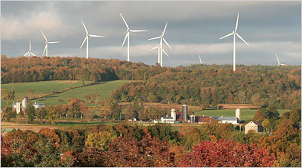
Disadvantages
Need wind!
Can kill birds
Affects landscape scenery

Slide 19
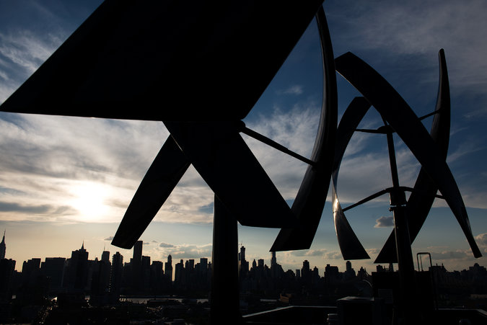
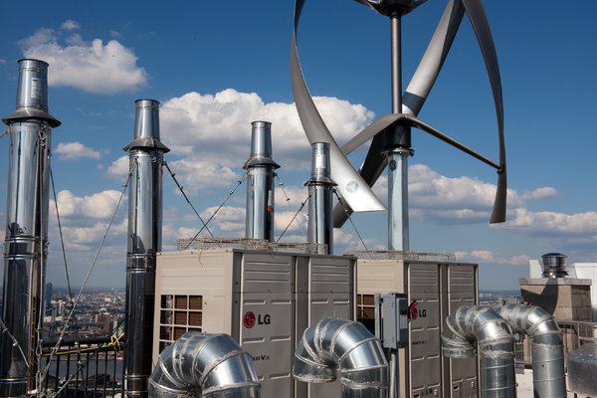
New York Times Article

Slide 20
Homework
Write a question you still have about wind power or solar power
Research the answer to the question
List your source!

