Slide 1
SWBAT evaluate the advantages and disadvantages of using biofuels as an energy source. Do Now: Why are turbines and generators important?
ES Unit 11 5/19/16
Lesson 5

Slide 2
Agenda
Mini-lecture
Reading
Discussion

Slide 3
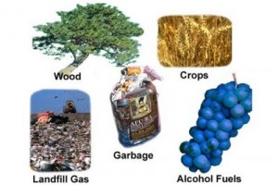
Biofuel
Biomass: any organic matter that can be used as an energy source.
Ex: wood, crops, garbage, yard and animal waste
Biofuels: Energy recovered from biomass.

Slide 4
Stop and Think
Is biomass an example of renewable or nonrenewable source of energy?
1: renewable
2: nonrenewable
It’s renewable!

Slide 5
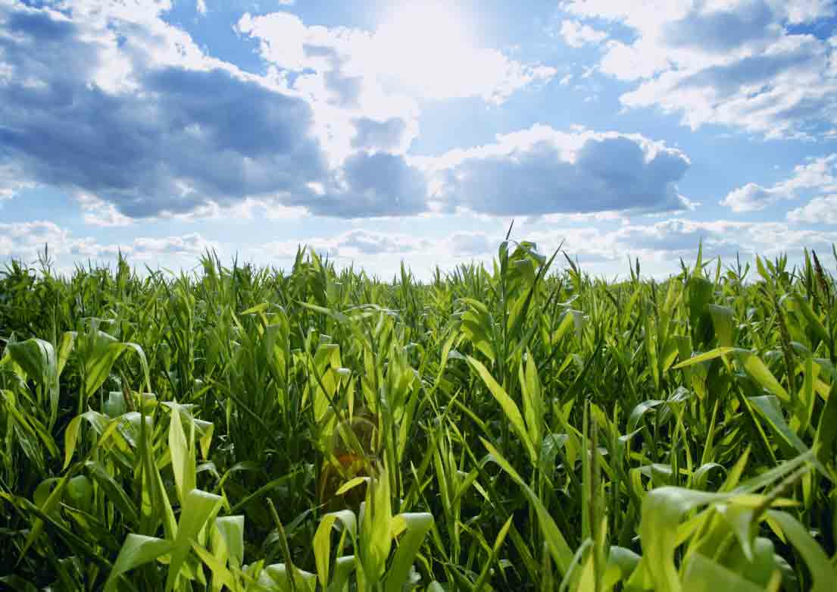
Renewable vs. Nonrenewable

Slide 6
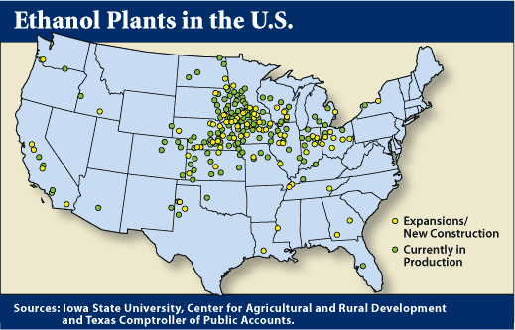
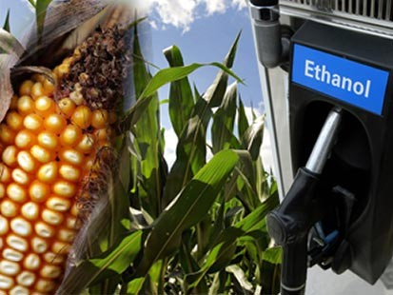
Ethanol
Can be made from corn, wheat, sugar, etc.
E-10: fuel that is 90% gasoline and 10% ethanol
Adding ethanol lowers carbon dioxide emissions

Slide 7
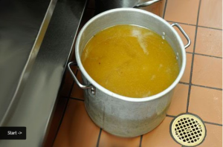
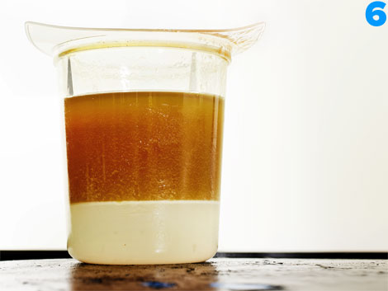
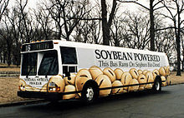
Biodiesel
Combine alcohol with vegetable waste oil
Used for diesel engines
Pure form
Mixture: 20% biodiesel and 80% regular diesel

Slide 8
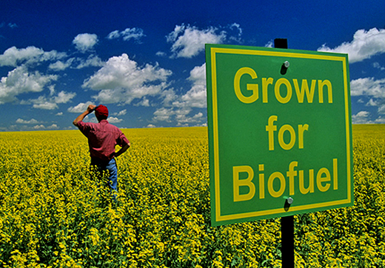
Biofuel Benefits
Biofuels produces less pollutants (SO₂ and NO)
It’s renewable!

Slide 9
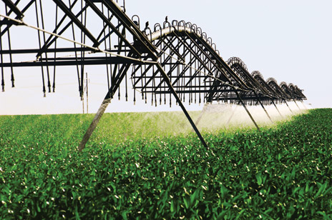
Biofuel Disadvantages
Converting farmland from food crops to biofuels → rise in food prices
Biofuel agriculture competes for water with all other uses

Slide 10
Stop and Think
Do you think biofuels release CO₂? Why or why not?

Slide 11
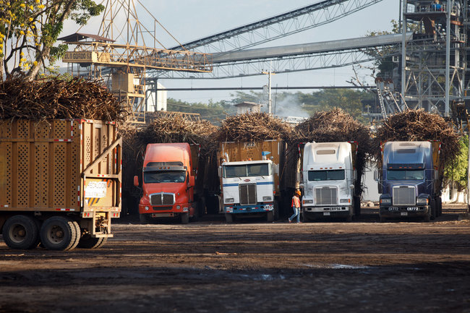
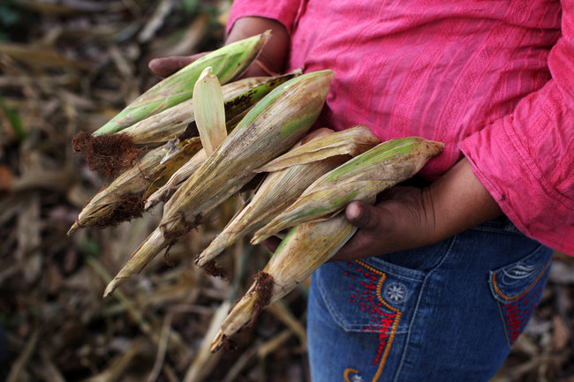
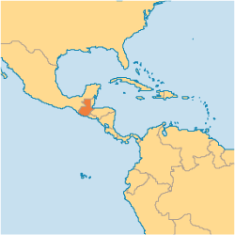
The Biofuel Controversy

Slide 12
Biofuels Discussion
From the perspective of the fossil fuel industry, would they be for or against the use of biofuels? Why?
Do you believe that biofuel is being produced for the benefit of developed countries (the U.S., Canada, etc.) and at the expense of developing (Guatemala) world countries? Why or why not?
7) Do you think biofuels should replace fossil fuels as the world’s primary energy source? Why or why not?

Slide 13
Homework
You have a rich friend who wants to start a biofuel company. Write them two paragraphs either persuading them to start the company OR dissuading them from doing so. Use evidence from the text!

