Slide 1
SWBAT weigh the advantages and disadvantages of nuclear energy. Do Now: Why might someone argue in favor of coal over natural gas?
ES Unit 11 5/18/16
Lesson 4

Slide 2
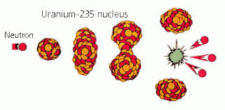
Nuclear Fission
The nucleus of an atom splits into smaller parts.

Slide 3
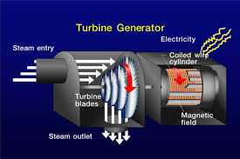
Vocab
Turbine: an engine that has a part with blades that are caused to spin by pressure from water, steam, or air
Generator: a machine that produces electricity

Slide 4
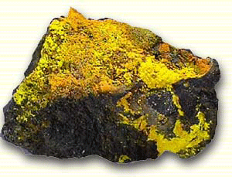
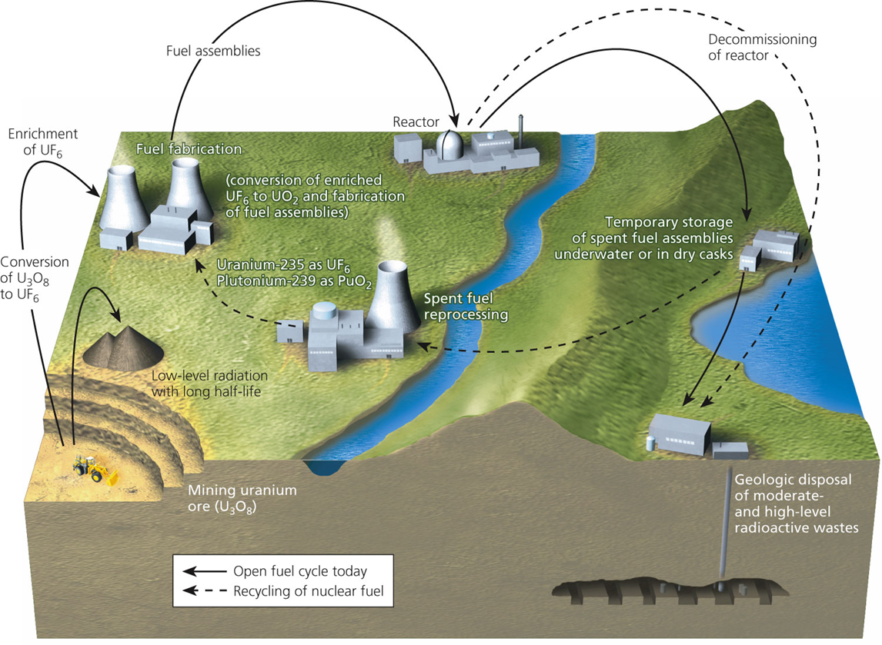
The Nuclear Fuel Cycle
Mine the Uranium
Process Uranium to make fuel

Slide 5
Stop and Think
Is nuclear energy a renewable or nonrenewable source of energy?

Slide 6
Effects of Radiation
Genetic damage: mutations that alter genes
Genetic defects can become apparent in the next generation
Somatic tissue damages: burns, miscarriages and cancer

Slide 7
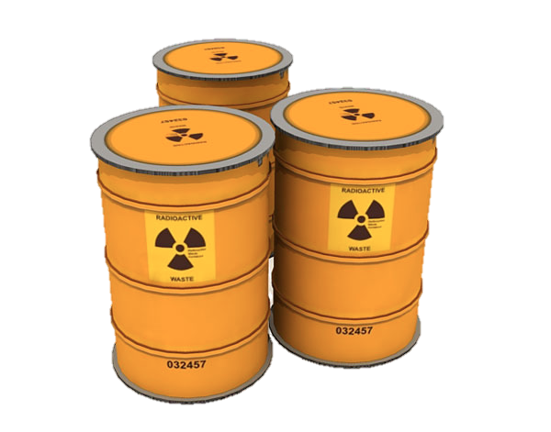
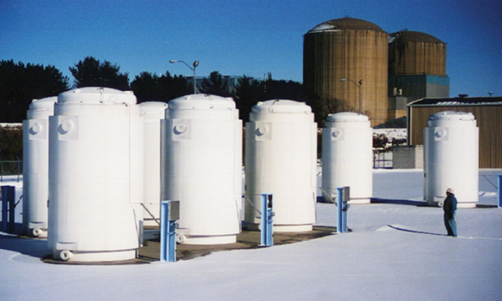
Radioactive Waste
Above ground disposal
Dry cask storage: Stored in steel cylinder in a concrete cylinder.
Cheap
Geologic Disposal
Use a geologic formation and excavate a tunnel to dispose of high level radioactive waste.

Slide 8
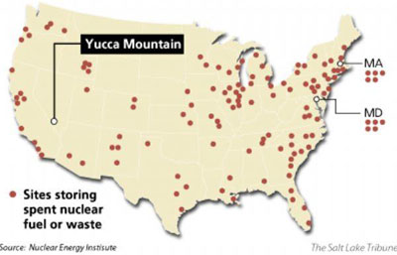

Slide 9
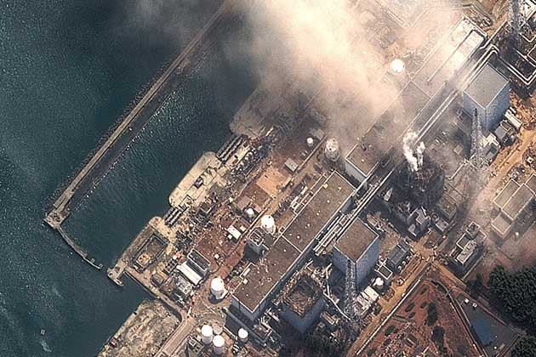
Meltdown
Nuclear accident in which the coolant system fails.
Nuclear fuel becomes molten mass that breaches the reactor and contaminates the outside environment with radioactivity.

Slide 10
Advantages of Nuclear Energy
Large fuel supply
Low environmental impacts (without accidents)
Much lower CO₂ emissions than fossil fuels
+

Slide 11
Disadvantages of nuclear energy
High costs
Low net energy yield
High environmental impact with accidents
No acceptable solution for long-term storage of waste
-

Slide 12
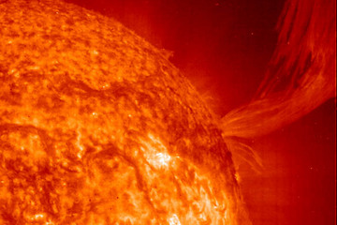
Will nuclear fusion save us?
Nuclear fusion
Fuse lighter elements into heavier elements
No risk of meltdown or large radioactivity release
Still in research after 50 years and $34 billion

Slide 13
Turn and talk
Do you think the advantages of nuclear power outweigh the disadvantages? Why or why not?

Slide 14
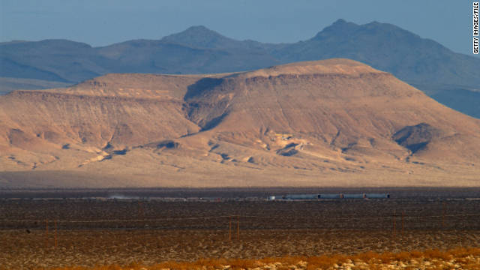
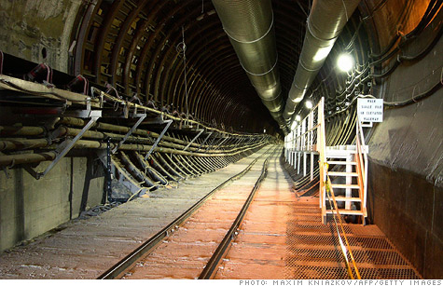
Yucca Mountain

Slide 15
Let’s review
What is the difference between nuclear fission and nuclear fusion?
Why might someone argue in favor of nuclear energy over fossil fuels?
Why is nuclear energy considered a nonrenewable source of energy?

